Slide 1

Litter Pack
Lesson 4: Litter and the Water Cycle

Slide 2
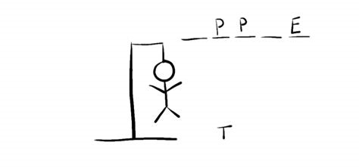

Hangman

Slide 3
The Water Cycle
Water vapour Condensation into clouds
Snow or Rain (Precipitation)
Rivers
Underground rivers
Evaporation from rivers, lakes and seas
Ground water run off
Seas and lakes

Slide 4
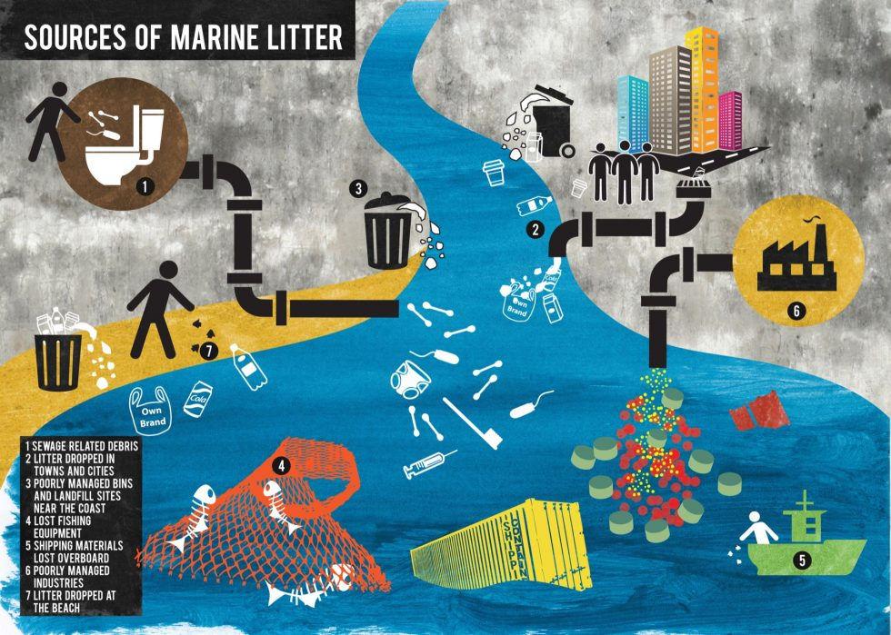
https://www.sas.org.uk/our-work/plastic-pollution/plastic-pollution-facts-figures/

Slide 5
Act out the water cycle
In groups create a play you can show to the rest of the class
Add in some litter – where is it dropped? How does it end up out to sea?
Can you add in a sea animal trapped in some litter?

Slide 6
Draw the water cycle
Label the parts:
Condensation (clouds)
Evaporation
Run off
Rivers
Precipitation

Slide 7
Recap the water cycle
Tell a friend what happens in the water cycle
What is happening here?
https://www.youtube.com/watch?v=8PavA4rUypE

Slide 8
What can we do?
Reduce the amount of stuff we use – only buy what you need, not lots of things just because you can.
Reuse where possible – why not mend something instead of throwing it out
Recycle – most plastics can be collected in your kerbside collections in Devon. Check your local District Council for details
Support Waste related charities eg. Wasteaid and The Plastic Bank
Do a beach clean or litter pick as a class…

