Slide 1
Waste starters

Slide 2
Thinking about the Future
These starters aim to get KS2 students to think about the future and their part in helping look after the planet.

Slide 3
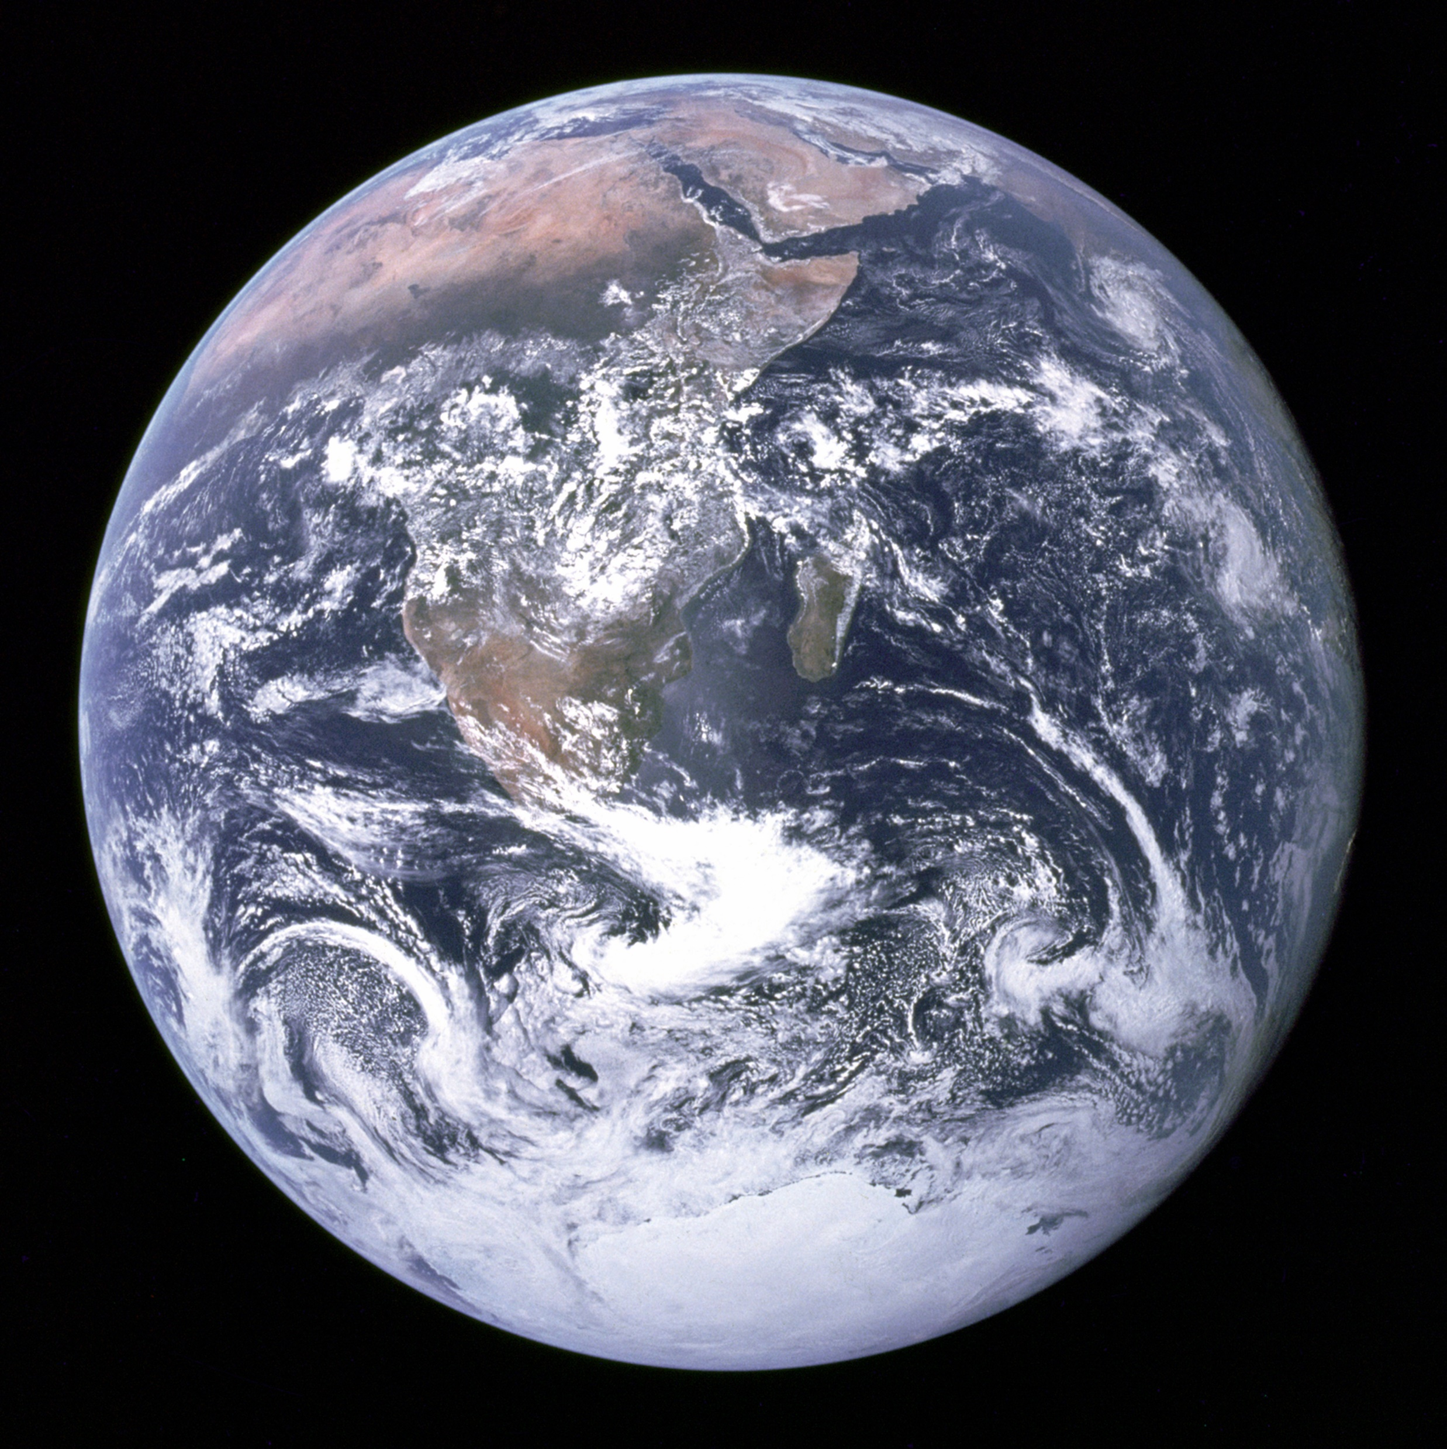
The Earth from Space
This photo of the Earth was taken from Apollo 17 in 1972 when they were 29,000km away. It is one of the most famous photos in history and is usually called “The Blue Marble”.

Slide 4
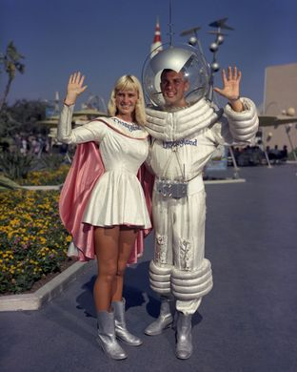
You walk into class and instead of your teacher you find someone from the future sitting in the chair.
They tell you that you can ask three questions about what the world is like. What three questions would you ask them and why?

Slide 5
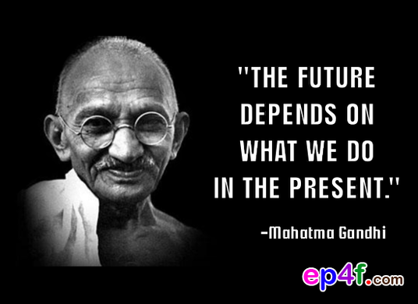
What do you think this means?

Slide 6
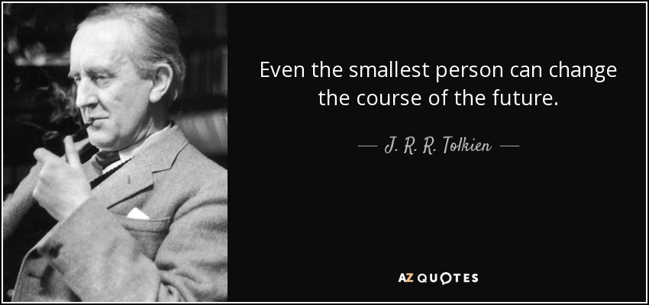
What might this quote mean?

Slide 7
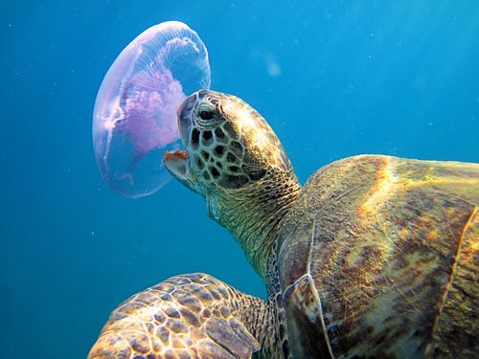
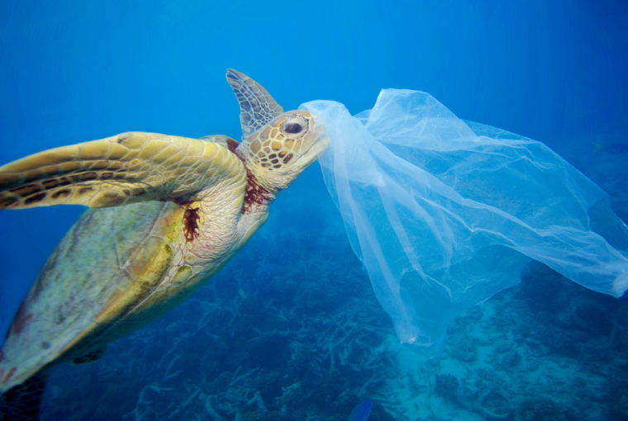
What kind of future do you want?
Look at these two pictures:

Slide 8
Rubbish Jokes
A week of rubbish jokes

Slide 9
Rubbish Jokes
Doctor, Doctor everyone keeps throwing me out with the trash.
Don’t talk rubbish!

Slide 10
Rubbish Jokes
If you crossed a gangster and a rubbish collector, what would you have?
Organised grime.

Slide 11
Rubbish Jokes
I recently asked a friend, 'Has your son decided what he wants to be when he grows up?'
'Yes, he’s very lazy and wants to be a bin man', my friend replied.
I had to think about that one for a moment. 'That's a rather strange thing to say,' I finally managed to reply, as I know how hard bin men work.
'Well,' said the boy's father, 'he thinks that bin men only work on Tuesdays'.

Slide 12
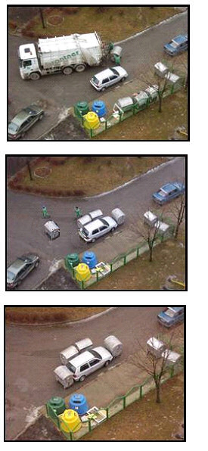
Rubbish Jokes
The joke’s on them:
These rubbish collectors could have got annoyed that someone blocked their way to the wheelie bins. Instead they blocked the car in with the bins, thus getting their revenge in a safe yet obvious way!

Slide 13
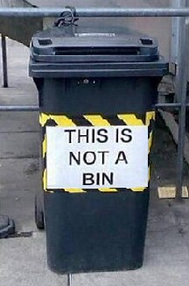

Surrealism in action!
Rubbish Jokes
Magritte’s famous picture.
The quote says: “This is not a pipe.”
The modern equivalent:

Slide 14
Starter games
Ideas for some Rubbish Topic starter games…

Slide 15
List of rubbish words:
Reduce;
Reuse;
Recycle;
Biodegradable;
Compostable;
Aluminium;
Packaging;
Energy from waste;
Compost;
Squash;
Waste;
Textiles
Landfill site;
Plastic;
Zero-waste lifestyle;
Plastic pollution;
Ocean plastics.

Slide 16
List of sustainability words:
Resource management
Sustainable development
Climate change
Global warming
Greenhouse gas
Ozone layer
Pollution
Life cycle analysis
Renewable energy
Sweatshop
Carbon footprint
Organic
Globalisation
Fairtrade
Rio Earth summit
Deforestation
Ecosystem
Biodiversity
Environmental footprint
Species extinction

Slide 17
Green, Green, Green
1. Sit in a circle.
2. Choose a Rubbish or Sustainability topic word from the word bank.
3. Choose one person to stand in the centre of the circle and one to stand outside.
4. They repeat their word three times
5. The person around the outside of the circle who is the orange, must interrupt by shouting the word green, before the other person has managed to say it three times.
6. If they interrupt successfully the person in the middle chooses another word.
7. If they are not quick enough they replace the person in the middle.

Slide 18
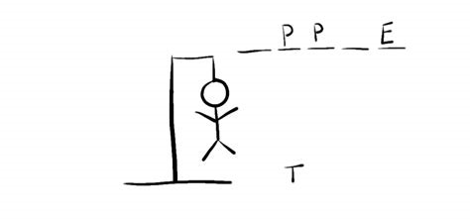
Hangman (use topic words)

Slide 19
Question of the Day
Can we live without plastic?
What is the biggest thing you waste?
When do you think humans started producing and dealing with waste?
What do you think a Garbologist does?
Where does plastic come from?

Slide 20

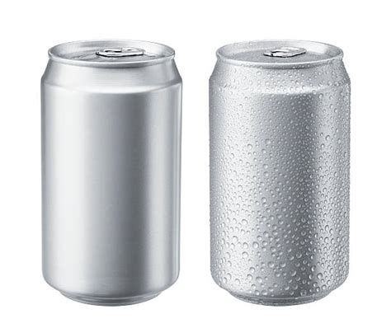
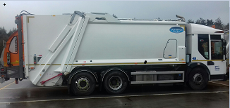
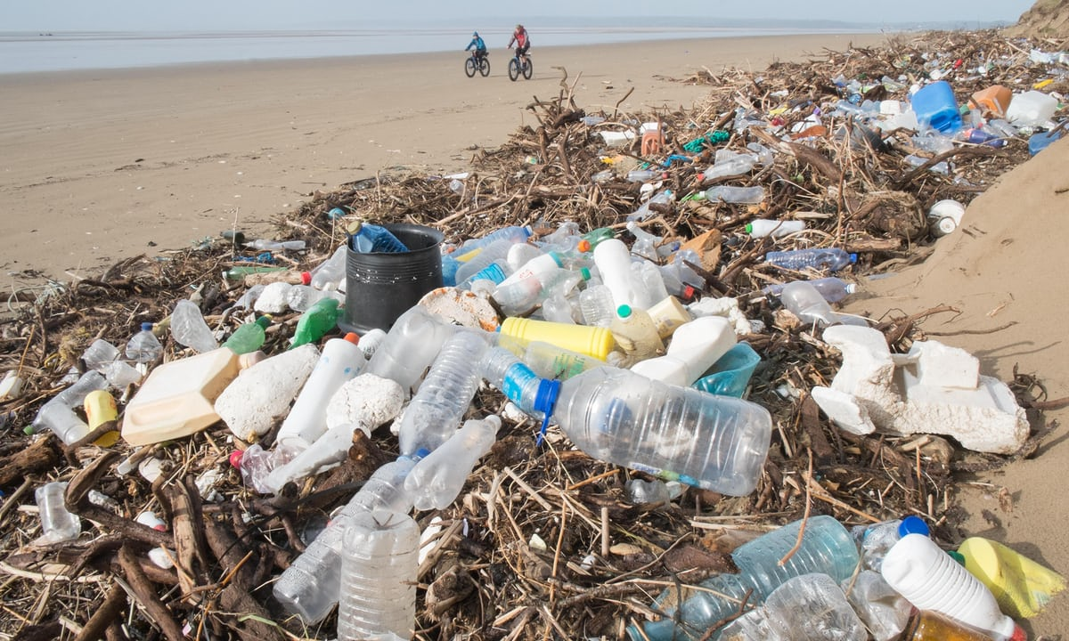
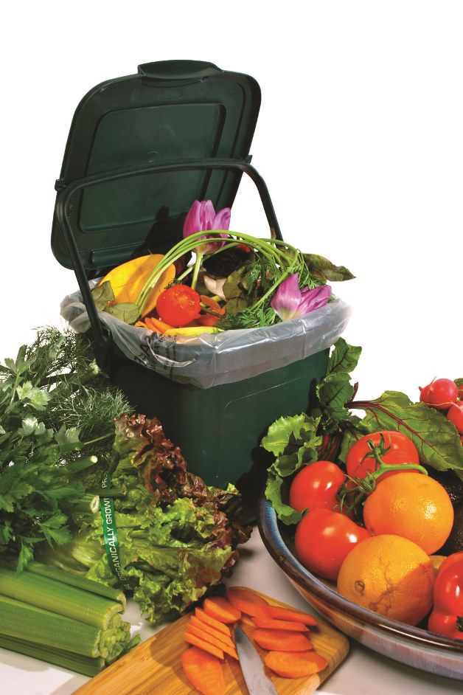
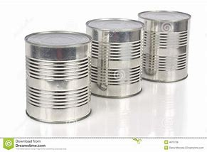
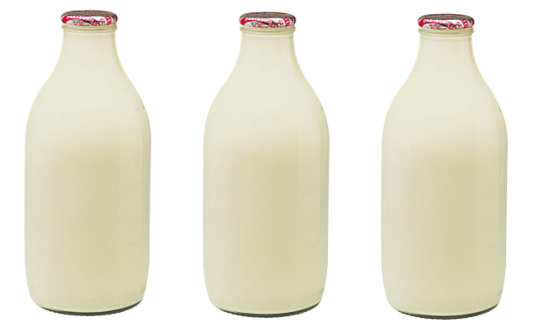
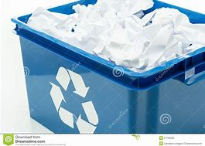
SLAM / Splat / Memory game

Slide 21
Waste definitions
Reduce;
Reuse;
Recycle;
Biodegradable;
Compostable;

Slide 22
Using videos and songs
Ideas using videos and songs to start lessons about rubbish and sustainability

Slide 23
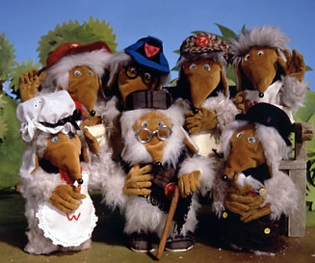
The Wombles
The Wombles starred in a children’s TV show in the 1970s
Listen to their catchy tune here: https://youtu.be/XWQMMPFtoG4
Can you think of some characters that could litter pick in your local park or green area?
What song would they sing as they tidied up the local area?

Slide 24
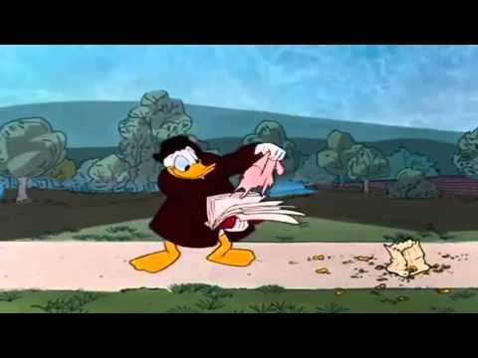
Donald Duck the Litterbug
This is a cartoon from America released in 1961.

Slide 25
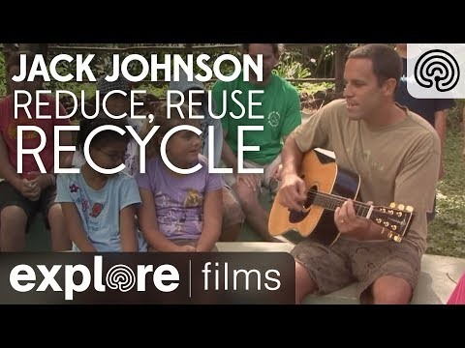
The 3 Rs (Jack Johnson)

Slide 26
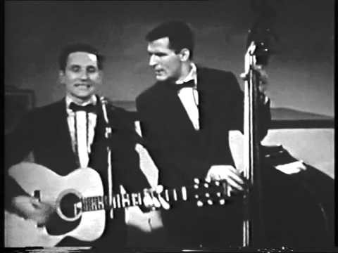
My Old Man’s a Dustman
This is a song from the 1950s
It was recorded by Lonnie Donnegan who was a skiffle artist
Can you think of new and more modern lyrics?

Slide 27
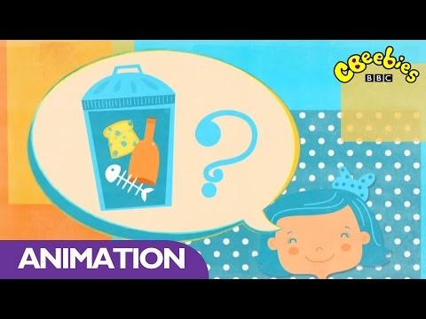
Cbeebies – video and song
Could you make a song up about recycling and rubbish?

