Slide 1


Dear Teachers,
Welcome to our World War Two themed teaching pack, looking at how we managed scarce resources during the war and how that has relevance today.
After a general introduction, the pack is divided into three sections; Rationing, Make-Do & Mend, and the National Salvage Scheme.
Each section contains an introduction to the theme, followed by two class-based activities and a follow-on activity for further research or home learning.
Notes on the slides give you more details and tips for delivery in the classroom, as well as resource lists where applicable.
*Note – this pack covers resource use during war time scarcity, rather than focussing on the conflict itself.

Slide 2
National curriculum links
Art & Design
pupils should be taught to improve their mastery of art and design techniques.
pupils should be taught to develop their techniques, including their control and their use of materials, with creativity, experimentation, and an increasing awareness of different kinds of art, craft and design.
Design & technology
select from and use a range of tools and equipment to perform practical tasks.
select from and use a wide range of materials and components, including construction materials, textiles and ingredients, according to their characteristics.
Cooking & Nutrition
prepare and cook a variety of predominantly savoury dishes using a range of cooking techniques.
understand seasonality and know where and how a variety of ingredients are grown, reared, caught and processed.
Geography
name and locate the world’s seven continents and five oceans.
locate the world’s countries using maps.
History
changes within living memory.
a study of an aspect or theme in British history that extends pupils’ chronological knowledge beyond 1066.
English
retrieve and record and present information from non-fiction.
plan their writing by;
discussing writing similar to that which they are planning to write in order to understand and learn from its structure, vocabulary and grammar.
draft and write by;
organising paragraphs around a theme.
in non-narrative material, using simple organizational devices e.g. headings, sub-headings etc.
evaluate and edit by;
assessing the effectiveness of their own and others’ writing and suggesting improvements.

Slide 3

Make-Do and Mend in World War Two:
A teaching pack for primary schools
PART ONE
Copyright Devon County Council, April 2021
Permission granted to reproduce for personal and educational use only. Commercial copying, hiring, lending is prohibited.

Slide 4
Contents
Key words (PowerPoint 1)
Introduction (PowerPoint 1)
Rationing (PowerPoint 1)
Make-Do and Mend (PowerPoint 2)
National Salvage Scheme (PowerPoint 3)
Notes:
**TO BE LINKED TO THE SECTIONS SO THEY CAN BE CLICKED ON**

Slide 5
Key words
Blockade – the closing off of a place to prevent people and goods entering or leaving
“The German army formed a blockade to prevent ships getting to Britain.”
Import – to bring in (goods, food, people) from another country
“Our country has to import wheat from the USA.”
Rationing – a system of limiting the amount of something that each person is allowed to have
“During rationing, we were only allowed one egg per week.”
Allotment – a plot of land for growing vegetables
“I am growing carrots on my allotment.”
Salvage – saving to use again
“He managed to salvage a tin can from the bin.”

Slide 6
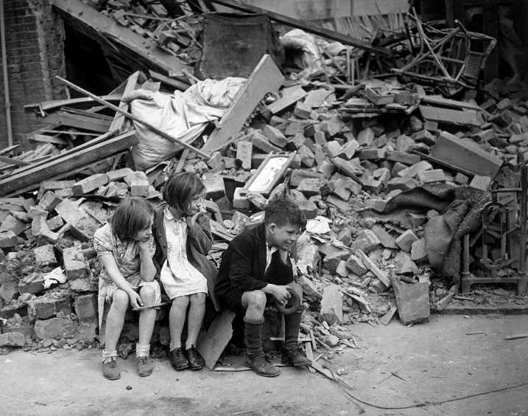
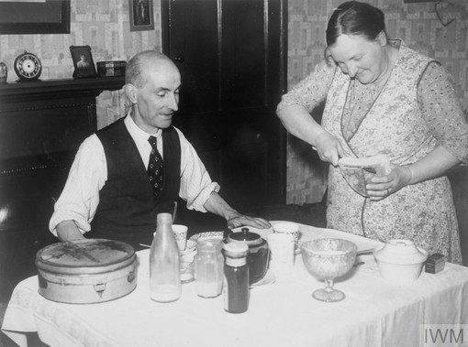
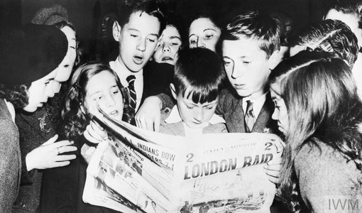
World War Two
World War Two broke out in September 1939 and continued for 6 years until 1945.
Whilst fighting took place across Europe and beyond, what was life-like for people at home in Britain?
In this pack, we will explore how families learnt how to “make-do and mend” during difficult times.
Notes:
Image of children on rubble https://commons.wikimedia.org/wiki/File:WWII_London_Blitz_East_London.jpg

Slide 7
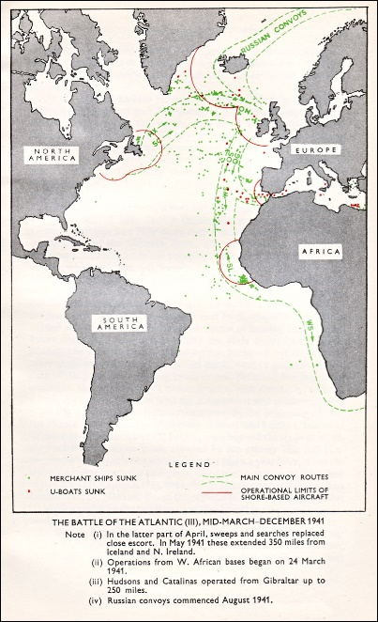

Introduction
As an island nation, Britain has always been dependent on imported food, fuel, medicines, clothing and other resources.
In the 1930s, Britain needed more than one million tonnes of imports a week.
One tonne is the same weight as a baby elephant – imagine what a
million tonnes
would look like!
At the time world war two began, we were importing half our meat, more than half our cheese and a third of the eggs we were eating.
A lot of these goods came from America, across the Atlantic Ocean.
Notes:
Image of convoy route https://en.wikipedia.org/wiki/Convoy#/media/File:Convoy_routes_1941.jpg

Slide 8
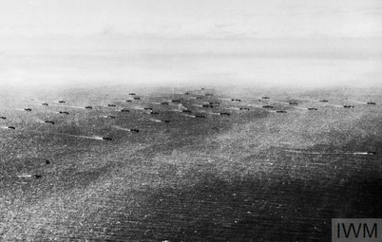
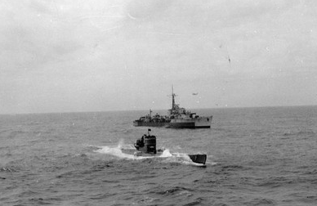
During World War Two, convoys of ships travelling across the Atlantic Ocean to Britain had to be protected by the British and Canadian air and naval forces.
This was because the German army had formed a blockade and was attacking ships to prevent them from bringing vital food and other supplies to Britain.
During WW2, German U-Boats sank 3,500 merchant ships and 175 warships.

Slide 9
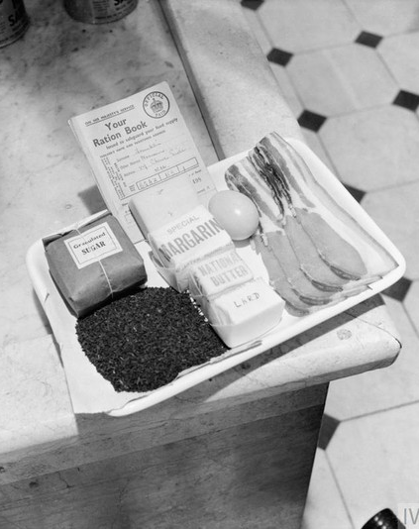
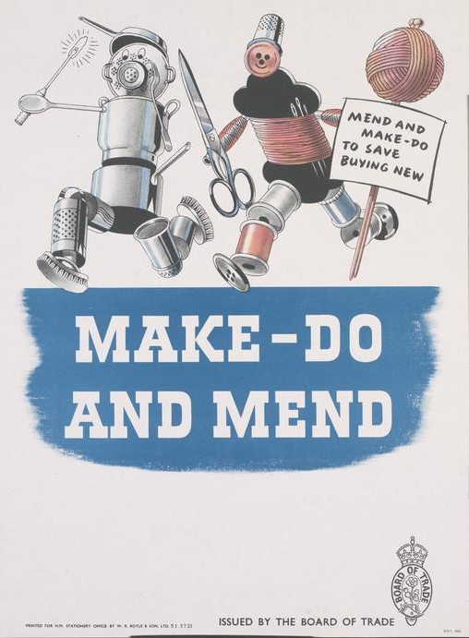
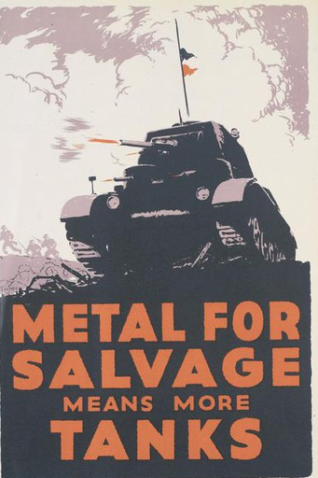
In order to make the most of limited supplies, the Government
introduced three important schemes and campaigns:
Rationing Make-Do and Mend The National Salvage Scheme

Slide 10
QUICK QUIZ – check how much you can remember!
Q1. What year did World War Two start?
Q2. How many tonnes of food and goods was Britain importing each week?
Q3. Name three foods we were importing.
Q4. Match up the words with their definitions:
Blockade a system of limiting the amount of something that each person is allowed to have
Imported a plot of land for growing vegetables
Rationing the closing off of a place to prevent people and goods entering or leaving
Allotment saving to use again
Salvage to bring in (goods, food, people) from another country
Notes:
ANSWERS
1.1939
2. One million tonnes per week
3. Meat, eggs, cheese
4.

Slide 11

RATIONING
During WW2, it became difficult to import the food Britain needed to feed everybody.
This was because lots of ships which used to bring food were being used for the war instead and because the German army attacked ships in the Atlantic Ocean, trying to prevent food from getting to Britain.
In response, the British government introduced ‘rationing’ in 1940. This was a way of limiting the amount of food and clothes each person could buy, making sure there was enough to share around.

Slide 12
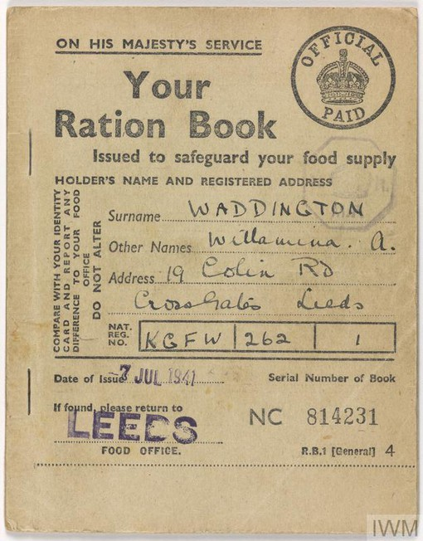
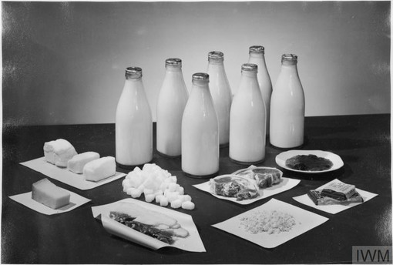
Ham
Clothes
Rice
Jam
Peas
Margarine
Meat
The first foods to be rationed were butter, bacon and sugar.
These were followed by lots of other items:
Breakfast cereals
Canned food
Chocolate
Tea
Soap
Cheese
Sweets

Slide 13
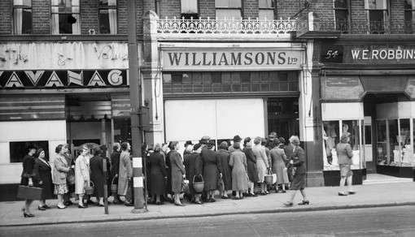
People were issued coupons to keep control of what they bought in the shops.
Rationing continued after the war ended until 1954 – so it went on for 14 years in total!
Shops often had empty shelves and women had to queue for long periods of time to get their rations. This was difficult for those with young children or those who had jobs. (Why do you think that was?)

Slide 14
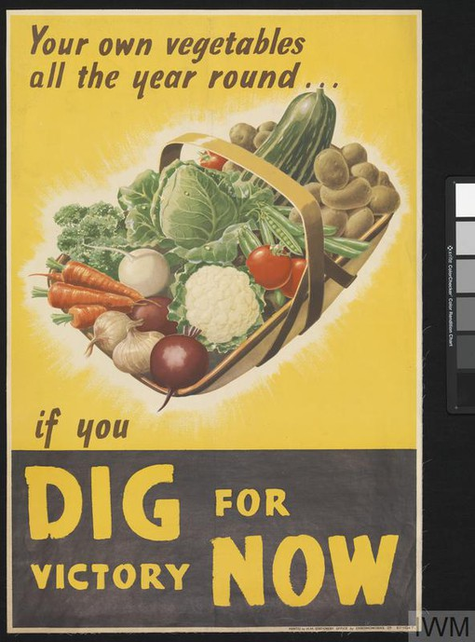
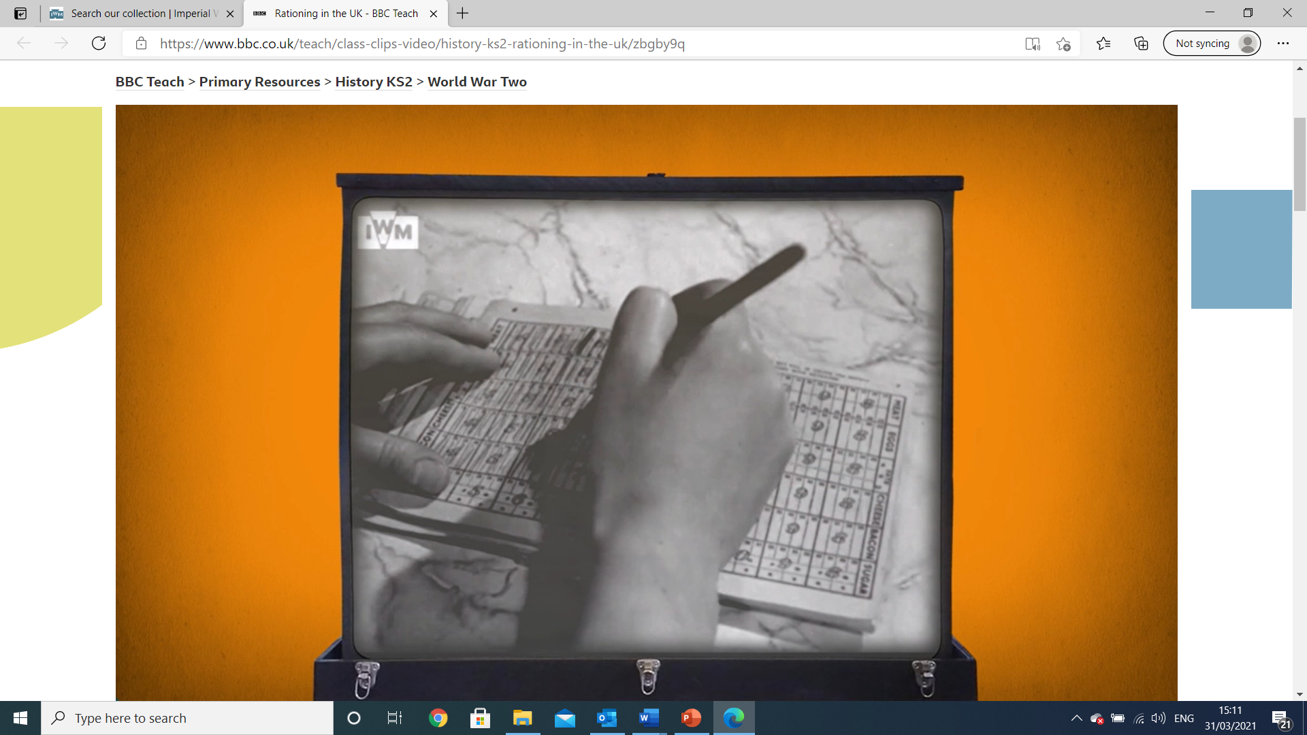
To make sure there was enough to eat, the government encouraged people to grow as much of their own food as possible. As well as creating allotments for fruit and vegetables, some people kept rabbits, chickens and ducks for eggs and meat.
Watch this short video to find out more: bbc.co.uk/teach/class-clips-video/history-ks2-rationing-in-the-uk/zbgby9q

Slide 15
ACTIVITY ONE: Get cooking!
People had to become very inventive with their cooking, substituting ingredients that were not available.
For example, sugar was heavily rationed, so people used grated carrots to sweeten cakes and biscuits.
Bananas were not available so recipes for ‘mock banana’ were invented, using mashed up parsnips and a little bit of sugar. Yummy!
Shops even sold carrots on sticks for children to eat instead of lollipops!
For this activity, have a go at making two wartime recipes – one savoury and one sweet – from the following slides….
Notes:
Recipes are available as separate worksheets

Slide 16
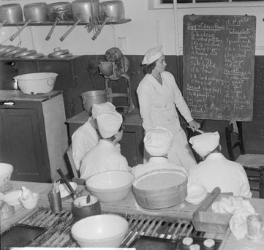
Potatoes were sometimes used to make pastries and cakes due to a shortage of flour. Have a go at cooking these savoury potato scones from a WW2 recipe:
Ingredients
150g flour
50g mashed potato
1 teaspoon baking powder
½ teaspoon salt
25g butter
4 tablespoons milk
Method
Mix flour and salt
Add potato and baking powder
Rub in butter
Add milk to make a soft dough
Roll out to 2cm thickness and cut into rounds
Bake for 15 minutes in a hot oven (about 200ºC)
Ask an adult to help with the hot oven
What did your scones taste like? Were they easy to bake? What kind of toppings could you spread on them? Try to choose things that would have been available during the war.

Slide 17
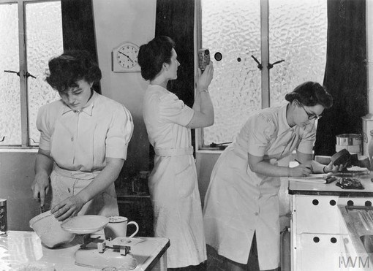
Now try baking these carrot biscuits, sweetened with grated carrots!
Ingredients (makes 12)
1 tablespoon margarine
2 tablespoon sugar
1 teaspoon vanilla essence
6 tablespoons self-raising flour
4 tablespoons grated raw carrot
1 tablespoon water
Method
Cream the margarine and sugar together with the vanilla essence
Mix in the grated carrot
Fold in the flour adding water as it gets dry
Drop spoonfuls onto a greased baking tray and press down a little
Pre-heat oven to 200ºC
Place in oven for 10 - 15 minutes
Ask an adult to help with the hot oven
What did your biscuits taste like? How did they compare to biscuits you buy in the shops?
Notice how your home-made biscuits have no packaging, so there is less waste?

Slide 18
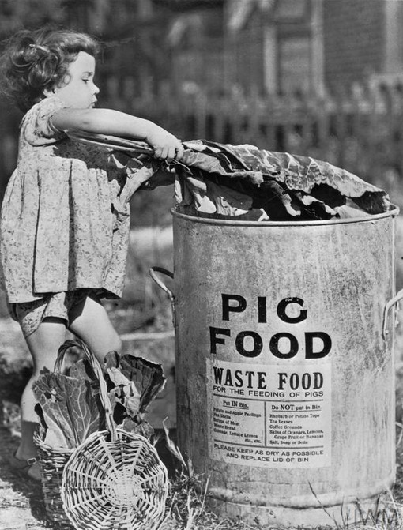
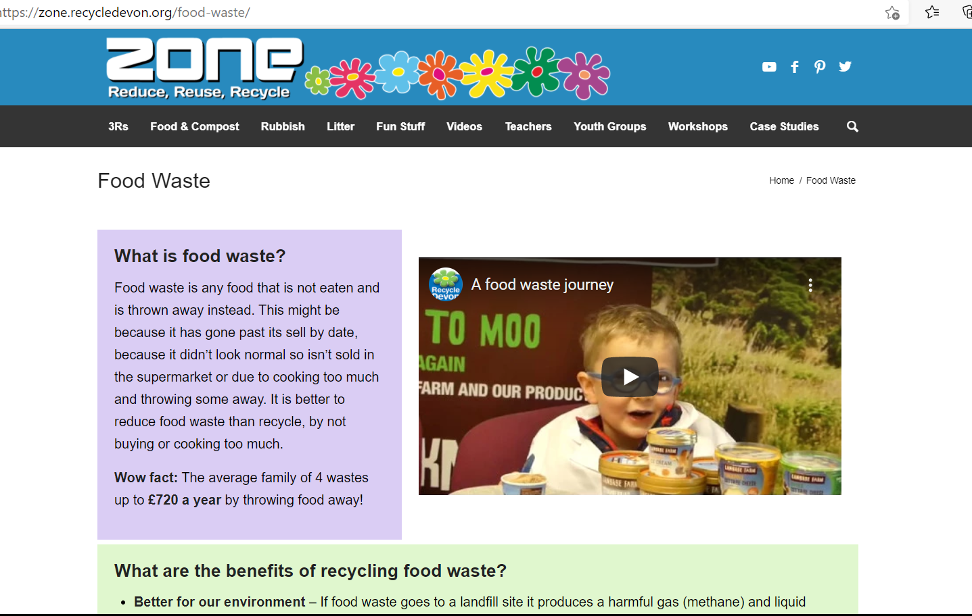
Food leftovers
Food leftovers such as vegetable peelings were collected during the war and used to feed pigs and chickens.
If you have any leftovers at home, what do you do with them? Do you make compost at home?
Does your local council provide a food waste collection service? Find out if they do and
watch this short film to explore what
happens to your food waste:
Food Waste - Zone (recycledevon.org)
You can find out lots more about rationing,
and read personal stories from people who
lived through it, here:
1900s.org.uk/1940s50s-rationing.htm and here:
BBC - WW2 People's War - Devon Category

Slide 19
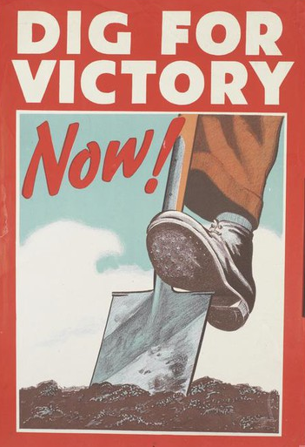
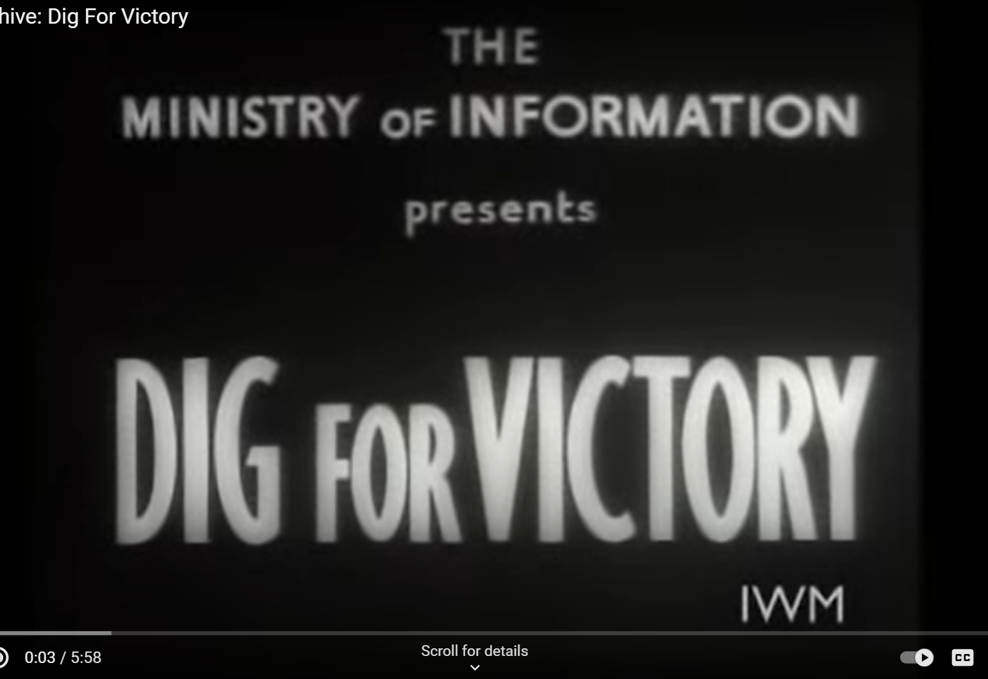
ACTIVITY TWO: Dig for Victory!
As many foods were rationed throughout the war, the government encouraged people to grow as much of their own food as possible.
The ‘Dig for Victory’ campaign used posters, leaflets, and short films to teach people how to grow food. Watch this information film produced by the government: youtube.com/watch?v=35NpLveVZDg
The campaign was very successful, by the end of the war around 70% of all food was home produced.
People turned their gardens into allotments,
as well as any other patches of land they
could find; school playing fields, parks,
even tennis courts!
Notes:
Film: Dig for Victory length 05:58

Slide 20
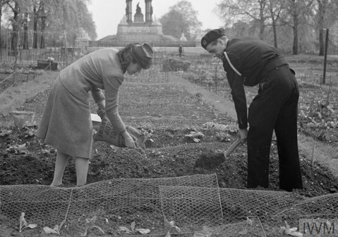
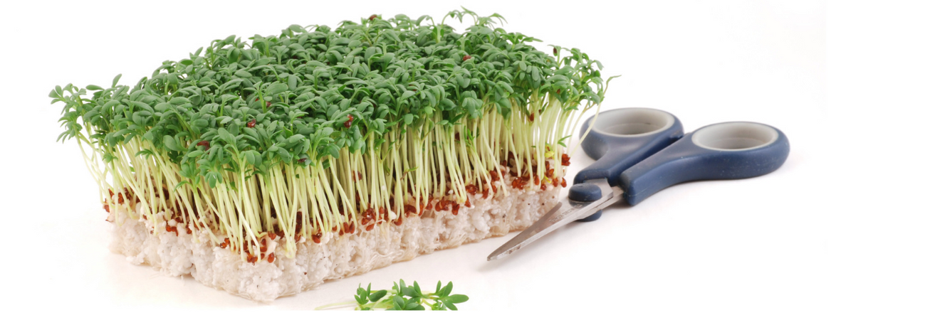
Growing
Have a go at growing your own vegetables. You don’t even need a garden, or a lot of time. Try out these ideas:
Small space/indoors: herbs on the windowsill; parsley was popular during
the war because it contains lots of vitamins.
Small amount of time: sprout seeds on some damp cotton wool. You could try cress or mustard seeds, which
are full of nutrients.
Lots of space: why not try growing potatoes, carrots, beetroot, beans, and cabbages. You could even try and create a whole ‘Victory Garden’.
Houseplants: there was a shortage of houseplants as every bit of land was being used to grow food and no plants were being imported. Some householders grew their own by sprouting carrot tops in a dish of water. Why not try this yourself?
Notes:
Image of beansprouts: https://pixnio.com/flora-plants/seeds/bowl-seed-pea-bean-food-vegetable-kernel

Slide 21
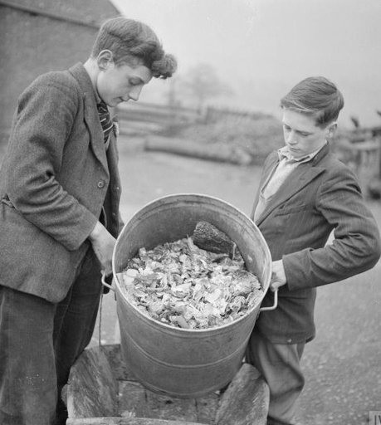
Compost
Plants need compost to grow strong and healthy. During the war there were no fertilisers available to buy; people had to make their own compost from vegetable scraps, dead leaves, horse manure and even urine!
Making compost in your own garden is simple and a great way to reuse fruit and vegetable waste. Why not give it a try?
You can find lots of information and
helpful hints here:
zone.recycledevon.org/food-and-compost/

Slide 22
And finally…
Try to use the 3Rs at home to make less food waste:
REDUCE – planning meals weekly can help your family create a lot less food waste. Why not sit down together and plan out a week of meals? You can find lots of ideas using an internet search engine.
REUSE – use up leftover food to make other meals. Yesterday’s dinner could be today’s lunch! Turn brown bananas into a delicious cake or banana bread. Can you find more recipes that use up leftover food? Get creative and search here for more ideas: lovefoodhatewaste.com/recipes or here:
Have Your Food and Eat It - Recycle Devon
RECYCLE – if you have vegetable peelings why not compost them in the garden at home? Any leftover food / plate scrapings might be collected by your local council in a food waste collection scheme. Check here to see what you can do in your area:
Food and Compost - Zone (recycledevon.org)
Food Waste - Zone (recycledevon.org)
 | Breakfast | Lunch | Dinner
Monday
Tuesday
Wednesday
Thursday
Friday
Saturday
Sunday
Notes:
These activities are suitable for homework / home learning

Slide 23
Thank you for using the Make-Do and Mend teaching pack, we hope you found it useful.
There are PowerPoints available for part 2 and 3 of the pack here https://zone.recycledevon.org/world-war-2-pack/
You can find lots of free resources about waste, recycling, composting and more on our website:
zone.recycledevon.org/

Slide 24
Credits and acknowledgements
Wartime images:
Imperial war museum
Image of Junior Salvage Stewards badge:
sallybosleysbadgeshop.com
Image of Salvage Stewards badges:
ww2civildefence.co.uk
Copyright Devon County Council, April 2021
Permission granted to reproduce for personal and educational use only. Commercial copying, hiring, lending is prohibited.

