Slide 1


Dear Teachers,
Welcome to our World War Two themed teaching pack, looking at how we managed scarce resources during the war and how that has relevance today.
After a general introduction, the pack is divided into three sections; Rationing, Make-Do & Mend, and the National Salvage Scheme.
Each section contains an introduction to the theme, followed by two class-based activities and a follow-on activity for further research or home learning.
Notes on the slides give you more details and tips for delivery in the classroom, as well as resource lists where applicable.
*Note – this pack covers resource use during war time scarcity, rather than focussing on the conflict itself.

Slide 2

Contents
Key words (PowerPoint 1)
Introduction (PowerPoint 1)
Rationing (PowerPoint 1)
Make-Do and Mend (PowerPoint 2)
National Salvage Scheme (PowerPoint 3)
Notes:
**TO BE LINKED TO THE SECTIONS SO THEY CAN BE CLICKED ON**

Slide 3
Make-Do and Mend in World War Two:
A teaching pack for primary schools
PART THREE
Copyright Devon County Council, April 2021
Permission granted to reproduce for personal and educational use only. Commercial copying, hiring, lending is prohibited.

Slide 4

THE NATIONAL SALVAGE SCHEME
The demand for materials for manufacturing increased hugely during the war.
The Ministry of Supply started the “National Salvage Scheme” in December 1939 to save paper, rags, rope and string, household bones, rubber, food waste and all kinds of metal.

Slide 5
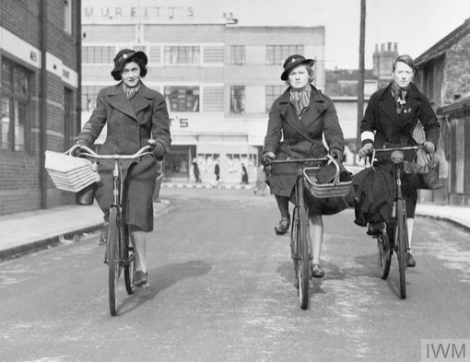
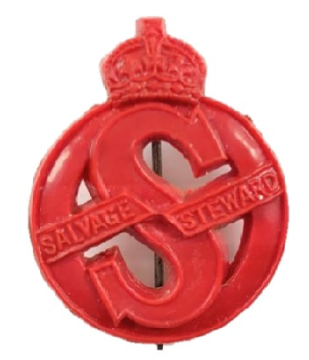
Salvage Stewards
The Women’s Voluntary Service helped run the campaign to encourage householders to salvage as much material as possible.
They delivered leaflets and knocked on doors to tell everyone about the National Salvage Scheme and they helped to organise collections for their local streets.
At first, it was difficult to convince people to salvage and recycle their waste. The government established a “Salvage Stewards” scheme. Their 4 main tasks were:
To encourage householders to take part in the salvage scheme.
To educate householders about what materials could be salvaged.
To assist in creating local dumps or depots to collect salvaged materials.
To report to the Local Authority.

Slide 6
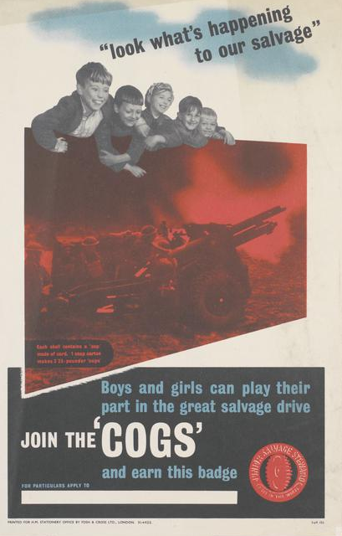
The COGS scheme
In 1940, the “COGs” scheme started. This encouraged children to become part of the National Salvage Scheme. They represented a small but important cog in the national machine.
The COGs jobs were:
To help to run collection services.
To encourage their families to change their behaviour and take part in the National Salvage Scheme.

Slide 7
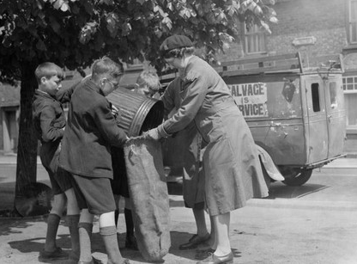
Each cog was given a leaflet entitled “What a cog should know” and taught the cogs song (see below).
1st verse (sung to tune of “There’ll always be an England”:
“There’ll always be a dust-bin, to save for victory, so treat it right, and let it fight for home and liberty. We’ll win this war together, as easy as can be. If dustbins means as much to you, as dustbins mean to me.”
You can find a video of the song here:
youtube.com/watch?v=_qhLPWcm-0w

Slide 8
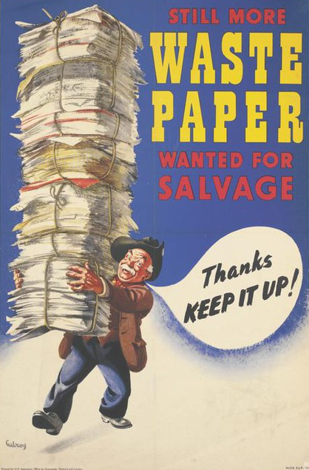
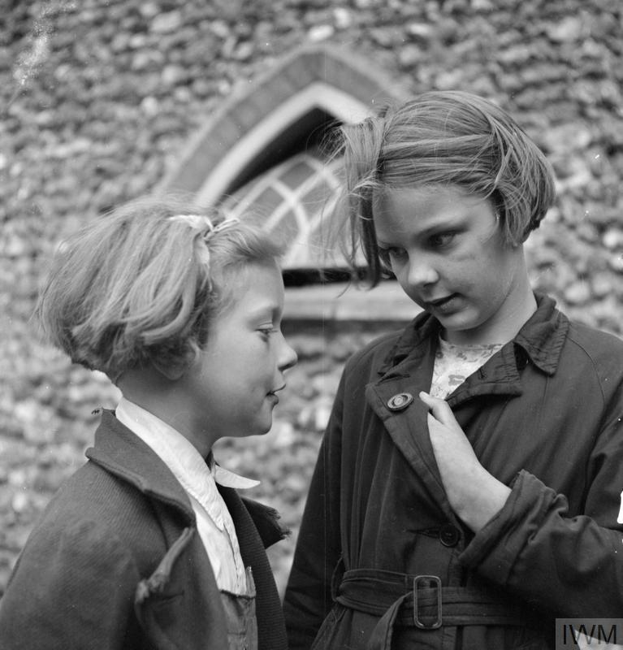
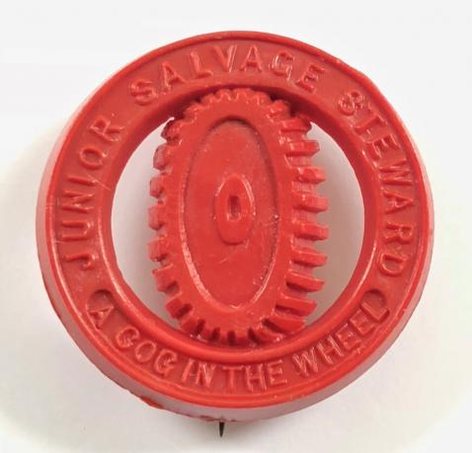
All of the salvaged materials needed to be collected by the local authorities and taken to factories for recycling.
Over a three-year period, 192,523 badges were given out to Cogs to recognise their efforts.

Slide 9
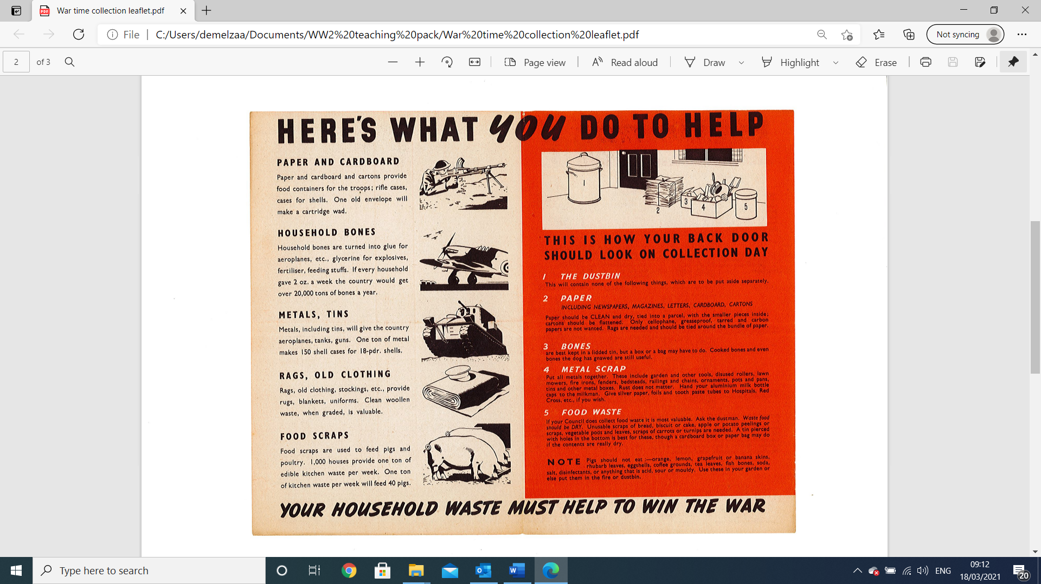
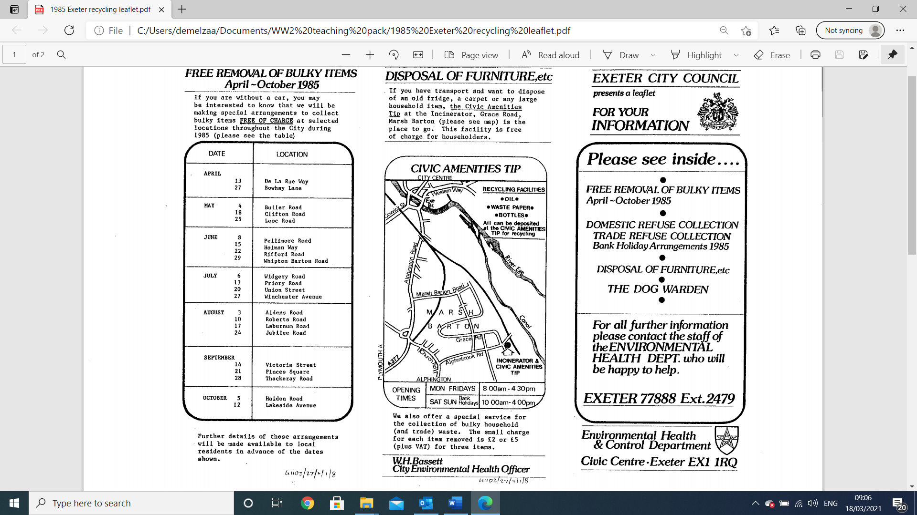
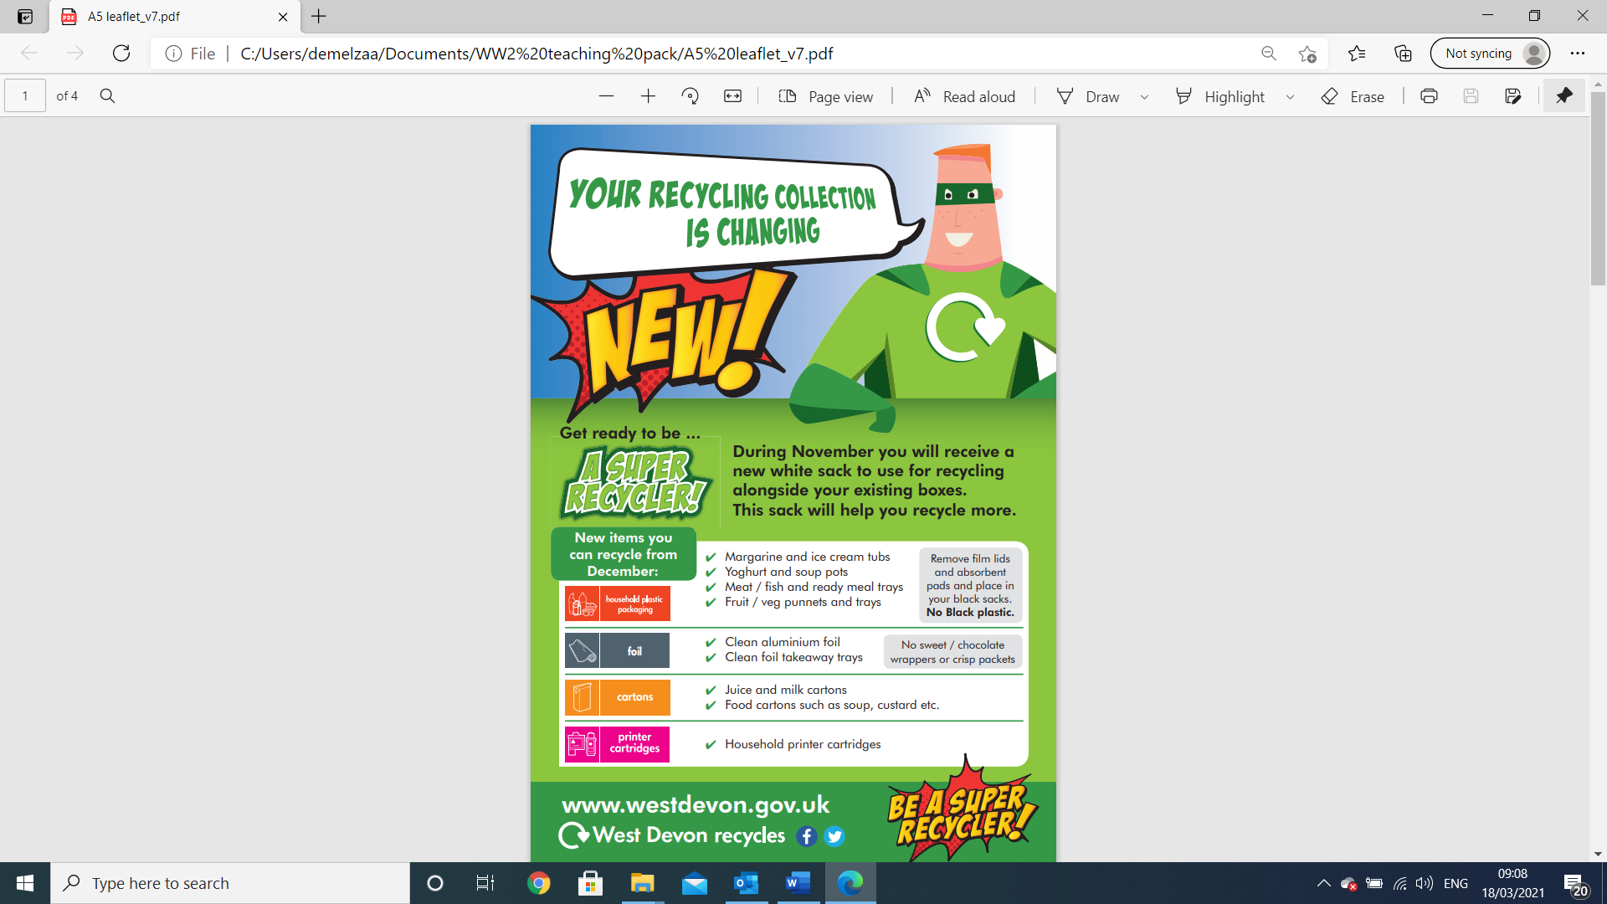
ACTIVITY ONE: Salvage and recycling leaflets
The following slides show recycling leaflets from three different time periods; WW2, 1985 and the present day (you can see them below in miniature).
Look at each carefully and complete the comparison task at the end.

Slide 10
Salvage leaflet from World War 2

Slide 11
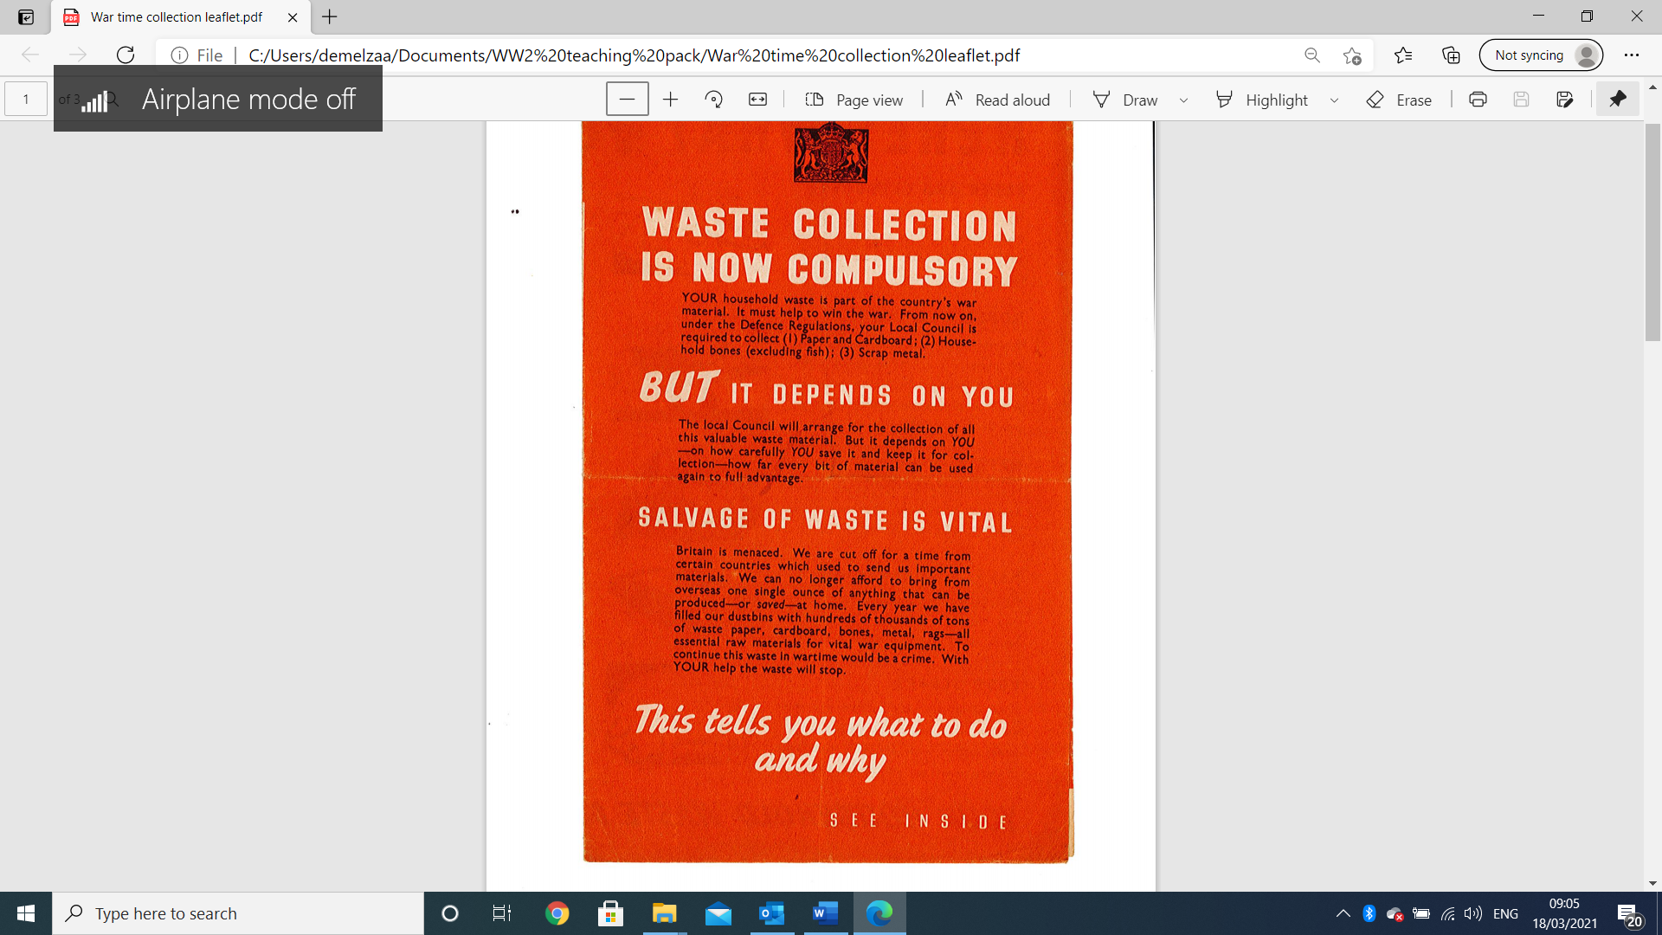
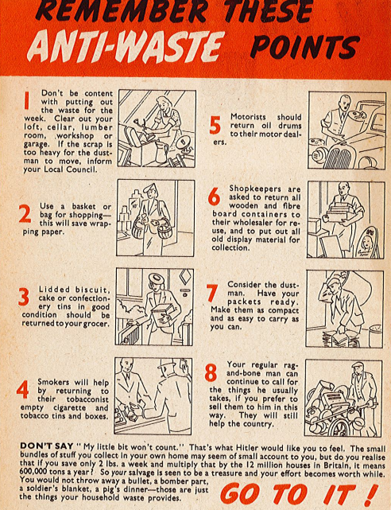
Salvage leaflet from World War 2

Slide 12
New
Today,
Exeter recycling leaflet 1985

Slide 13
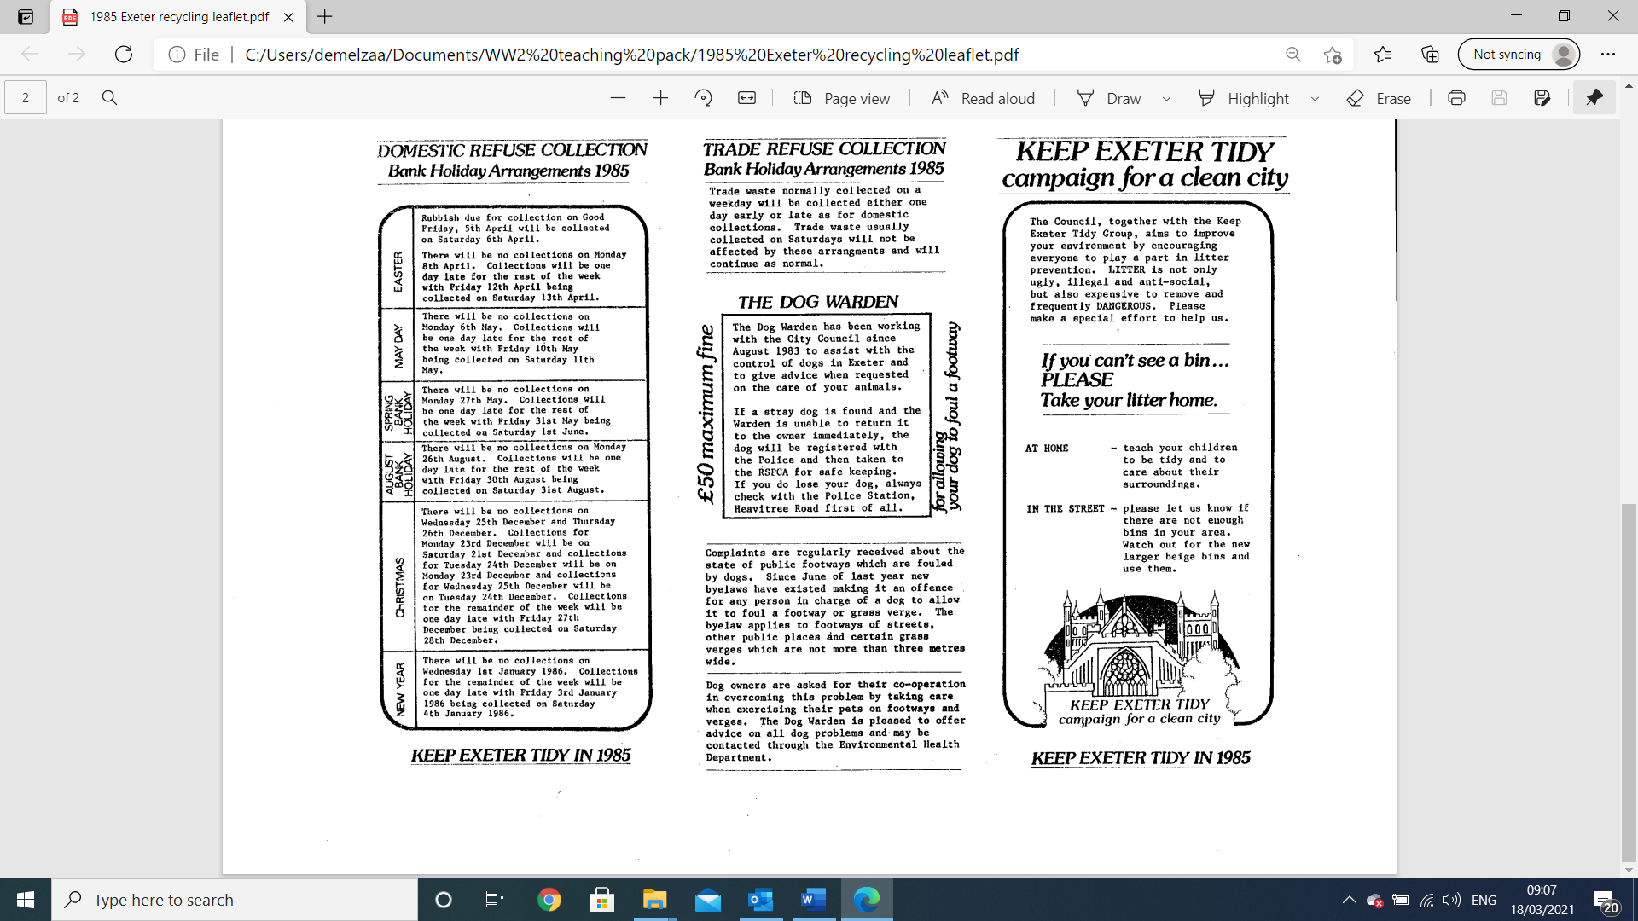
Exeter recycling leaflet 1985

Slide 14
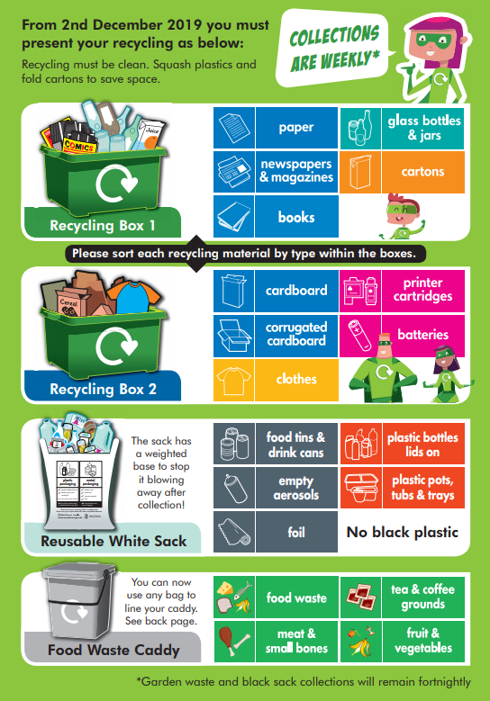
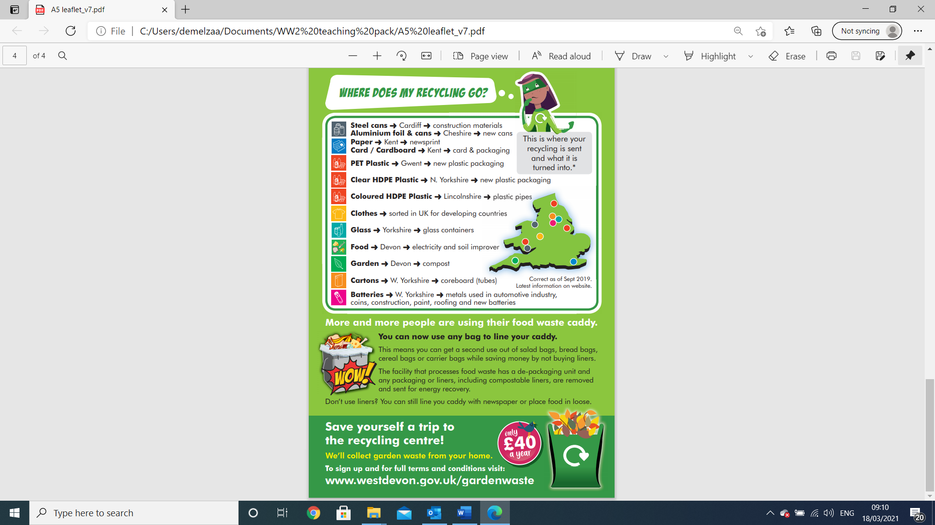
West Devon recycling leaflet 2019
Notes:
Note that this recycling leaflet shows a collection for West Devon Borough Council. It may not be the same as your local collection. See activity under “Earn your COGs badge” for an investigation into local recycling collections.

Slide 15
Now compare the three leaflets by considering their features and completing the table here.
Write notes in each of the boxes.
You could also award each feature a score from 1-5.
Notes:
The activity on the following two slides is available to download as a worksheet here ***********

Slide 16

Answer these questions:
  Which is your favourite leaflet? Why?
  Which leaflet do you think is the most persuasive and would make people want to recycle?
  What makes a leaflet most effective?
  What sort of information does it provide? Is it useful? Does it help you to know what and how to recycle?
Now you have looked at leaflets old and new, it’s time to get creative! Have a go at designing your own leaflet to encourage people to recycle at home.
Before you begin, check online to find out what can be recycled in your local area: recycledevon.org/recycling-collections/
You might like to try out a style similar to the WW2 leaflet, or maybe you can imagine a futuristic leaflet – what would it look like 50 years from now?
Take your leaflet home and put it on display to encourage your family to recycle.
Notes:
Film: Dig for Victory length 05:58

Slide 17
ACTIVITY TWO: Earn your Cogs badge
Take a look at the badge awarded to ‘Cogs’ during WW2. It shows a small cog within a much larger wheel, or machine. This represents how small actions can make a big difference to the bigger picture.
Have a go at the mini activities on the next slides and see if you can earn your own Cogs badge!
As an extension activity, why not try and make your own Cogs badge using a milk bottle lid as a base?!

Slide 18
Salvage quiz – part 1 Match up the materials with their uses during WW2
MATERIALS SALVAGED
RECYCLED INTO……..
Paper & card
Clothing & rags
Bones
Metal
Food waste
Rubber
Pig swill (food for pigs)
Explosives, soap, candles, glue, fertilizer
More paper, parts of bullets and bombs, targets for target practice
Airplane propellors, tanks, guns, ships, aeroplanes
Tyres, welly boots, fire hoses
Mattress stuffing, roofing felt, shipping charts and maps, army blankets and uniform. White shirts were even transformed into 5-pound notes!

Slide 19
Salvage quiz – part 2 Now try and match up some modern-day items
MATERIALS COLLECTED
RECYCLED INTO……..
Paper
Aluminium cans
Steel cans
Plastic bottles
Plastic yoghurt pots
Glass bottles
Clothing
Food waste
Benches, picnic tables, play equipment
Bikes, fridges, car parts, more cans
Toilet roll and newspapers
Fleece clothing
More glass bottles
Car lining / rags for industry
Engine parts / more cans
Compost / methane gas

Slide 20
It’s time to investigate what materials can be recycled where you live. Check the website to find your local collection and complete the table below. recycledevon.org/recycling-collections
Did you manage to complete all the tasks? Well done if you did – you have definitely earned a Cogs badge for helping to save resources and look after the planet!
Notes:
Find this is a worksheet on the following link ********
This activity is suitable for home learning

Slide 21
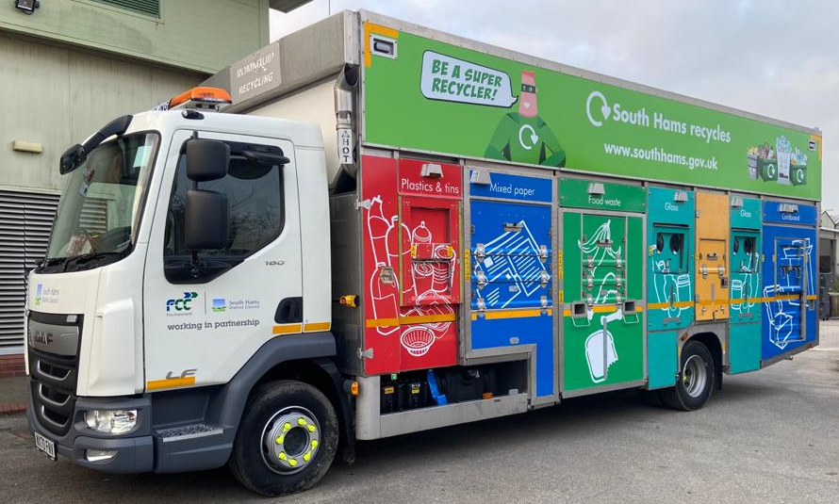
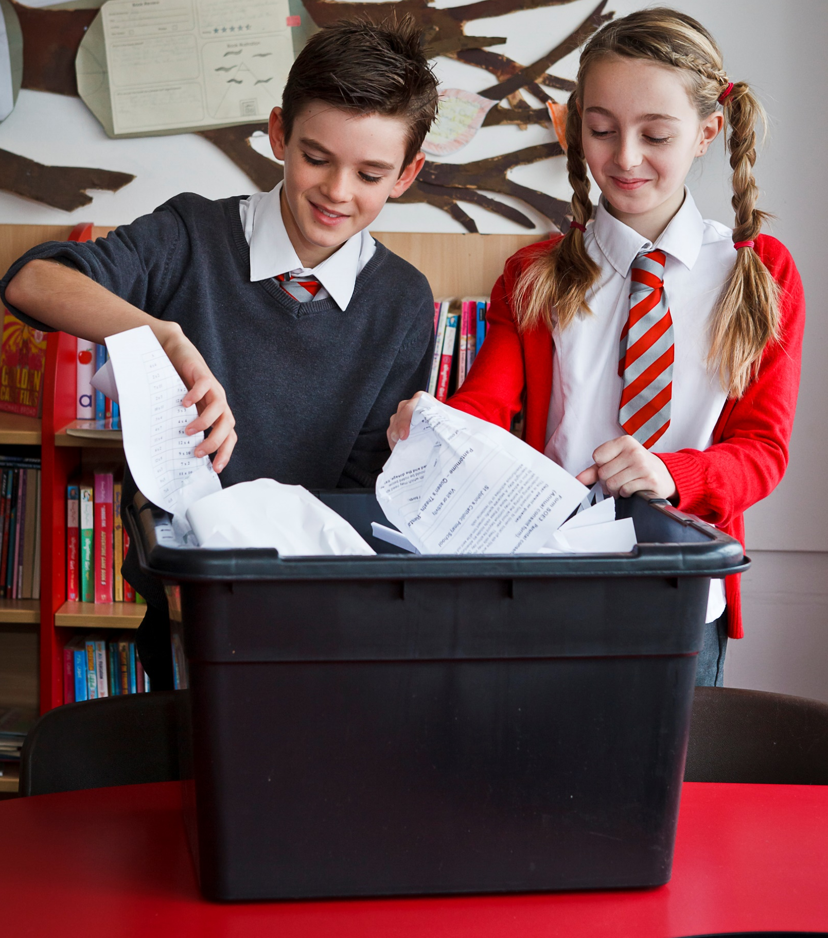
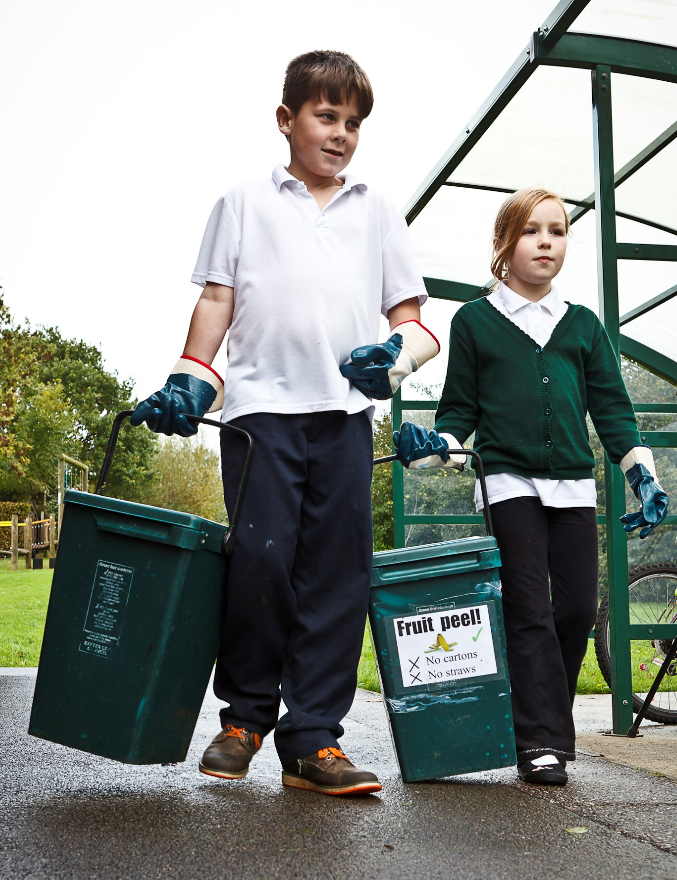
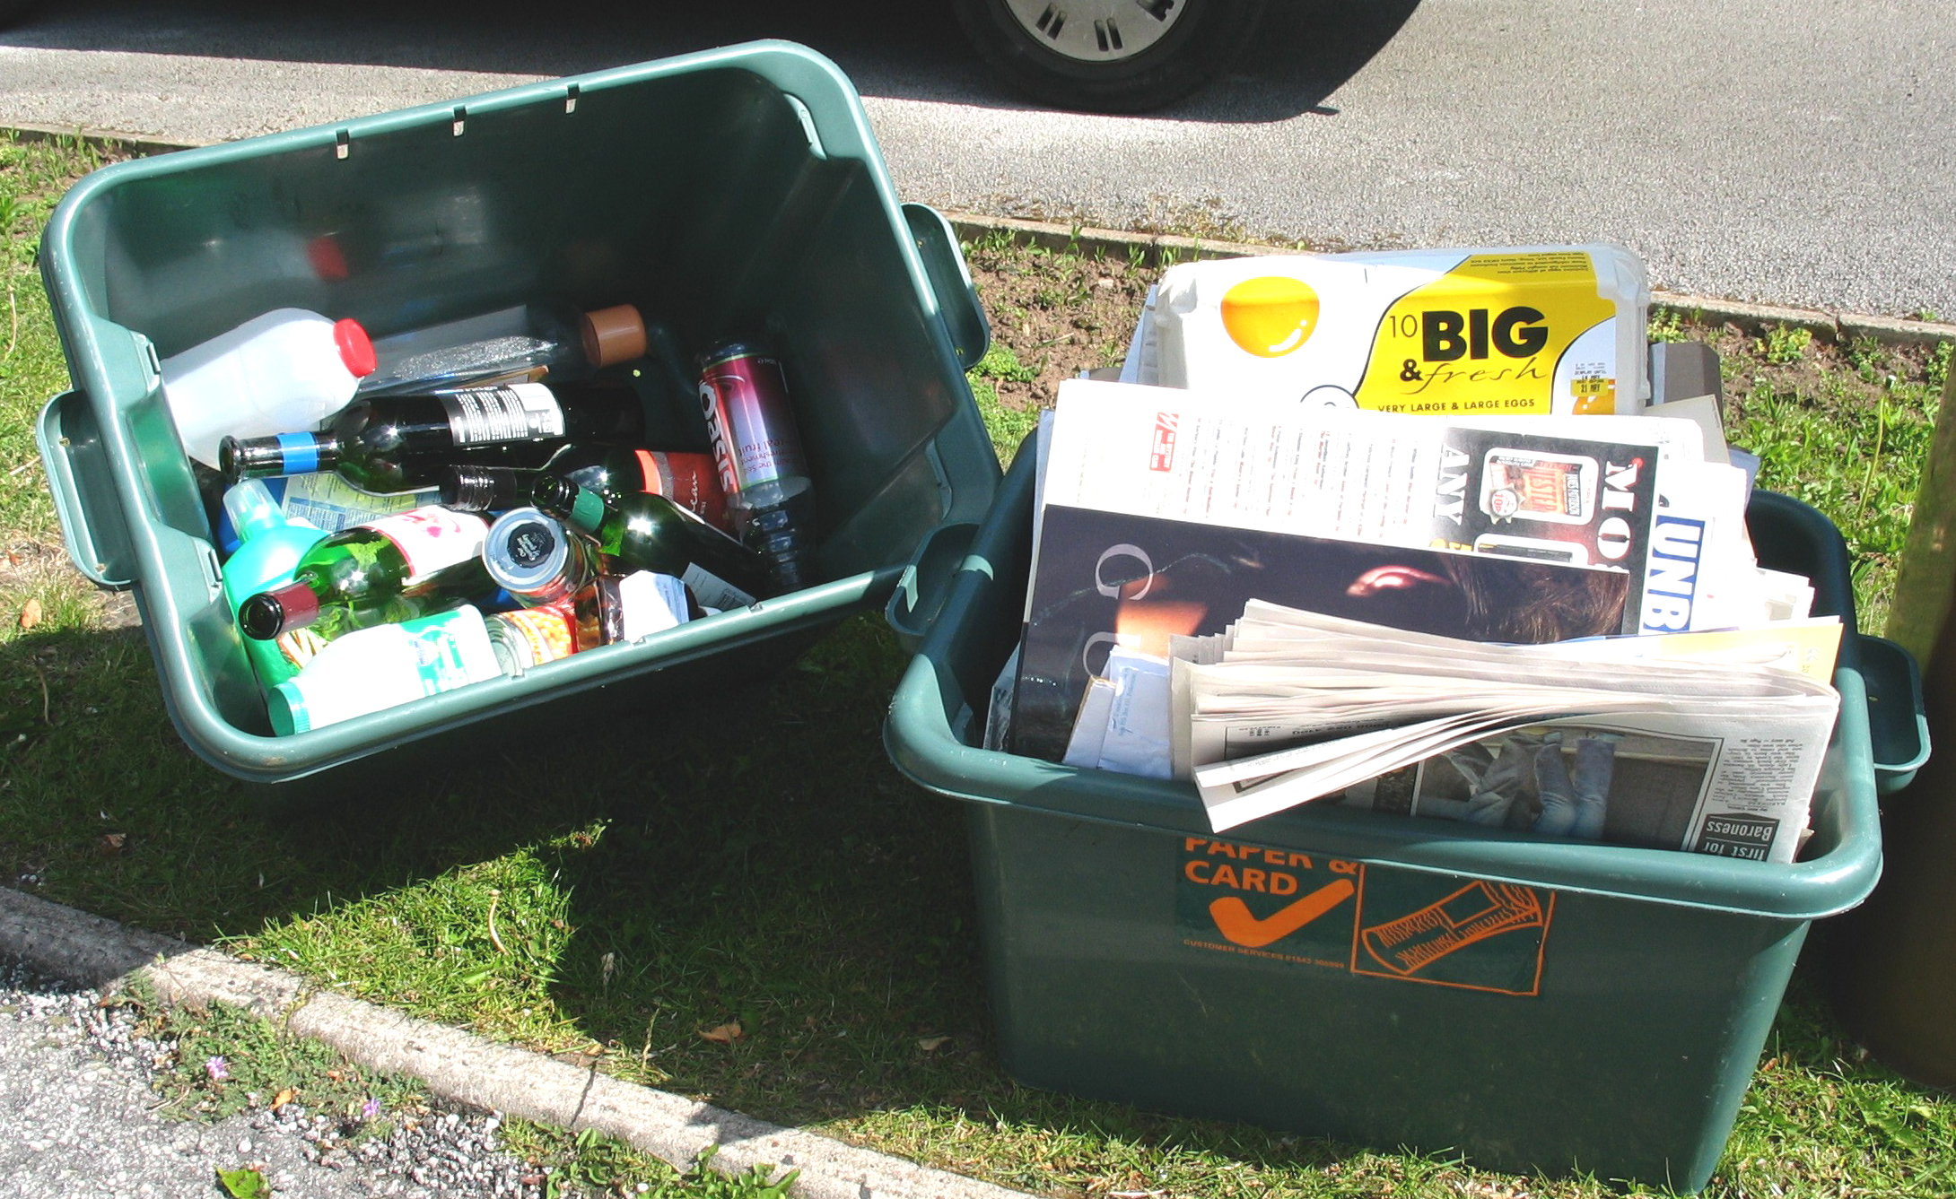
And finally…
Now you are a recycling expert, it’s time to take action at home!
Your task is to help sort materials into the correct boxes and bags for recycling, and to put them outside for collection (with your grown up’s permission).
What day did you put the recycling out? What time was it? Who usually does this job?
Were the boxes heavy or light? What was the weather like outside? Was it warm/cold? Light/dark?
Did you see the recycling lorry crew come and collect your recycling? How many people were in the lorry? Did you wave to them?
Notes:
This activity is an extension, suitable for home learning

Slide 22
Thank you for using the Make-Do and Mend teaching pack, we hope you found it useful.
There are PowerPoints available for part 1 and part 2 of the pack here https://zone.recycledevon.org/world-war-2-pack/
You can find lots of free resources about waste, recycling, composting and more on our website:
zone.recycledevon.org/

Slide 23
Credits and acknowledgements
Wartime images:
Imperial war museum
Image of Junior Salvage Stewards badge:
sallybosleysbadgeshop.com
Image of Salvage Stewards badges:
ww2civildefence.co.uk
Copyright Devon County Council, April 2021
Permission granted to reproduce for personal and educational use only. Commercial copying, hiring, lending is prohibited.

