Slide 1


Dear Teachers,
Welcome to our World War Two themed teaching pack, looking at how we managed scarce resources during the war and how that has relevance today.
After a general introduction, the pack is divided into three sections; Rationing, Make-Do & Mend, and the National Salvage Scheme.
Each section contains an introduction to the theme, followed by two class-based activities and a follow-on activity for further research or home learning.
Notes on the slides give you more details and tips for delivery in the classroom, as well as resource lists where applicable.
*Note – this pack covers resource use during war time scarcity, rather than focussing on the conflict itself.

Slide 2

Contents
Key words (PowerPoint 1)
Introduction (PowerPoint 1)
Rationing (PowerPoint 1)
Make-Do and Mend (PowerPoint 2)
National Salvage Scheme (PowerPoint 3)
Notes:
**TO BE LINKED TO THE SECTIONS SO THEY CAN BE CLICKED ON**

Slide 3
Make-Do and Mend in World War Two:
A teaching pack for primary schools
PART TWO
Copyright Devon County Council, April 2021
Permission granted to reproduce for personal and educational use only. Commercial copying, hiring, lending is prohibited.

Slide 4

MAKE-DO AND MEND
Clothes rationing was introduced by the Government in June 1941. It happened overnight to prevent ‘panic buying’ of clothes.
British people woke up one morning to find that clothes shops were closed, and coupons were the only way to buy new items!
A similar thing happened during the first UK lockdown during the Covid-19 pandemic – the Government ordered shops to close suddenly in 2020, and people ran out of toilet paper and other essentials.

Slide 5
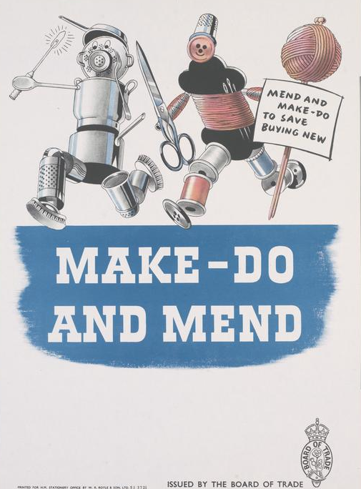
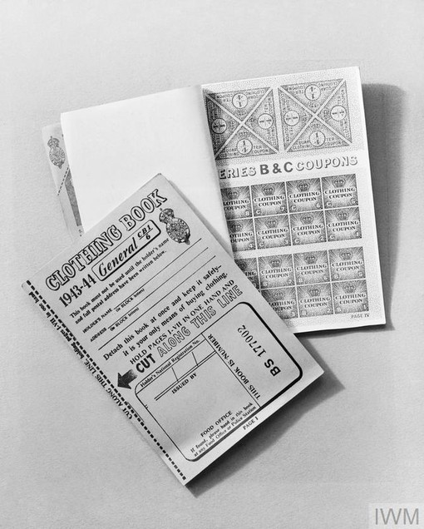
Clothes rationing and coupons
Each person was given 66 coupons per year from the Government, but they were not allowed to spend them all at once.
The amount was reduced each year until people only had 36 coupons a year by 1945.
Clothes rationing didn’t end
until 1952.

Slide 6
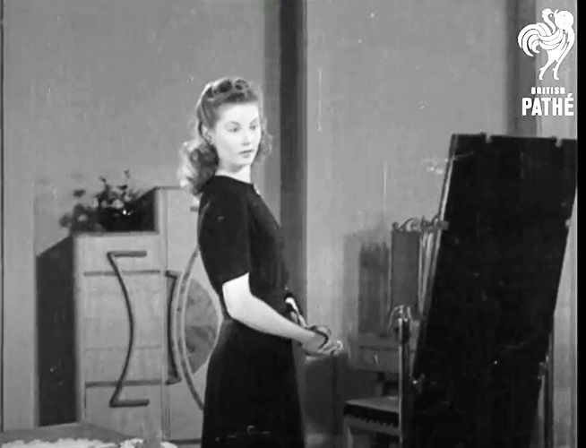
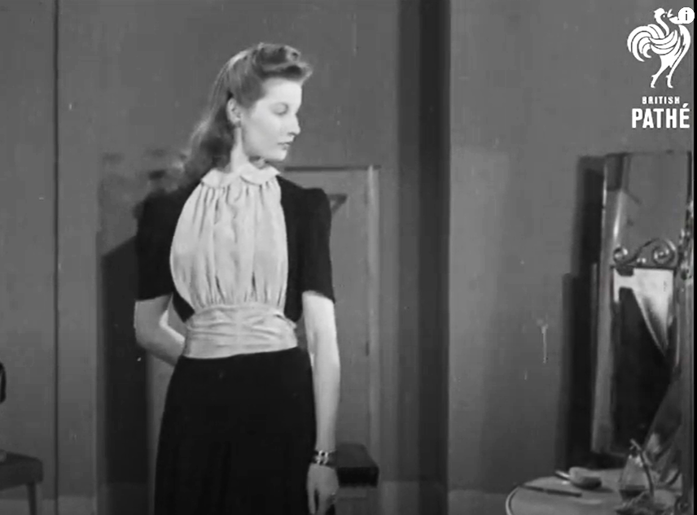
Being inventive
Because buying new clothes was so limited, people had to become inventive to make the most of what they had. Remember, clothes rationing lasted for eleven years! Here are some things people did:
Adding simple accessories to make the same dress look different every day of the week. Watch this video from 1943: youtube.com/watch?v=yE2P_EnG884
Unravelled old woollen jumpers, using the wool to knit new items.
Mended worn out clothes and socks by stitching, darning and patching. The Government encouraged people to “Make Do and Mend” using posters, training and films like this one: youtube.com/watch?v=f4RpJcVs1VI
Made their own new clothes (fabric used fewer coupons than buying clothes). Some people used black-out fabric for making clothes because no coupons were needed to buy it.
Notes:
Note the tone and use of language in the first video. It may be worth instigating a conversation around gender and how women were discussed

Slide 7
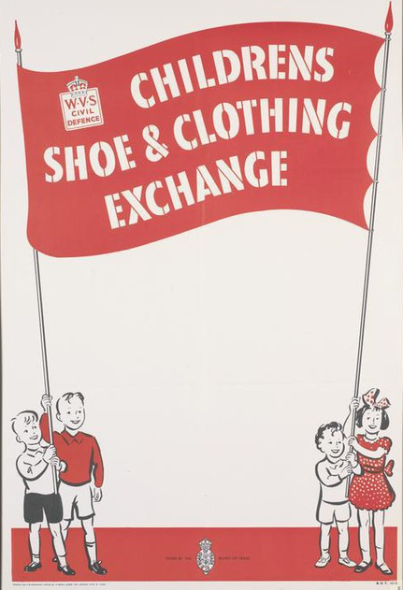
Rubber and leather were scarce resources because they were being used to make weapons for the war. New shoe styles came into fashion using less material. Some shoes were made using cork, jute or wood for the heels.
Clothing exchanges were set up for people to swap clothes with each other. These were mostly used for children’s items as they outgrew their clothes and needed bigger sizes more often.
New designs emerged for dresses and suits called “Utility Clothing”. These designs used less fabric by having straight sleeves, shorter skirts, and a maximum of two pockets. They were also limited to having a maximum of five buttons! Utility clothing was made to be long-lasting so that people didn’t have to use up coupons replacing their clothes so often.

Slide 8
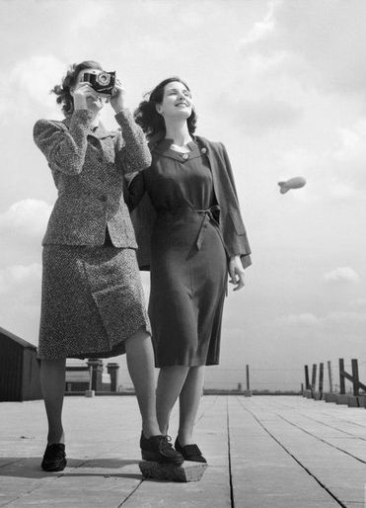
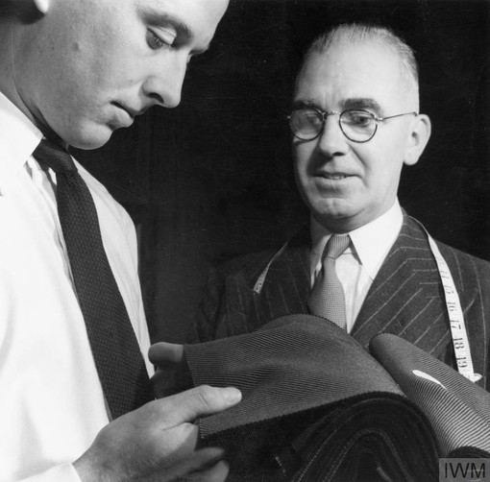
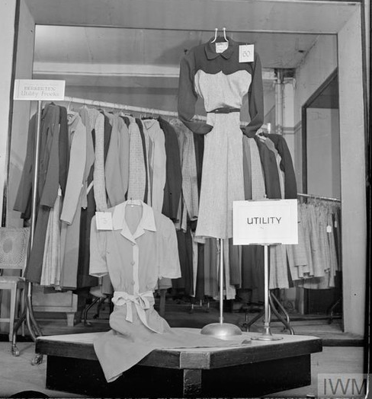
Utility clothing
Imagine if your clothes shopping was restricted in this way for eleven years!
You would soon learn how to “Make-Do and Mend”!

Slide 9
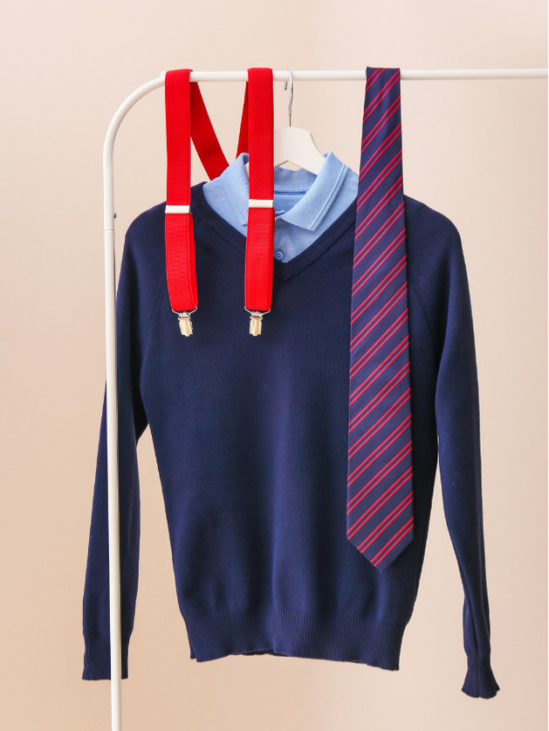
ACTIVITY ONE: Wartime wardrobe challenge
Clothing coupons were needed to buy all clothes and shoes, even school uniform!
Take a look at your school website to find a uniform list. There may be separate lists for boys and girls.
Using the table, work out how many coupons you would need to buy a complete set of uniform, including a PE kit. Remember that you will need more than one shirt / pair of trousers etc to last through the week.
Notes:
See worksheet for this activity ***LINK HERE**

Slide 10
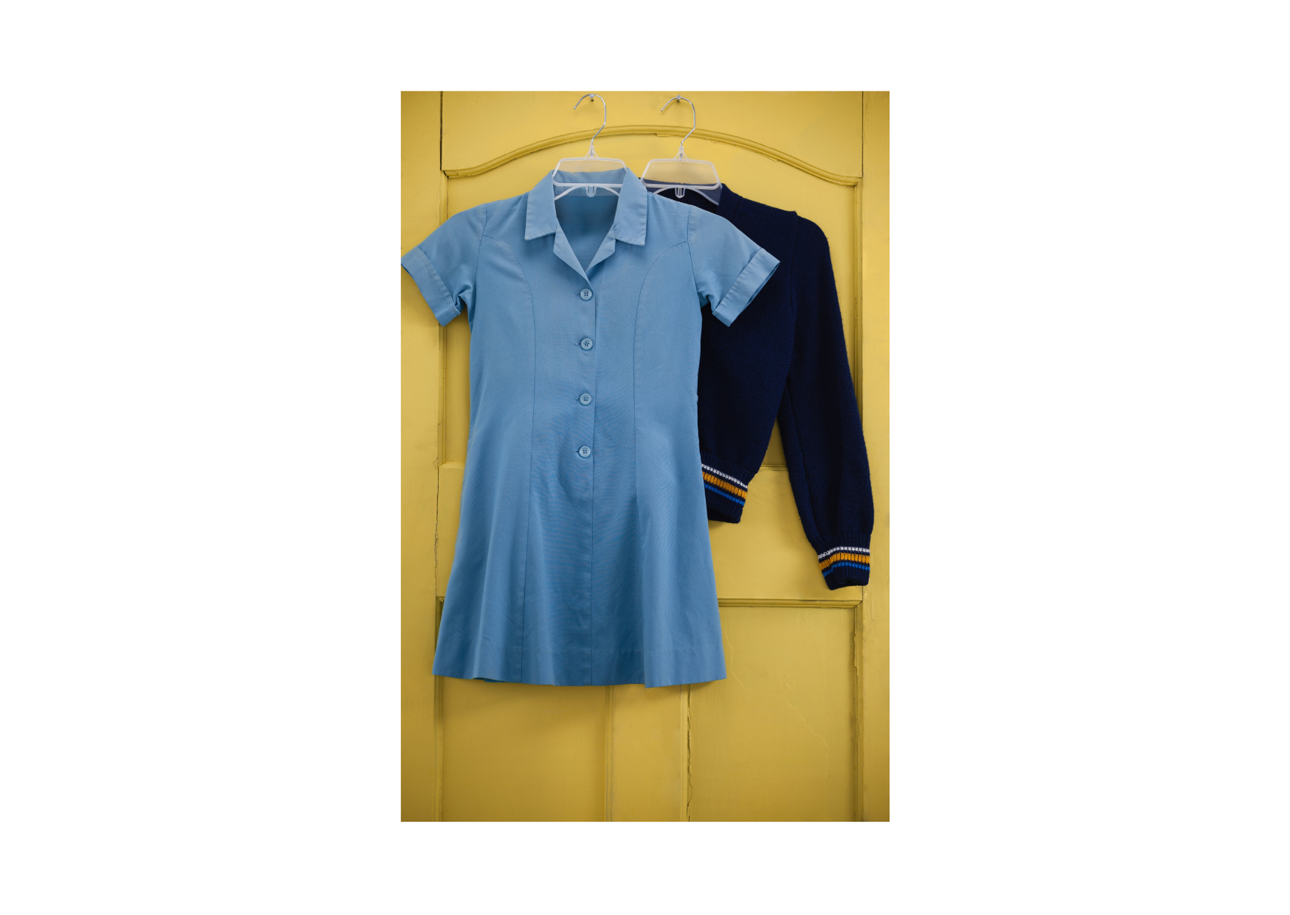
Wartime wardrobe challenge continued…
3) How many coupons did you need to buy a set of school uniform? Remember, you only have 66 coupons to last the year and you need other clothes too. What would happen if you grew and needed new shoes and more school uniform?
(Note: girls did not generally wear trousers or shorts in the 1930s/40s.)
4) Boys often wore shorts instead of trousers, even in the winter. Why do you think they did this?
5) In 1941 you would have had 66 clothing coupons, by 1945, you would only have 36 coupons to last the whole year! Can you try to exercise above again, this time with only 36 coupons to use. Would you make changes to your uniform? What else would you do to make clothes last longer?
Notes:
POSSIBLE ANSWERS: {a)Shorts took less coupons to buy than trousers b) If they fell over, boys would graze their knees instead of damaging their trousers c) It wasn’t so obvious if a child had outgrown their shorts, trousers would start to rise above the ankle! d) old trousers could be cut down to make shorts}

Slide 11
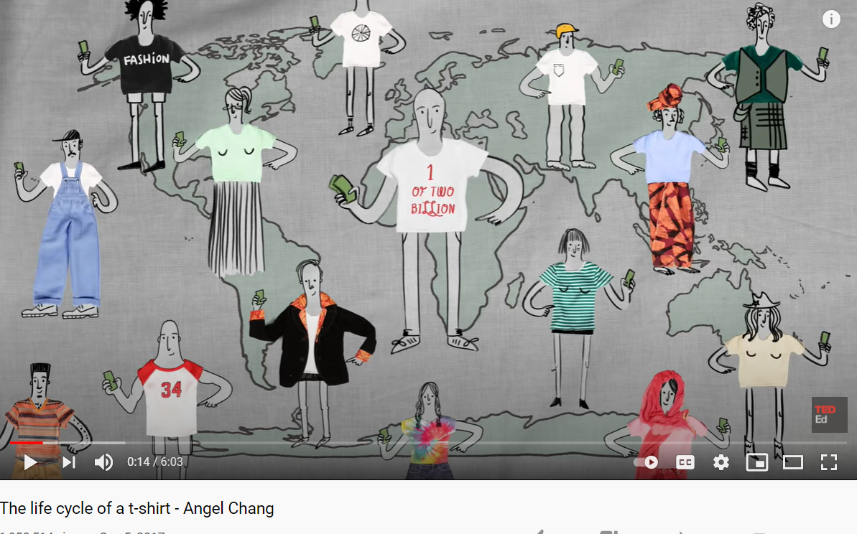
New clothes / old clothes
Today, the average life of a garment in the UK is 2.2 years – imagine how we would have coped during 11 years of clothes rationing.
In the UK today, the average person throws away 70kg of clothing in just one year; what a waste of resources! Why do we buy so many new clothes?
Watch this short video to find out more about the impact of new clothes: youtu.be/BiSYoeqb_VY
Notes:
Notes: we highly recommend supplementing this pack with a session on ‘needs’ and ‘wants’. BBC Northern Ireland have an excellent resource here: https://www.bbc.co.uk/northernireland/schools/4_11/pfocus/english/spring2001/worksheets/pr02.pdf
And the introductory sessions in the Material World pack here Material_World_Intro_lesson-lr.pdf (recycledevon.org)
VIDEO LENGTH: 06:03

Slide 12

Now you have watched the video about the impact of new clothes, have a class discussion:
What were the last items of new clothing you bought? Why did you buy them? How did it make you feel when you went into the shop or looked online at new clothes?
Some reasons you might discuss:
It makes us feel happy to buy things
We want to look nice
We saw an advert that made us want something
We saw a friend wearing something we liked and wanted it for ourselves
We want to impress other people
The clothes were in a sale
We were bored with our old clothes
Notes:
Notes: we highly recommend supplementing this pack with a session on ‘needs’ and ‘wants’. BBC Northern Ireland have an excellent resource here: https://www.bbc.co.uk/northernireland/schools/4_11/pfocus/english/spring2001/worksheets/pr02.pdf
And the introductory sessions in the Material World pack here Material_World_Intro_lesson-lr.pdf (recycledevon.org)
VIDEO LENGTH: 06:03

Slide 13
Now we have looked at why people buy and throw away so many clothes, and the impact this has on the environment, have a discussion with the people around you. What can we all do to reduce the impact?
Here are some possible ideas:
Buy fewer new clothes.
Buy second hand / used clothes.
Swap clothes with friends, family, and your community.
Wash / launder your clothes less often (this will save energy and water).
Dry clothes outside on a clothesline, avoid using a tumble drier whenever you can (to save energy).
Mend/repair broken and damaged clothes – sew on a missing button, darn a holey sock, adjust the waist of trousers.
Buy natural fibres where possible (to prevent microfibres – tiny bits of plastic from fleece clothing - entering waterways)
Donate old clothes to charity.
Recycle unusable clothing in your local recycling collection or nearest clothing bank.

Slide 14
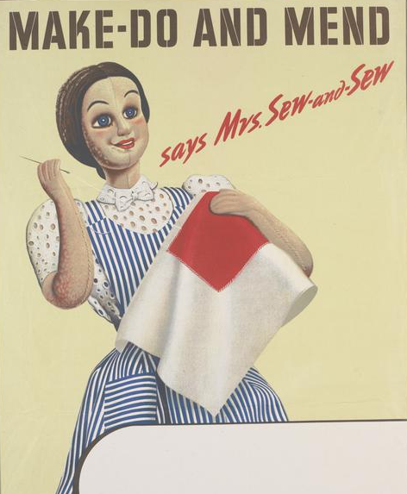
ACTIVITY TWO: Get sewing!
During World War 2, the Government encouraged people to “Make-Do and Mend” to look after their clothes and learn how to repair them.
The Government even created a character called “Mrs. Sew and Sew” who featured in animated films and instructional leaflets, giving sewing tips and explanations.
People became very creative; sewing, knitting, and making their own clothes.
Notes:
Film: Dig for Victory length 05:58

Slide 15
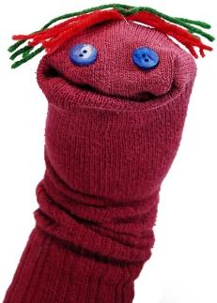
Why not learn some sewing skills yourself by making a sock puppet?
WHAT YOU NEED:
An old sock – perhaps you can find an odd one lying around that doesn’t have a pair?
Scraps of material such as felt
Buttons
Needle and thread
Scissors
A marker pen
Sequins, pompoms (not
necessary but will make
your puppet look fun!)
INSTRUCTIONS:
Put the sock on your hand so you can get a feel for where the mouth and eyes should be.
Use the marker pen to mark out the position of the eyes.
Sew eyes onto the puppet. Buttons look good, stitched on carefully with needle and thread, or you could glue on some googly eyes.
Add character to your sock puppet – use scraps of fabric to make hair, a hat, tongue, horns, a moustache; anything you can think of! Will you make an animal? A monster? A space alien?
How did it feel to make your own sock puppet? Do you feel proud? Was it difficult or frustrating at times? What was the easiest part? Have you learnt any new skills?
Notes:
Image of sock puppet: https://commons.wikimedia.org/wiki/File:Sock-puppet.jpg

Slide 16
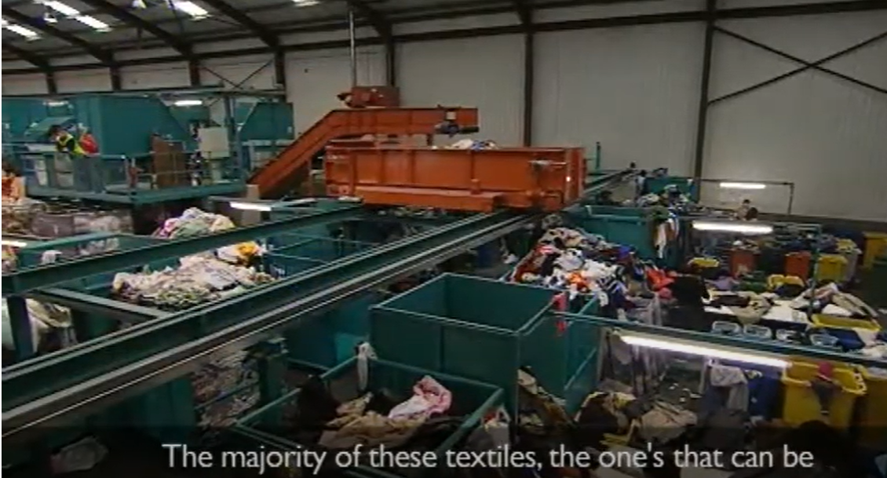
And finally…
A ‘textile’ is a type of cloth or woven fabric. Examples of where textiles are used are in clothing, curtains, cushions, and duvets.
Lots of people do not know that textiles can be recycled, sometimes from your home recycling collection.
Investigate your local recycling collection to see if textiles are taken. What kind of container should they go into? Do you have a ‘clothing bank’ nearby? Check on a map and see how far it would be to walk or cycle there to drop off your unwanted clothing and other textiles.
You can find out what happens to the clothes you recycle here youtu.be/puwKKURGVOI
Notes:
This activity is an extension, suitable for home learning

Slide 17
Thank you for using the Make-Do and Mend teaching pack, we hope you found it useful.
There are PowerPoints available for part 1 and part 3 of the pack here https://zone.recycledevon.org/world-war-2-pack/
You can find lots of free resources about waste, recycling, composting and more on our website:
zone.recycledevon.org/

Slide 18
Credits and acknowledgements
Wartime images:
Imperial war museum
Image of Junior Salvage Stewards badge:
sallybosleysbadgeshop.com
Image of Salvage Stewards badges:
ww2civildefence.co.uk
Copyright Devon County Council, April 2021
Permission granted to reproduce for personal and educational use only. Commercial copying, hiring, lending is prohibited.

