Slide 1
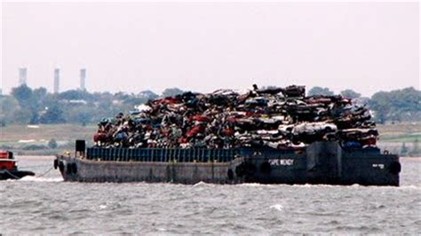

The Garbage Barge
Literacy
KS2
Prepared by Lucy Mottram, Waste Education Officer, Devon County Council

Slide 2
Rubbish words
Rubbish
Garbage
Trash
Black bin bags
Waste

Slide 3
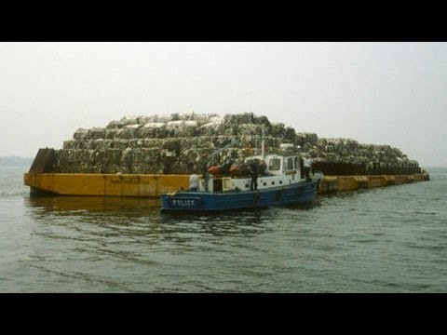

Garbage Barge video links
Documentary Report
Reading of The Garbage Barge by Jonah Winter

Slide 4
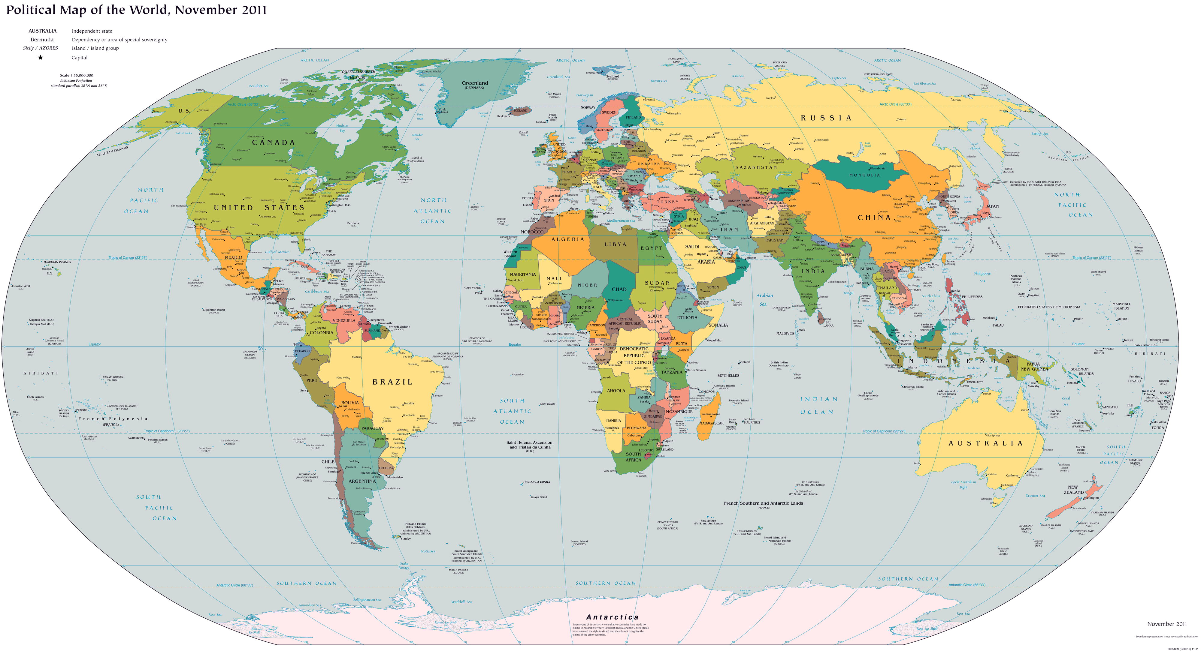

Slide 5
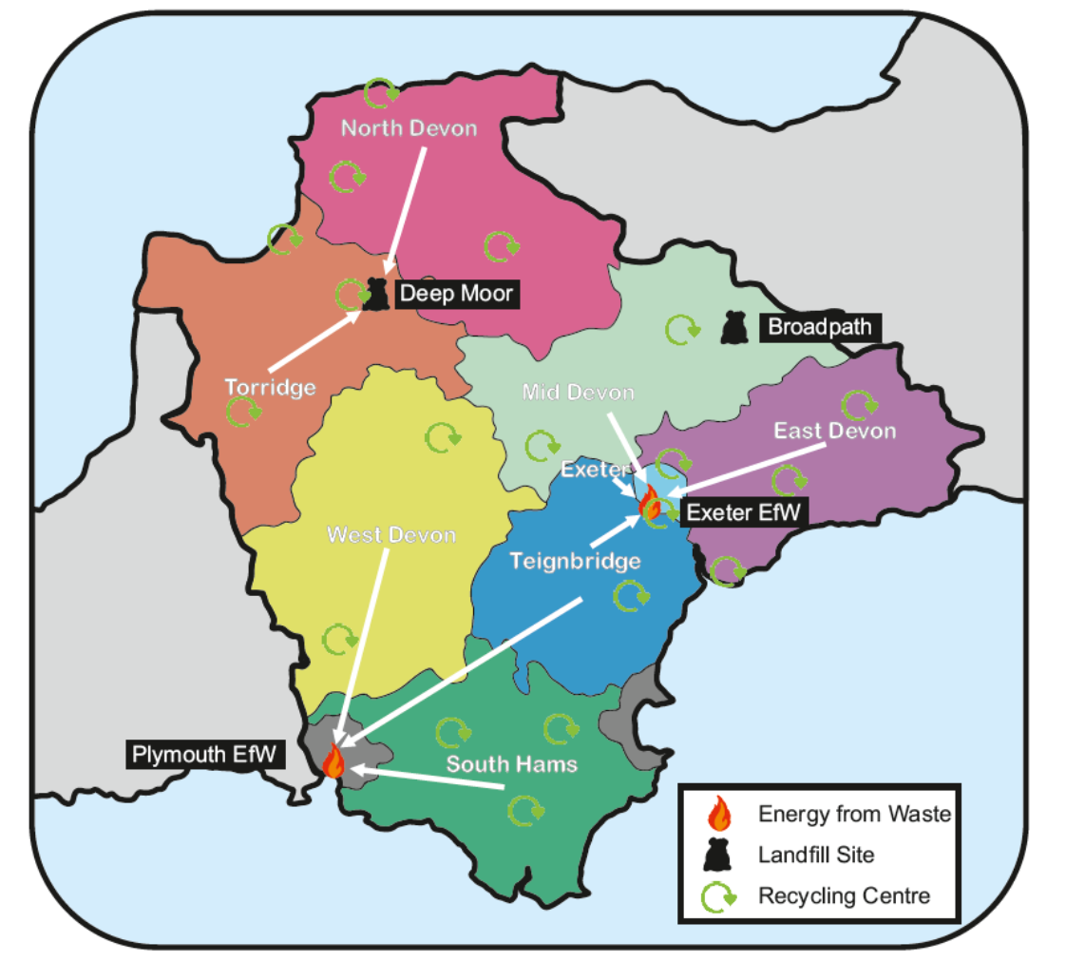
Where does your waste go?
This map shows what happens to your black bin bag waste in Devon, depending on which District you live in.

Slide 6
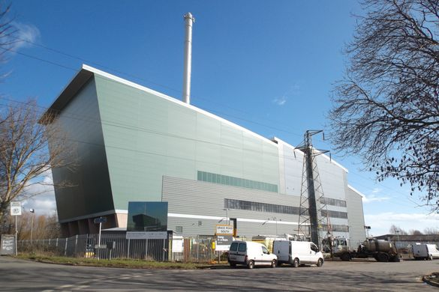
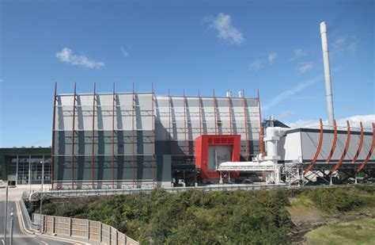
Energy from Waste plants
Exeter
Plymouth

Slide 7
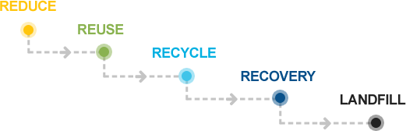
Waste Hierarchy

