Slide 1
Shared Responsibilities
Looking after our Wonderful World
PSHE Lesson KS2/KS3

Slide 2
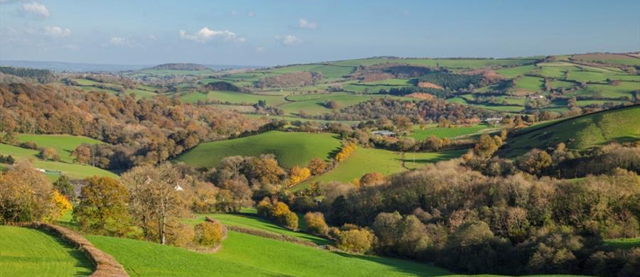
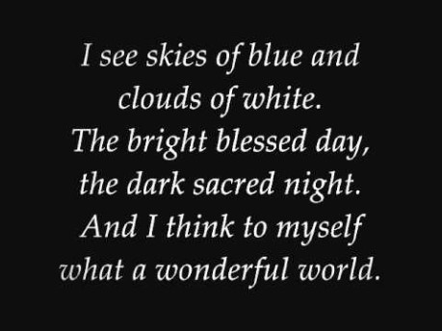
We are lucky to live in such a beautiful place!
Music: It’s a Wonderful World

Slide 3
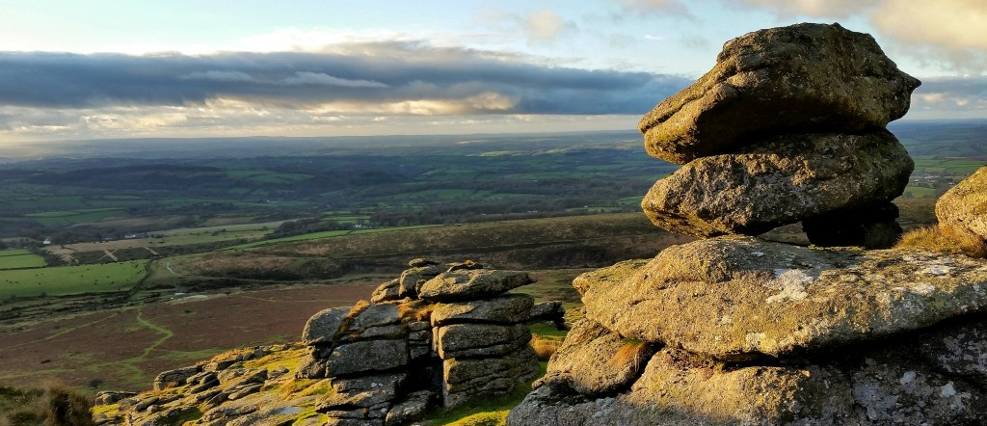
Dartmoor

Slide 4
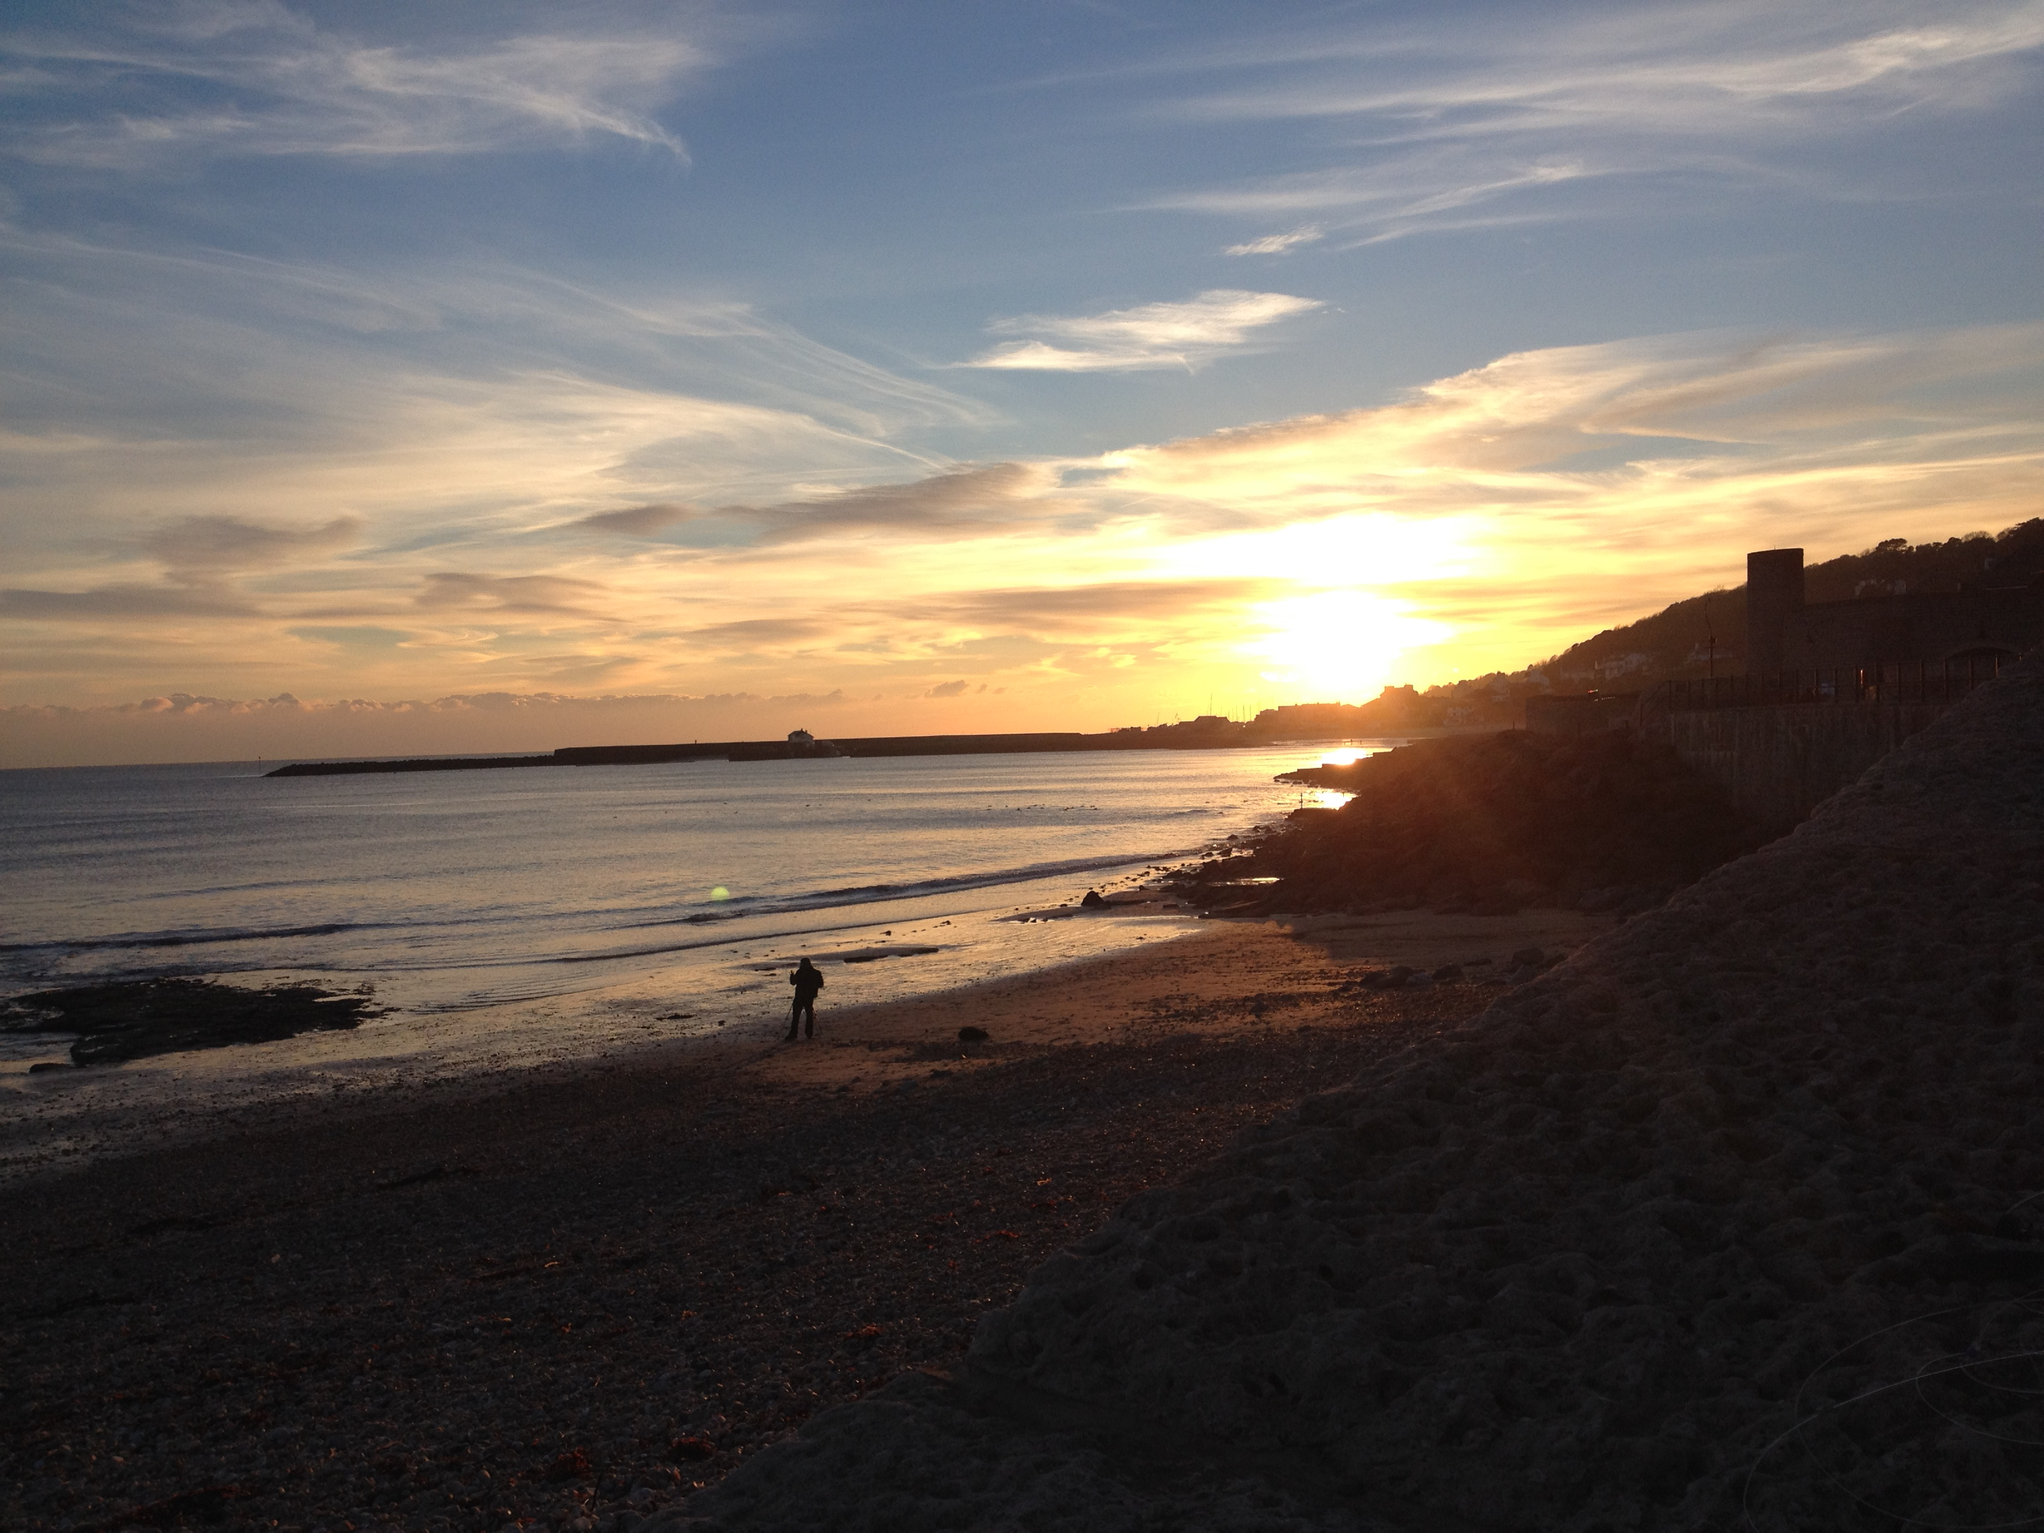
Lyme Regis

Slide 5
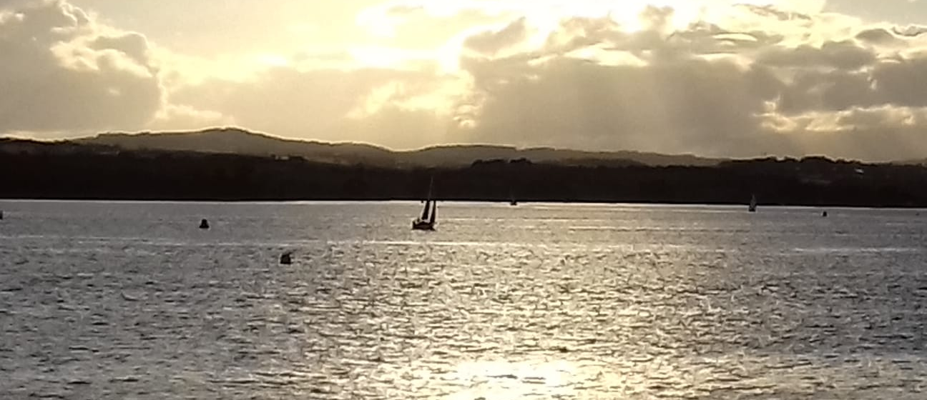
The Exe Estuary

Slide 6
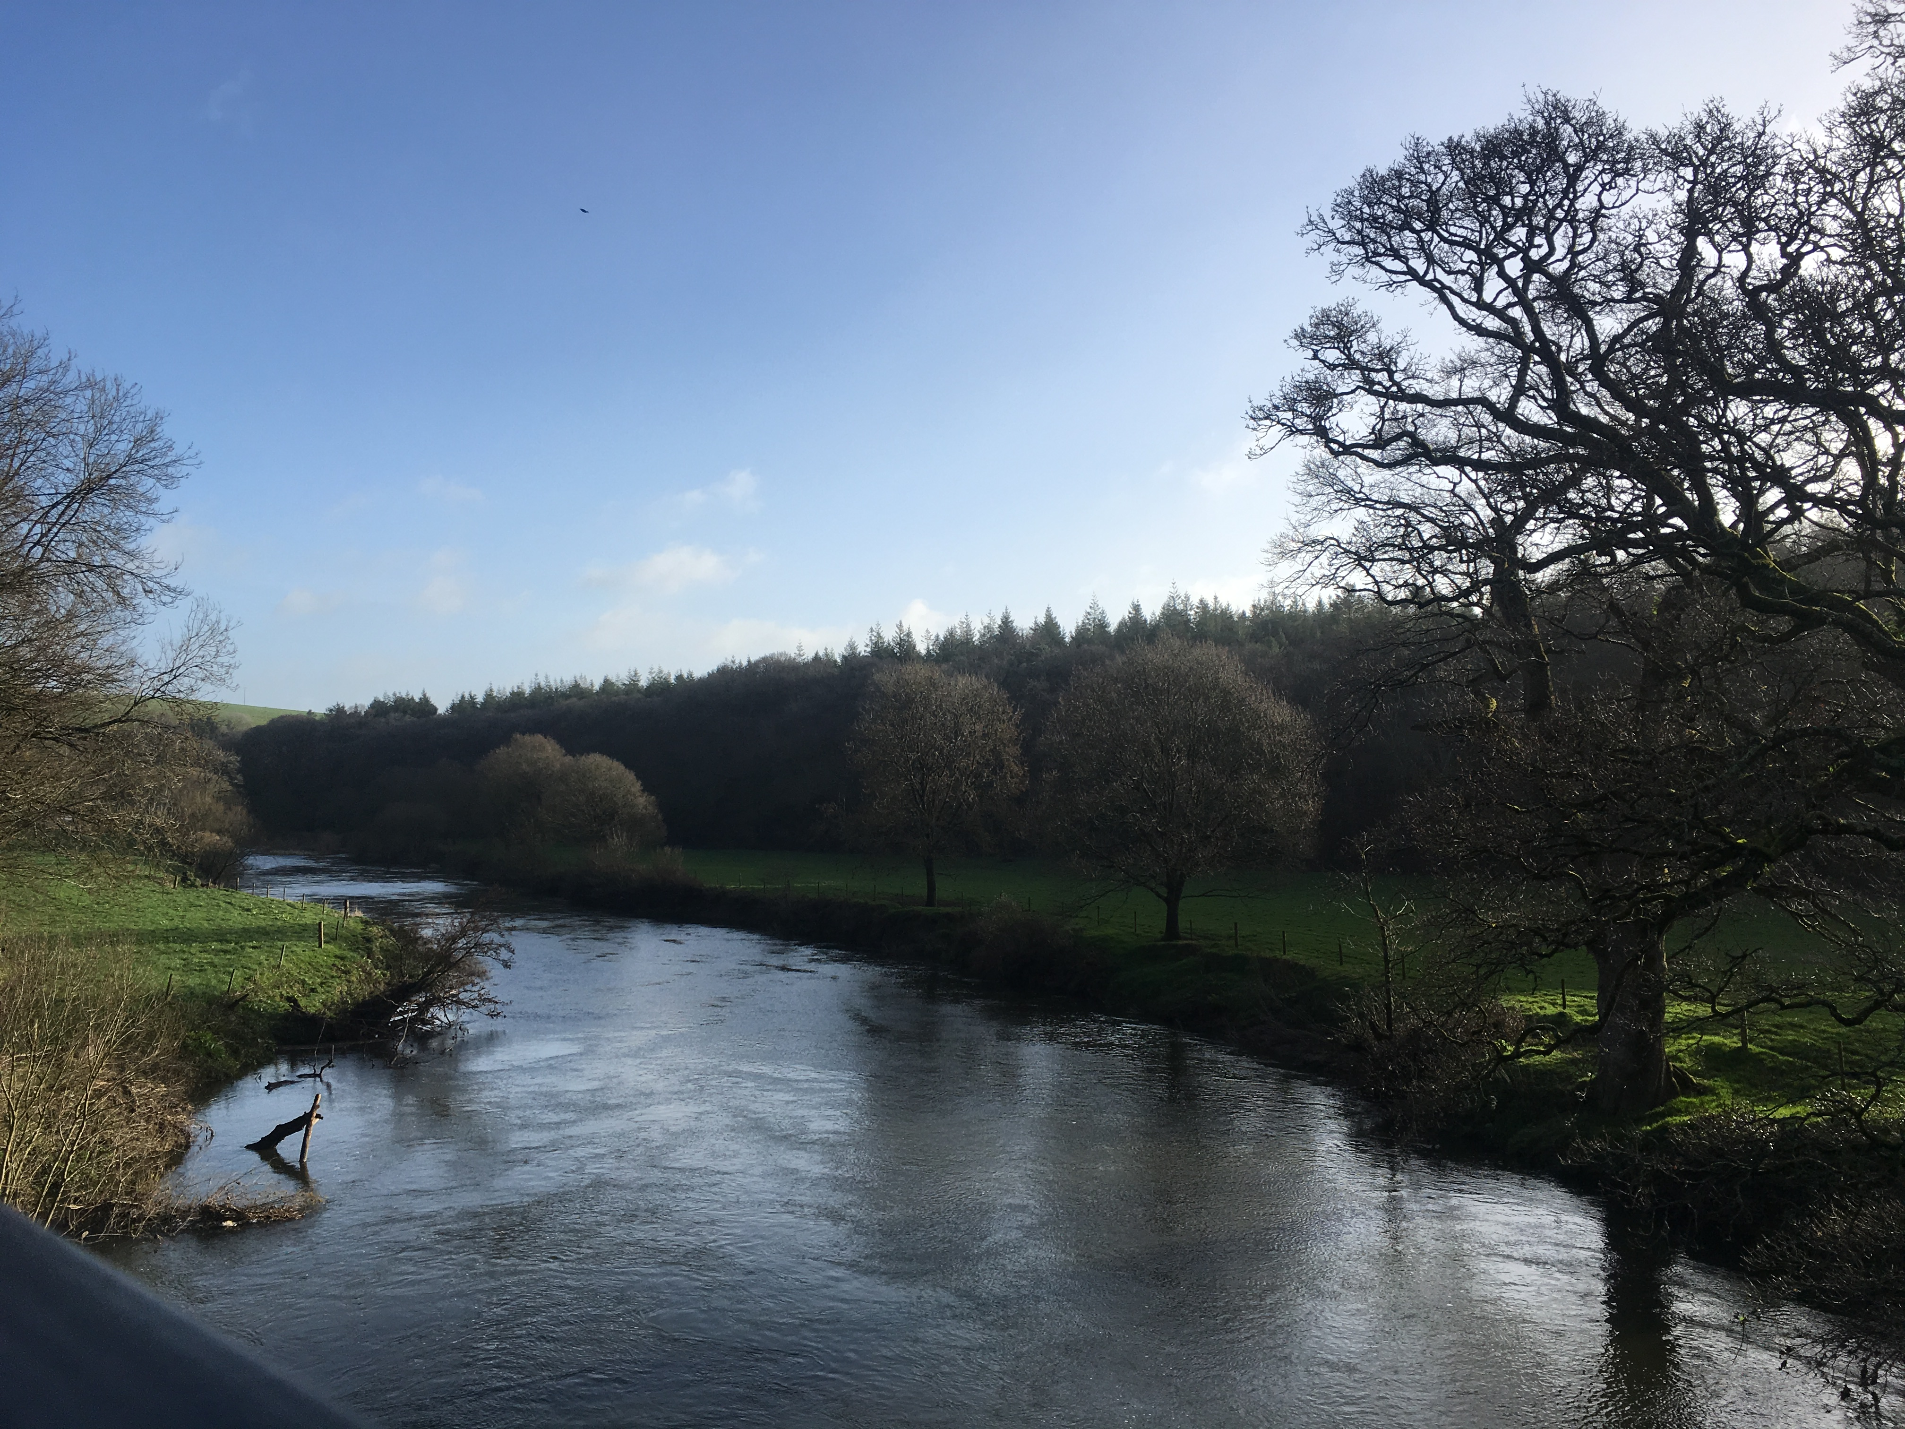
The Torridge River

Slide 7
We are all responsible for keeping it beautiful!
Fill in this table…
Places we love:
Places we would like to go:
The beach
Fiji

Slide 8
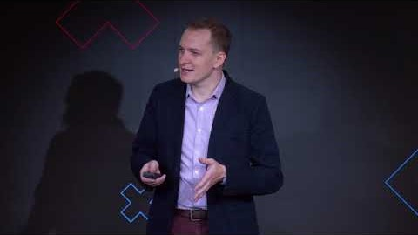
Watch the video:

Slide 9
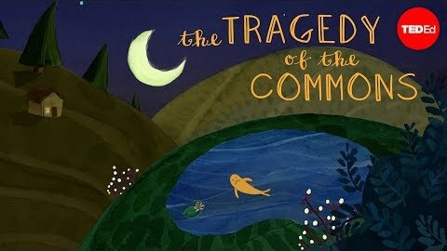
The Tragedy of the Commons

Slide 10
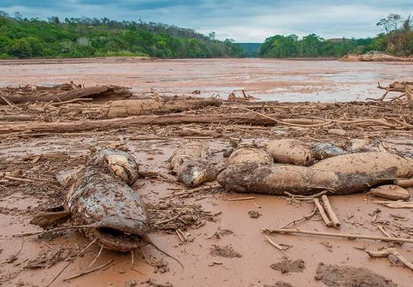
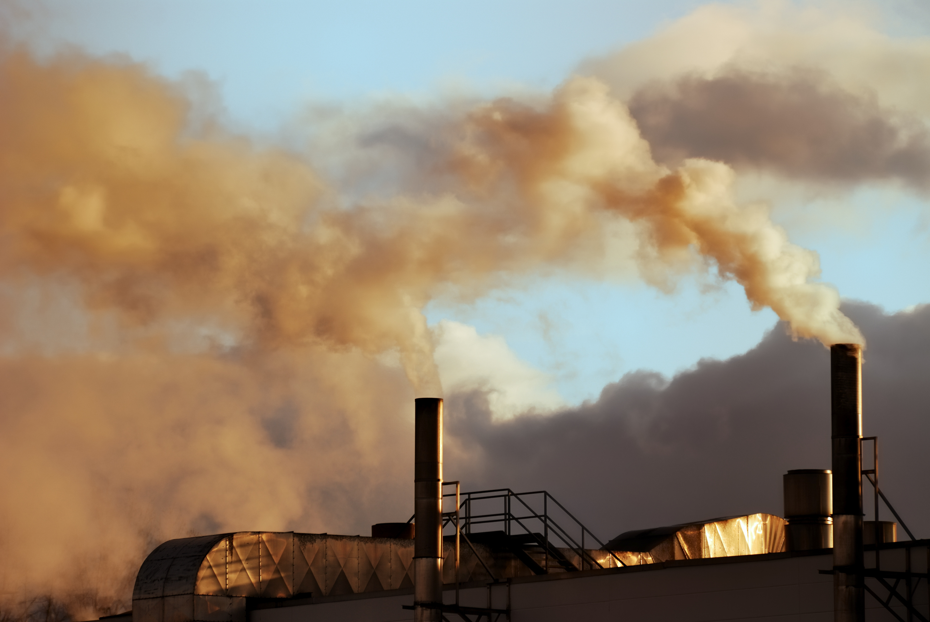
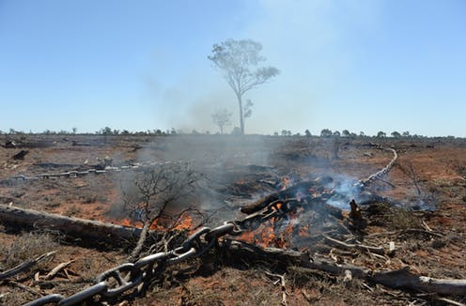
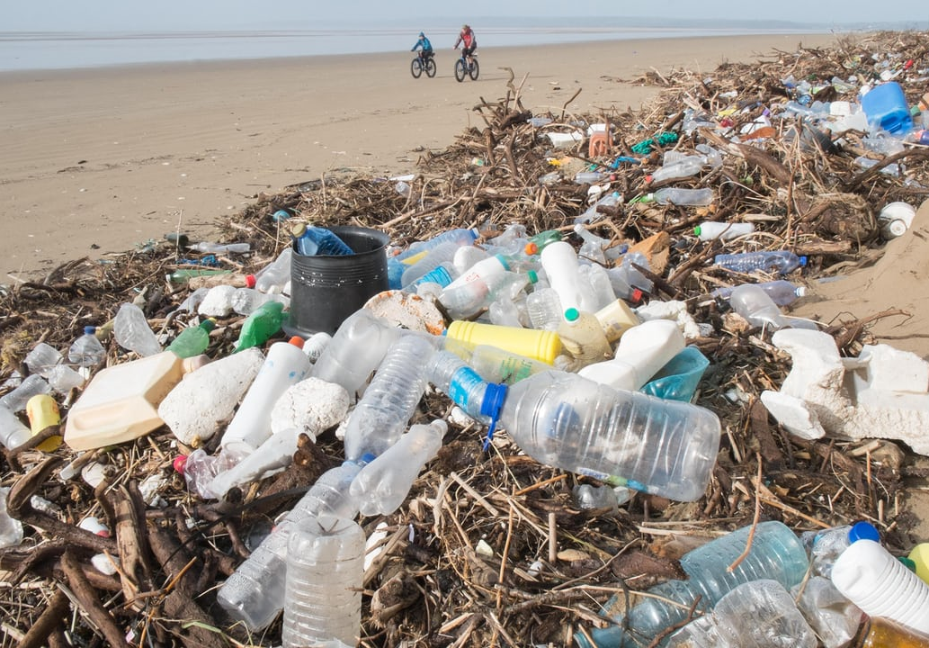
Environmental Issues
Fish dead after mining accident in Amazon
Pollution and greenhouse gas emissions from heavy industry
Deforestation in Amazon rainforest
Plastic pollution washed up on beach

Slide 11
Discussion questions
What is Shared Responsibility?
What do you have shared responsibility for?
Why is it important?
Do we all share responsibility for looking after: our classroom, our school, our world?
Which places do you care about?
Who looks after them?
Explain The Tragedy of the Commons…
What are the solutions?

