Slide 1
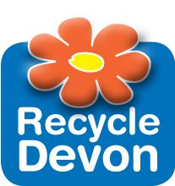
Circular Economy Educational Resource
A Recycle Devon collaboration, made possible from the generous donations from companies around the South-West using “waste” as a resource.
For all Design and Technology departments county-wide.
Notes:
ACTIVITIES/ EXTRA INFORMATION WITHIN THE NOTES SECTION

Slide 2
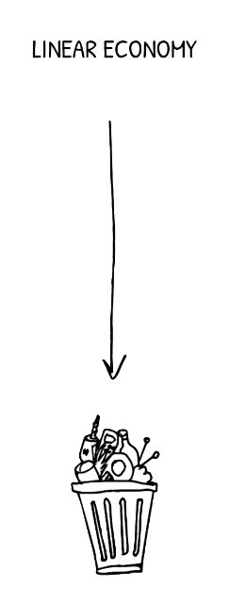

How did we previously manage waste?
In nature there isn’t any waste, in fact, we are the first species to produce “waste” which the planet cannot process
Just over 100 years ago materials and products became more abundant due to industrialisation that people didn’t think they needed to recycle
This meant everything no longer wanted ended up in the bin
This is called a linear economy

Slide 3
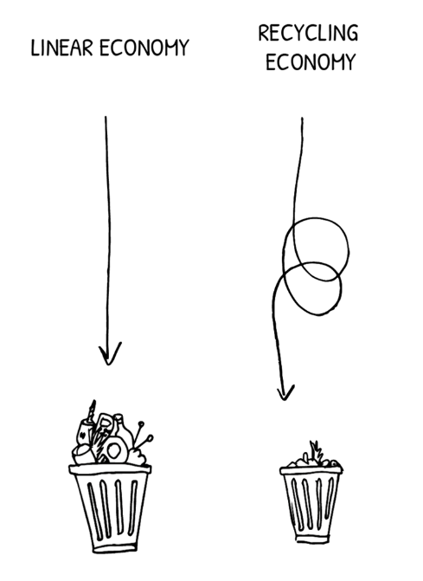
How do we currently manage waste?
It wasn’t until 1990 EU directives related to reducing our waste were introduced.
UK recycling has increased since 1990:
  2000: 13,000 tonnes of plastic bottles recycled
  2018: 350,000 tonnes of plastic bottles recycled.
We now live in a recycling economy- where less waste ends up in the bin.

Slide 4

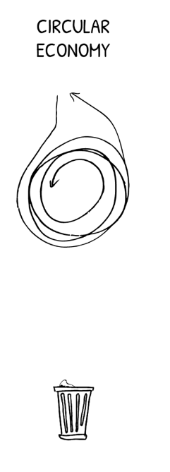
How is this changing?
Many countries are working towards achieving a circular economy- where nothing ends up in the bin.
Wales has committed to becoming a high recycling society by 2025 and circular by 2050.
Will other countries follow suit?

Slide 5

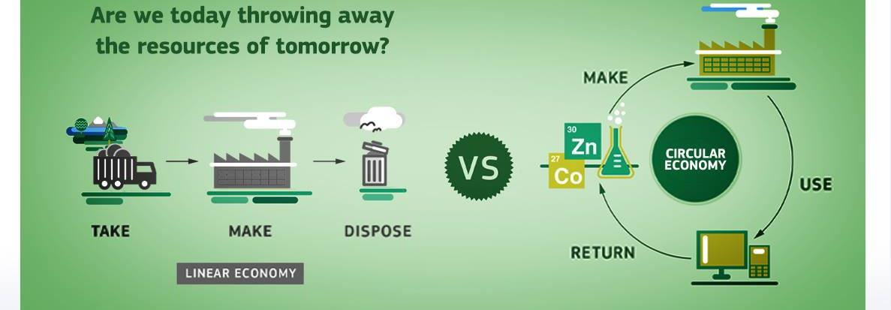
What is a circular economy?
A circular economy is an substitute to a linear economy, we can keep using our resources within our system for as long as possible.
Reuse as many times before disuse
Then recycle and regenerate products at the end of their life

Slide 6
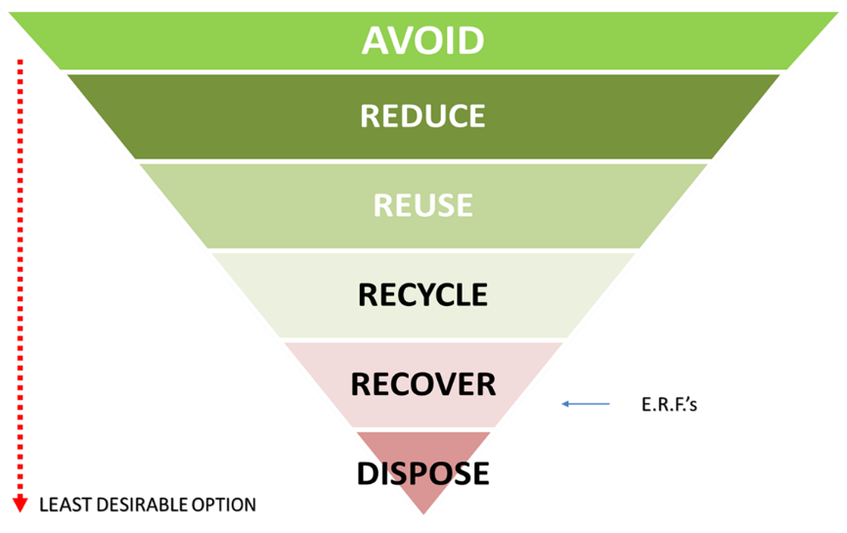

The Waste Hierarchy
CIRCULAR ECONOMY
Last option is to recycle, nothing goes to waste.

Slide 7
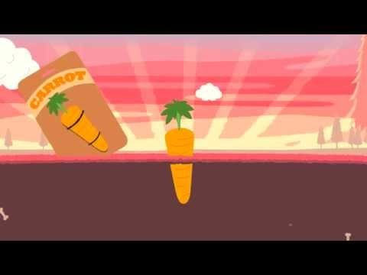
Notes:
https://www.ellenmacarthurfoundation.org/circular-economy/concept

Slide 8
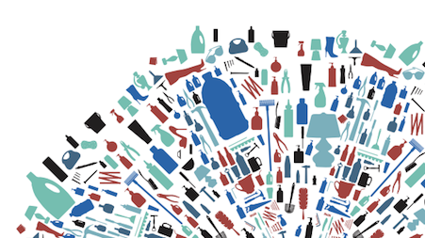
What are some benefits to a circular economy? (Discussion)
Reduces waste
Uses less energy and resources
Solution to the planet's resource shortage
Reduces pollution to our environment

Slide 9
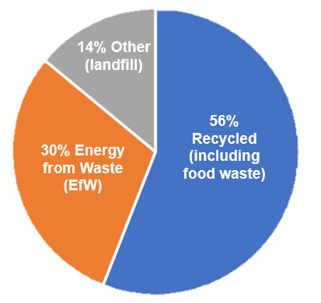
What is Devon doing to become more “circular”?
56% of the waste is recycled, one of the best recycling rates in the country
Raised environmental awareness
More companies are producing products from recycled materials which would have otherwise been wasted
(2018/19)

Slide 10

This resource will explore how local companies are turning waste into new things - creating a more circular economy

Slide 11
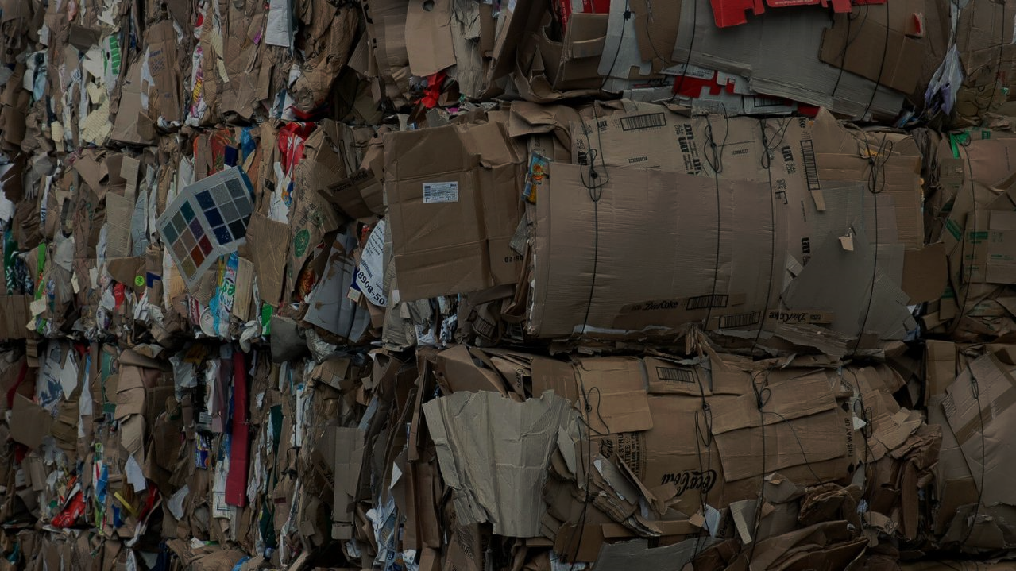

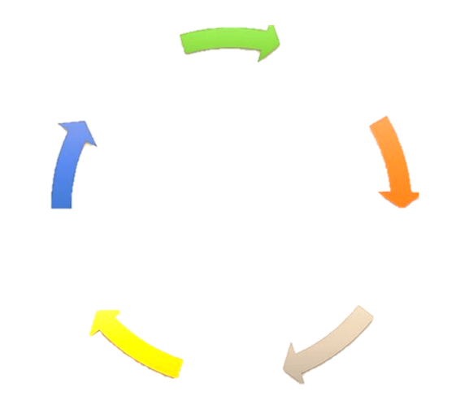
1
Gather recycled cardboard
Corrugated cardboard is made from a natural, renewable resource that is manufactured using high percentages of recycled fibre (up to 88%). The board is often reused multiple times and is recycled more than any other packaging material used today.
The production facility is built on top of a large closed loop recycling system which captures waste directly from the machines and processes it into tightly packed card bales for recycling.
The roof of the Atlas factory has efficient solar panels providing us with power for heating and lighting.
Processed into bales
CIRCULAR ECONOMY
Send back to be recycled
Recycle into cardboard boxes
Recycled cardboard produces 73% less air pollution than if it was made from raw materials- and can be recycled at the end of its life.
Reuse boxes many times
Notes:
Please use the box for storage and extend its life for as long as possible.

Slide 12
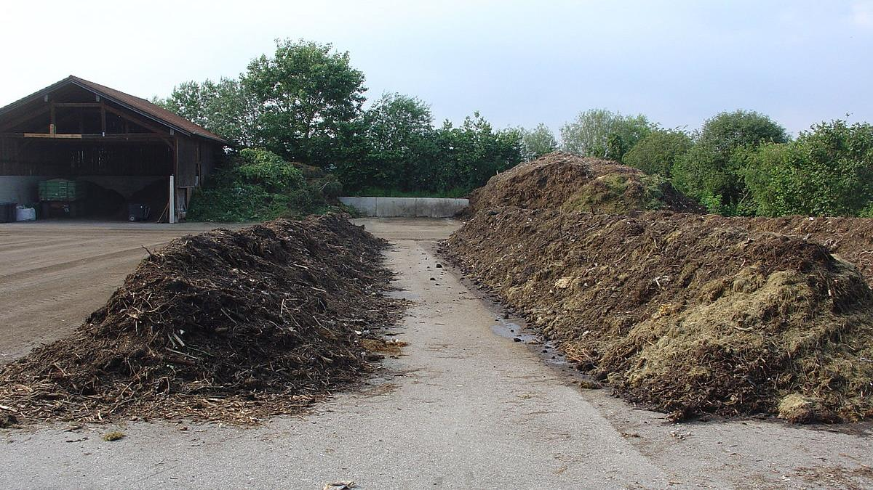
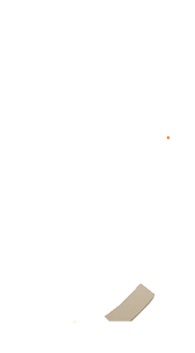

2
Produce compost over 3 months
Recycle garden waste
CIRCULAR ECONOMY
Helps grow plants & produces green waste
Sell compost back to consumer
Green waste is collected from households and businesses, this includes uncooked food waste, flowers, grass trimmings and plants.
Compost is produced from this green waste which is shredded and left in heaps for 3 months at temperatures above 60˚C to kill pathogens and weeds.
It can then be sold and applied to gardens and fields to help grow food and plants.
= A perfect example of a circular economy
Can you draw it?
Apply to fields and gardens
Disclaimer: plastic pot used to hold the compost have been reused, not bought especially for this project.
Notes:
Activity- try and draw this process as “circular”.

Slide 13
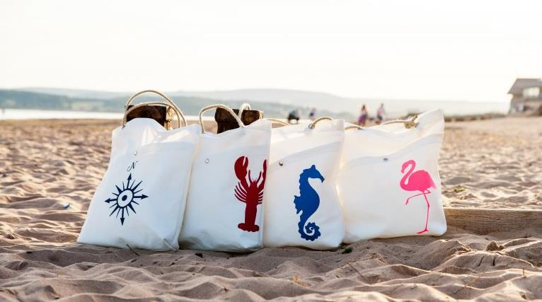

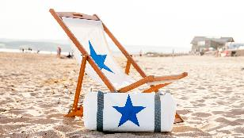

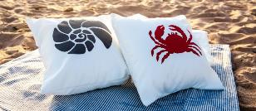
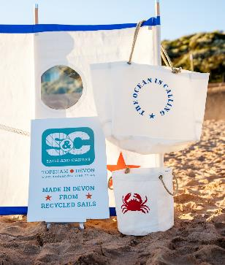
3
Sailcloth is not an environmentally friendly material, not bio-degradable and currently not accepted as a fabric to be shredded and reused as stuffing. By recycling the sailcloth, Sails and Canvas hope their products save some old sails from landfill.
The square cloth material in the resource box is a piece of recycled sailcloth, just like Sails and Canvas use to make their products.
Can you think of any other products which could be made with recycled sailcloth?
Notes:
Answer: Bags, outdoor pillow cases (waterproof material), wine carrier, sunglasses case, signs/banners, deck chairs.
What else can you think of outside the box? …Raincoats?

Slide 14
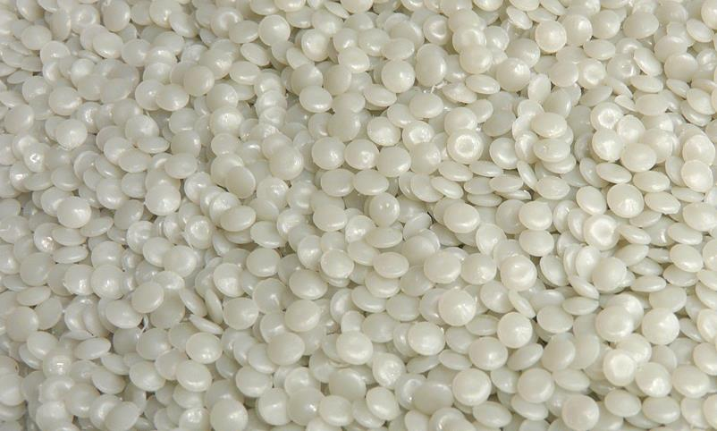

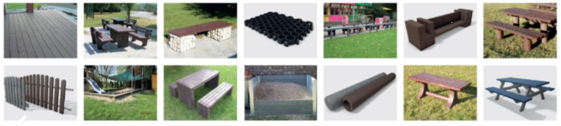
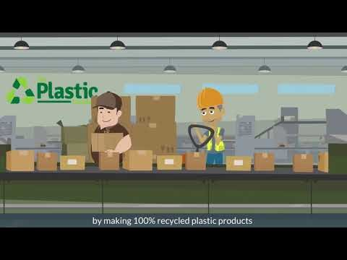
4 - 6
The Plastic Company in Kingsbridge produces 100% recycled plastic outdoor furniture, benches, bins, decking and many other products.
Using a recycled plastic product is thought to use 75% less energy than using oil as a raw material.
In the resource box there is a section of recycled plastic bench, decking and recycled foam.
Time for some quiz questions…
What is the percentage of plastic bottles which are recycled in the UK?
a. 25% b. 43% c. 17% d. 6%
How many plastic bottles do you think it takes to make one Plastic Company bench?
a. 1200 b. 800 c. 50 d. 375

Slide 15
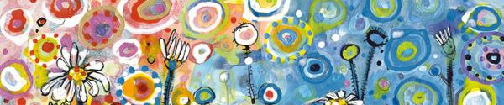
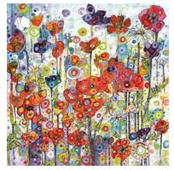

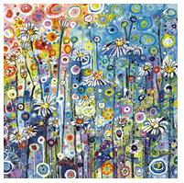
7
Which recycled material do you think the card in your resource box is made from?
50% recycled coffee cup waste
You can recycle it! The Eco-Friendly Card Company ensures that everything can be easily recycled, so don’t use foil, flitter, glitter or plastic-based laminates.
Everything is printed and manufactured in the United Kingdom. The Eco-Friendly Card Company is based near Newton Abbot, Devon and use many local artists for the card designs.
What do you think are the environmental benefits of manufacturing products locally?
Notes:
Environmental benefits:
Less co2 emissions from transport (airmiles)
Stricter environmental manufacturing rules in UK- less pollution.

Slide 16
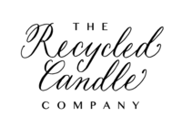
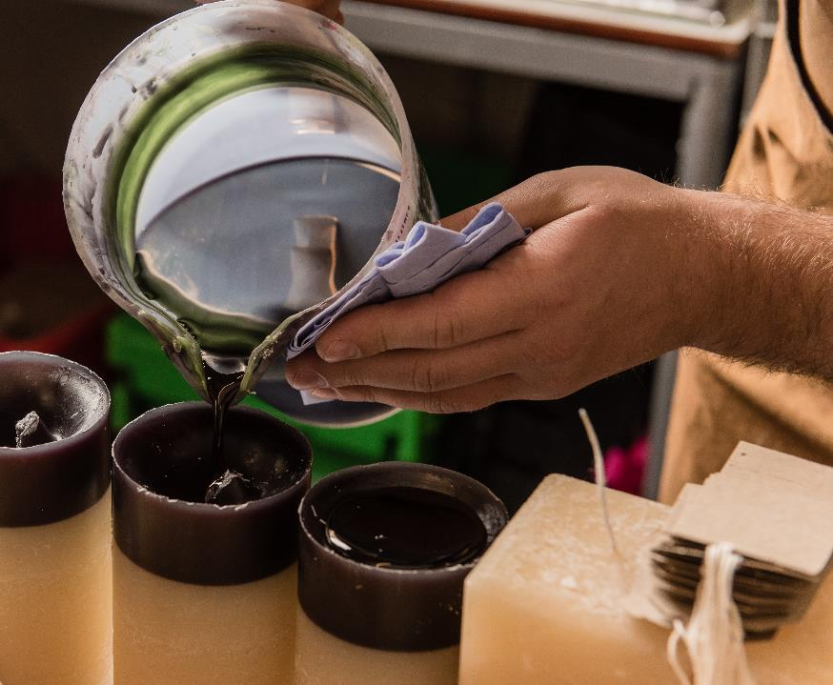
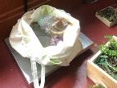
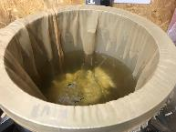
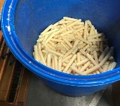
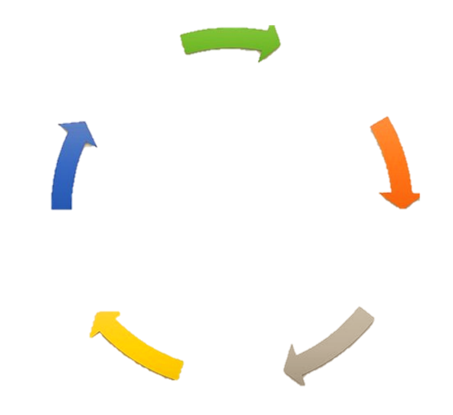
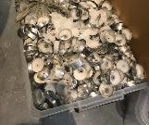
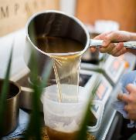
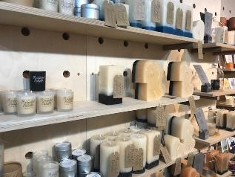
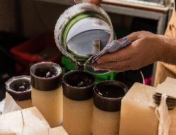
8
Donated wax is weighed
Melted
Filtered to remove wicks and impurities
The only wax recycling business in the UK, previously all candle wax would have been sent to landfill and wasted.
All candles are made on site in Exeter using 100% recycled wax collected from hotels, restaurants, churches and individuals
400 kg of wax is kept out of landfill each month!
CIRCULAR ECONOMY
Used candles taken back to the shop to be recycled sustainably
Moulded into the desired candle shape
Sold in the shop in Gandy Street, Exeter

Slide 17
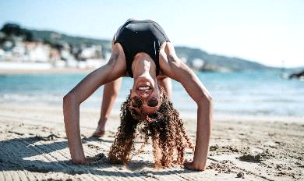
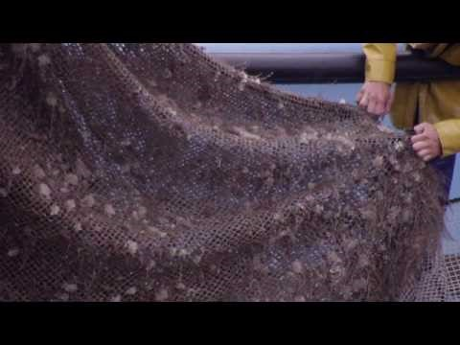

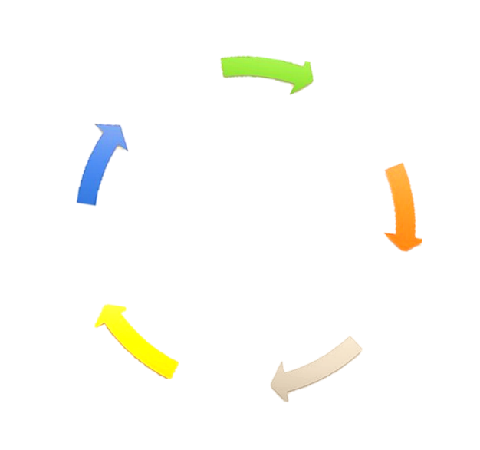
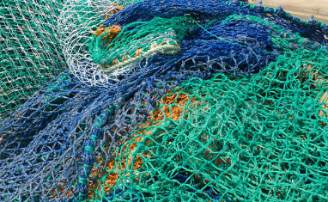
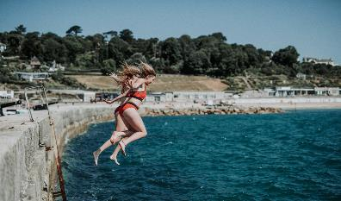
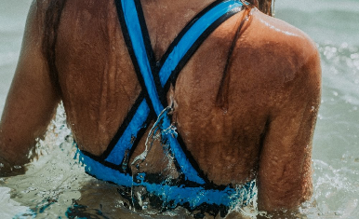
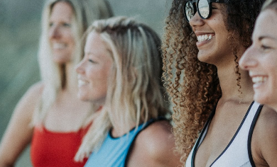
9
Gather fishing net waste from the ocean
Davy J swimsuits are made from 100% regenerated nylon from waste sources. These include abandoned fishing nets and textile discards and made in the UK
The founder Helen Newcombe grew up in Devon
An average of 640,000 tons of fishing nets are left in the oceans every year (1/10 of all marine litter)
For every ton of waste nets collected there is enough nylon regenerated to create more than 10,000 swimsuits
Melt nylon nets into threads
Send back to Davy J to be recycled
Spin regenerated nylon into swimsuits
Wear for many years
At the end of the swimsuit’s life it can be sent back to DavyJ to be recycled = circular

Slide 18
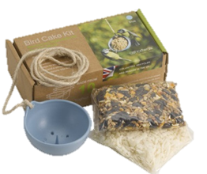

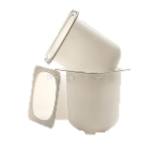
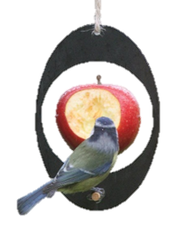
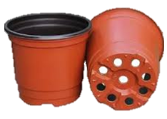
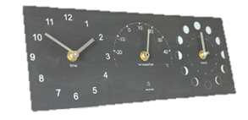

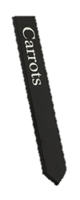
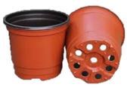
10-13
Made from recycled yoghurt pots. One of the advantages of using yoghurt pots is that they are nearly always white or translucent so Ashortwalk can produce products in a range of colours.
The process: The different materials are collected, cleaned and shredded back down into small flake. We can then melt the flake into new materials and new useful products.
The process is completed in Cornwall.
This bird feeder is made from recycled plant pots. This is also perfect for using waste food to feed the birds, such as old apples or stale bread.
Triple clock made from recycled plastic bottles, and crushed stone powder, the material has a very solid, robust slate-like look and feel.
Looking at the resources in your box, what recycled materials do you think they are made from?
Plant pot labels made from recycled plant pots, a great example of how a circular economy works.
Notes:
Activity: Draw a circular economy circle for one of these products- plant pot labels is the best example to use.
Plant pots are recycled → Chipped up into small pieces → remoulded into new product → sold back to the consumer → used to label plants → at the end of its life can be recycled → FULL CIRCLE.

Slide 19
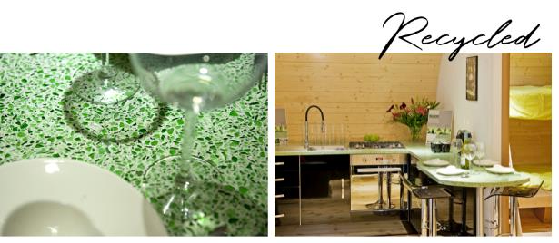

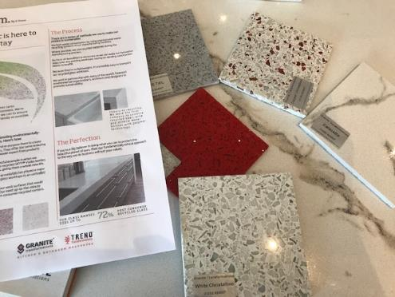
14-15
Recycled glass worktops containing up to 72% post-consumer recycled content.
The glass is crushed and mixed with a binding agent to create the worktops. In the process, water recycling systems are used in the manufacturing facilities to limit water consumption.
This uses 60% less raw material compared to a new granite worktop.

Slide 20
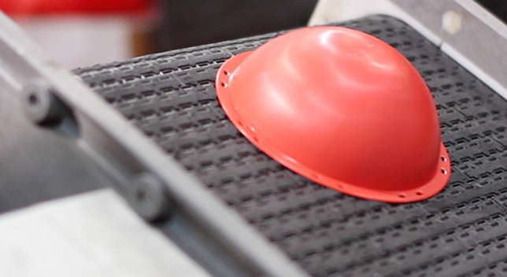




16-17
The resource box contains a coaster and ID card holder made by CHX- they are made from 100% recycled plastic.
CHX Products is a leading UK manufacturer of recycled plastic products for use in promotion, based in Cornwall. The process uses 100% recycled material.
CHX has installed solar panels on the factory roof, producing 30% of the factory's electricity. This is an important step in working towards a carbon neutral business.
Over CHX also invests in recycling factory waste in a re-crush and re-use process.
The last few years Corporate Social Responsibility has become high on the agenda, with many organisations having environmental targets to meet.
→ CHX want to help their customers meet these values by providing recycled promotional merchandise.
Notes:
Possible to discuss what defines a company being responsible (corporate social responsibility)? Several companies we have presented are trying to be more responsible for their actions, carbon emissions and limiting the overall product environmental impact.

Slide 21





18-19
We make some stationary from recycled materials.
What do you think they are made from?

Slide 22


20
Weaver Green is based in Kingsbridge. Their environmentally friendly, recycled rugs look and feel just like wool, but contain up to 3000 salvaged plastic bottles each. All of the products are made in exactly the same way meaning everything sold has helped prevent hundreds of single use plastic bottles from ending up in our environment.
As they are made from plastic, the rugs are stain resistant and hard wearing meaning they can last longer than a normal rug!
How many plastic bottles do you think are purchased globally every minute?
1 million !

Slide 23
Group activity Test your learning
What is the difference between a linear and circular economy?
What does “circular economy” mean?
Can you think of a product you’ve seen today which was made of recycled materials you didn’t expect?
Can you think of something you waste which could be turned into something new?
Create a circular economy diagram for that product.
Notes:
Questions also available in quiz and group circular activity on our website.

