Slide 1
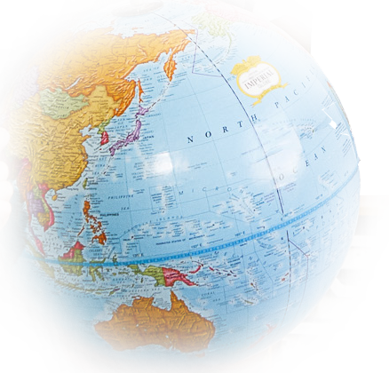
Material World
Plastics PowerPoint for lessons 1 and 2

Slide 2
Properties of plastics – example table
Object | What is it used for? | What properties does it have? | How do these make it useful for its job? | Symbol (if any)?
Water bottle | Containing water | transparent light | The liquid inside can be seen. It is light and easy to transport. | 1
Toothbrush bristles | Cleaning teeth | light flexible non absorbent | They bend so they doesn’t hurt teeth. The brush is light so it’s easy to use. | 2
Saucepan handle | Holding a pan | hard rigid non-conductive of heat opaque non absorbent | It doesn’t bend so it supports the weight of the saucepan. It doesn’t get hot so you can hold a hot saucepan. It doesn’t absorb water so it’s easy to clean.

Slide 3
oil
Russia
finite
7%
1855
transparent
1 million
50 years
refinery
10 million
Notes:
Questions for the Slam game. Read out the questions and ask pupils to select the correct answer from the slide above:
What is plastic made from? Oil
Which country extracts the most oil? Russia
Approximately how many years of oil do we have left? 50 years
What is the name of the place where oil is separated into different parts? Refinery
What % of the world’s oil is used to make plastics? 7%
Which word describes a material which we can see through? Transparent
How many plastic bags are used every minute around the world? 1 million
When was the first plastic created? 1855
How many barrels of oil does Russia produce each day? 10 million
What do we call a resource which will one day run out? Finite

Slide 4
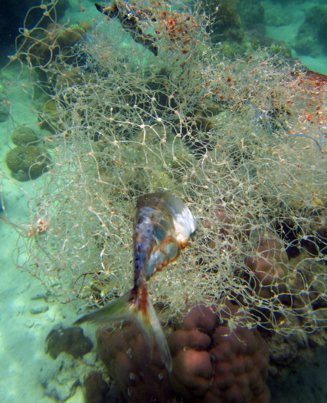
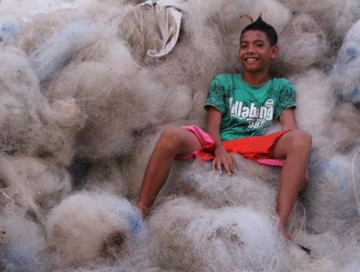
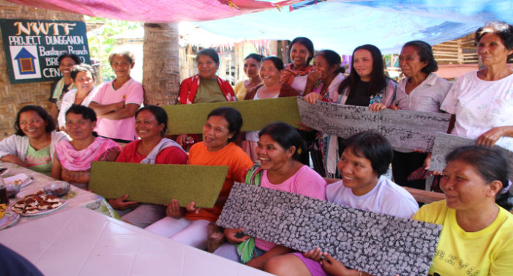
Fishing nets to carpet tiles
Every year 640,000 tonnes of waste material from fishing is discarded in the ocean globally.
Discarded nets float in the water trapping and killing marine wildlife and affecting the livelihoods of local fishermen.
On one island in the Philippines, local people, often unemployed women, collect and clean the nets when the fishermen can no longer use them.
A company called Interface buy the nets and transform them into recycled yarn and then carpet tiles.
Almost 67 tonnes of nets have
been recycled so far.

Slide 5

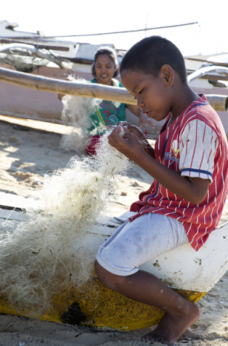

Benefits to people and wildlife
Selling used fishing nets for recycling has given local people extra income to provide for their families. This means they can buy school books for their children, for example.
Fishermen benefit from the recycling project because there are fewer old fishing nets floating in the sea and getting tangled in boats’ engines.
Wildlife benefits by having less dangerous marine litter from discarded nets.

