Slide 1


Our school trip to an efw
[Name of class and date go here]

Slide 2
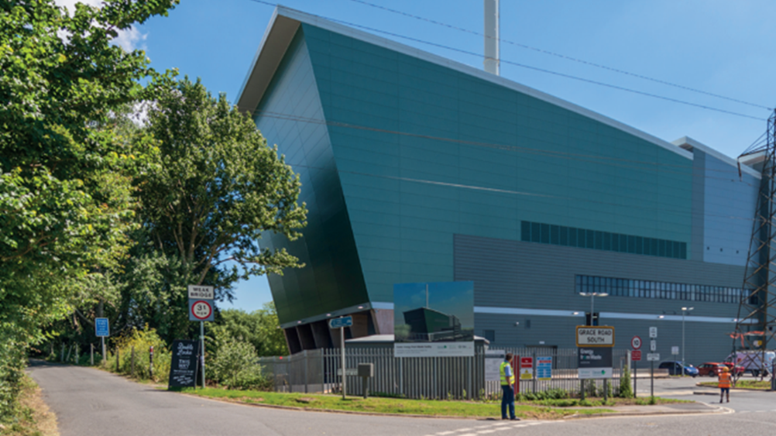
Exeter Energy from waste plant

Slide 3

What does an EfW do?
They burn rubbish to make energy (electricity and heat)
They are better than landfill sites as a way of getting rid of our rubbish
They power homes and businesses
They are on all year round, 24 hours a day, 7 days a week
The bottom ash from the fire is recycled into aggregate for road-building
The gases from the fire are scrubbed clean before they go out of the flue stack (chimney)

Slide 4
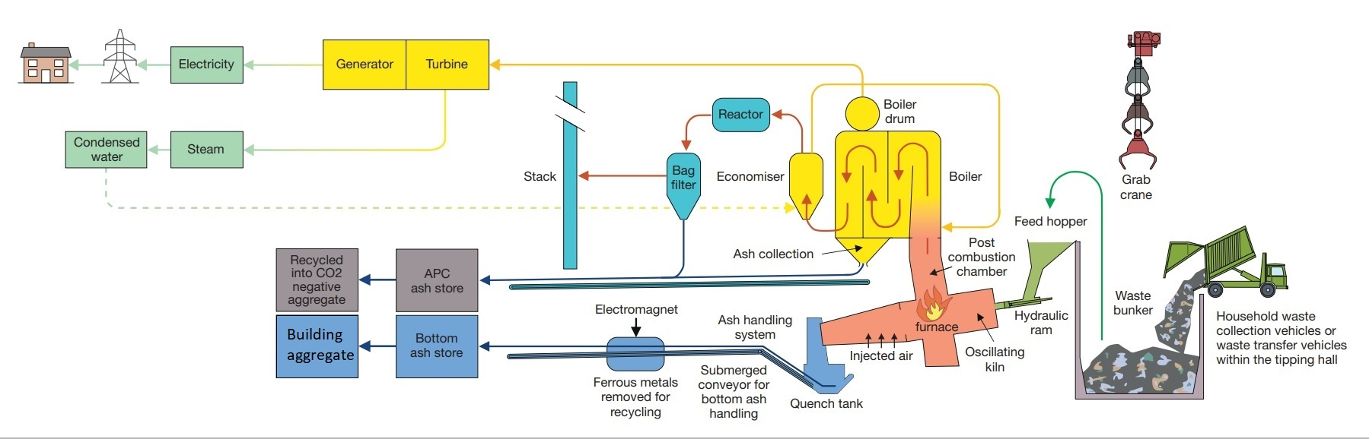
We learnt about the EfW process (Exeter)

Slide 5
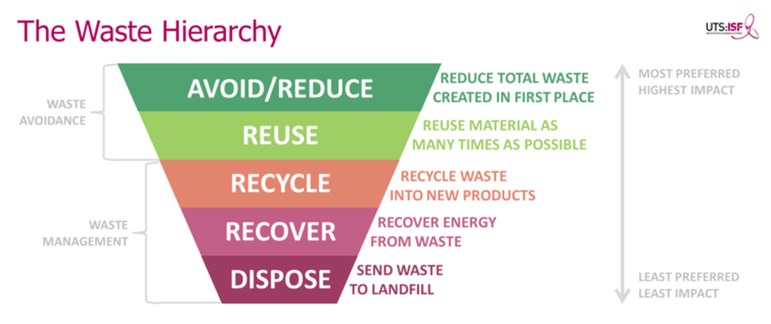
The Three Rs
Reduce
Reuse
Recycle

Slide 6
Things we enjoyed
The Grabber Game
Getting a pencil
Seeing the fire!

Slide 7
Things we didn’t like
E.g. the smell of all that rubbish
The amount of rubbish we all make

Slide 8
Things we learnt
The 3 Rs – Reduce, Reuse and Recycle
How much rubbish we make! (Devon has about 190,000 tones of black bin bag waste to deal with every year!)
Some ways to stop making so much rubbish

Slide 9
The End
We really enjoyed our trip!

