Slide 1
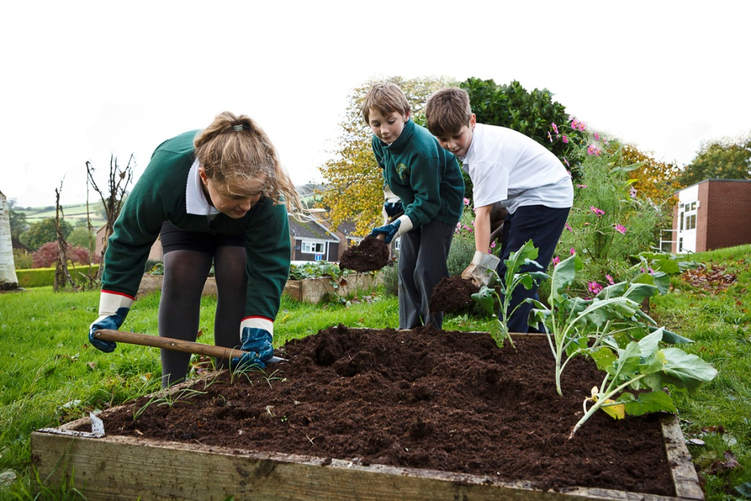
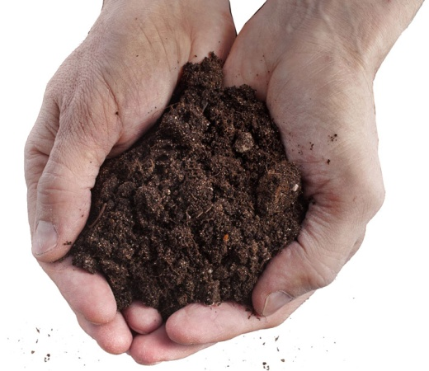
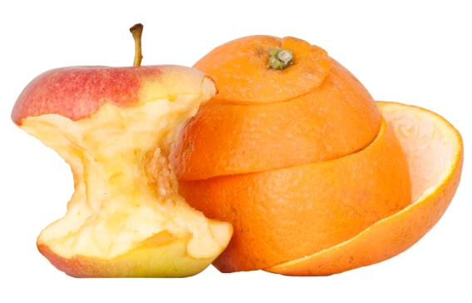
Welcome ************* Primary School to our compost assembly!
Notes:
Use the images in this PowerPoint to help you design your own inspiring assembly. Add in as many images as you can from YOUR school, including ones featuring your pupils, teachers and anybody else involved in composting. (Always check with people before taking their photo.)

Slide 2
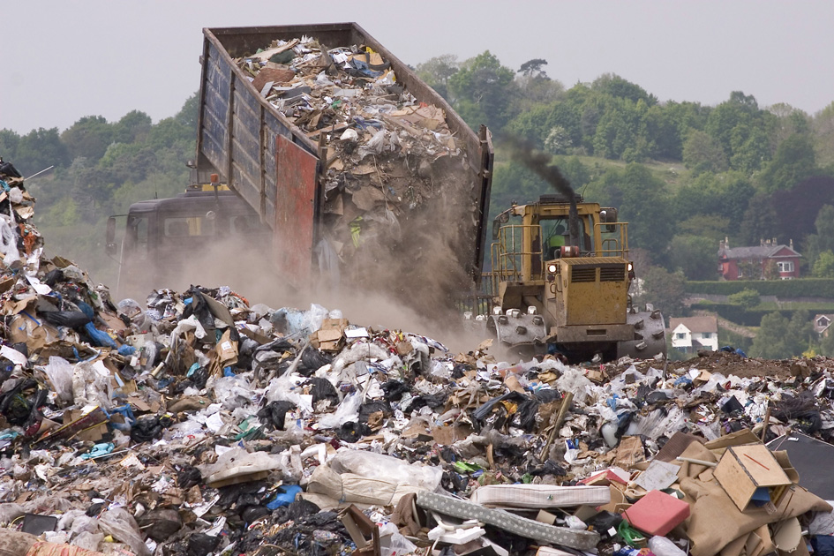
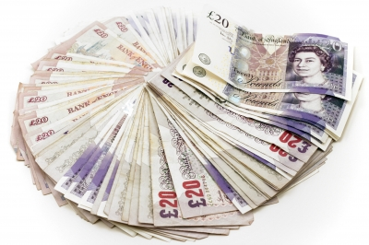
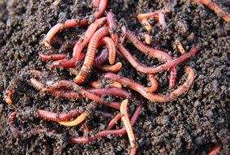
Why compost?
Notes:
Group 1 (one slide)
Landfill sites are filling up fast. Food and garden waste rotting in landfill produce methane, a greenhouse gas which is contributing to climate change.
To save money – by paying less for rubbish collections and not having to buy in compost from a shop.
To help wildlife – a compost bin is an amazing habitat for many creatures who form part of a larger food chain.

Slide 3
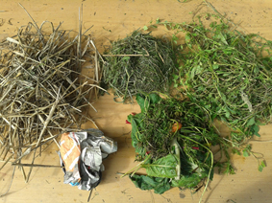
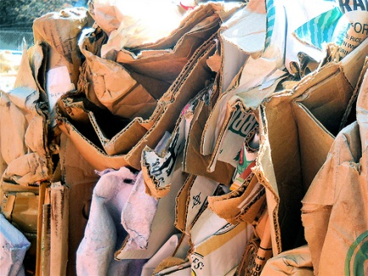
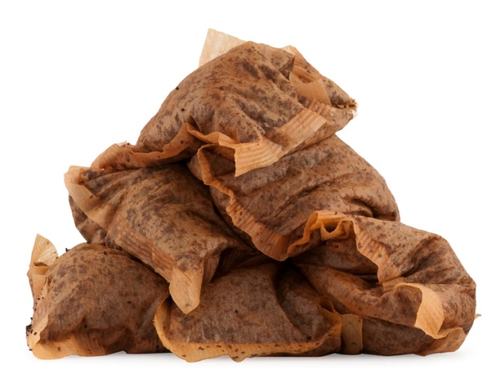
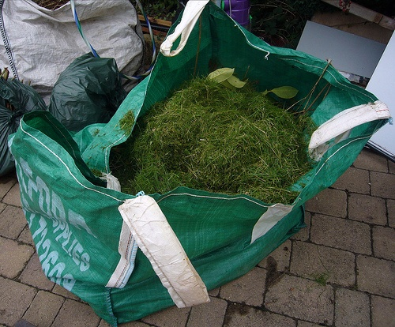
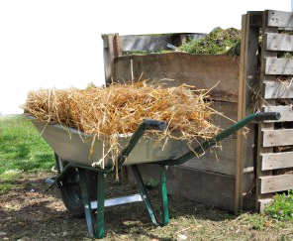
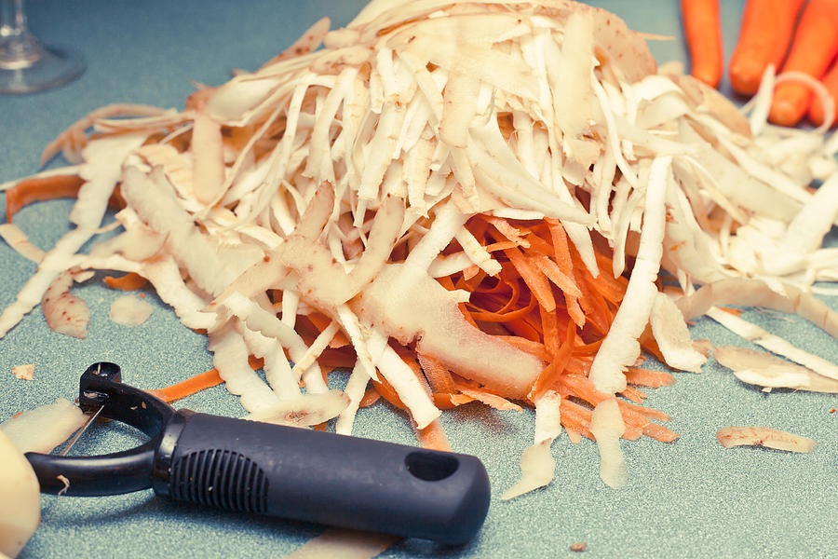
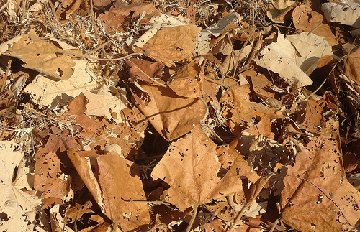
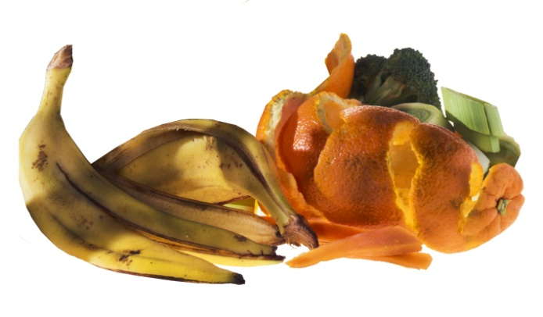
What can we compost in our school?
Notes:
Group 2 (one slide)
We can compost anything which recently lived. Usually this will consist of organic waste such as: fruit & vegetable peels, tea bags, grass cuttings, leaves, small twigs, cardboard etc. If your school has a special ‘in-vessel’ composter, such as a Ridan or Jora, you will also be able to compost cooked food leftovers and meat as these systems are ‘vermin-unfriendly’ and can reach high temperatures to kill off harmful bacteria.

Slide 4
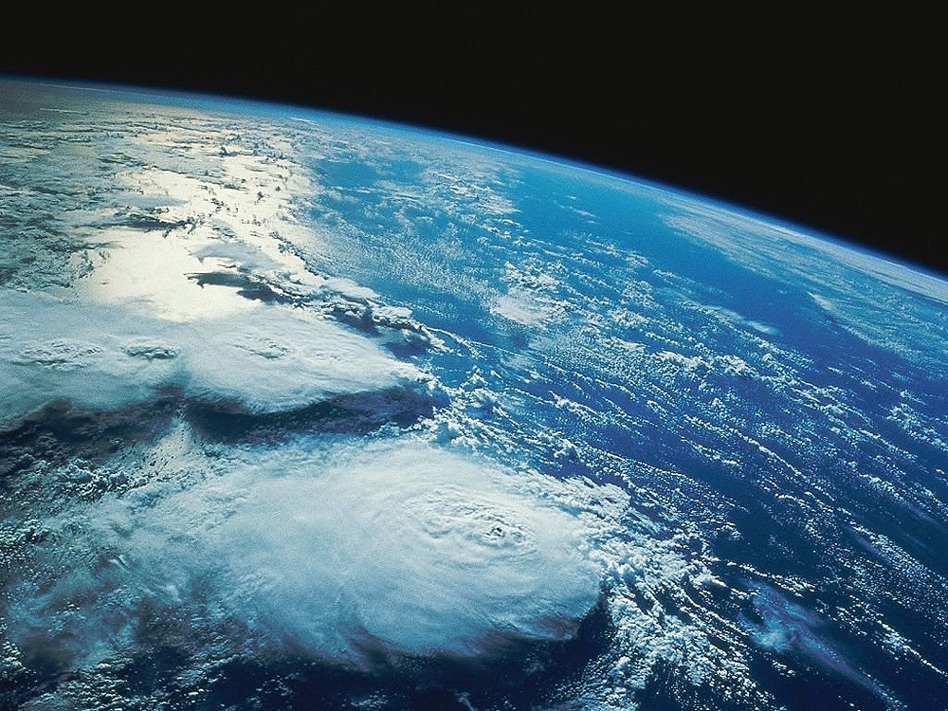
How does compost happen?
The needs of compost are the same as for all life on Earth. They are......
Notes:
Group 3 (three slides)

Slide 5
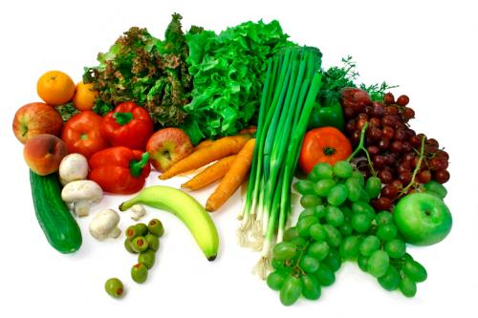
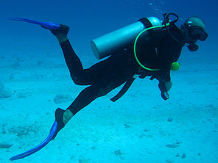
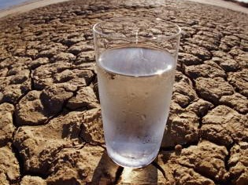
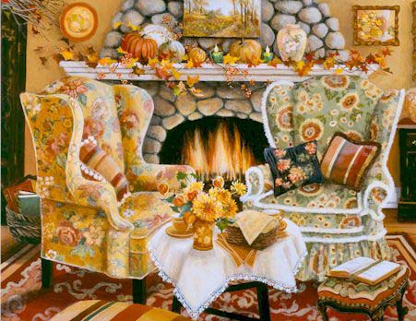
Food
Air
Warmth
Water
Notes:
Food: this is the material we add to the compost bin – fruit peel, tea bags, cardboard etc.
Water: most of the water comes from the wet materials we put in the compost bin, like apple cores and tea bags.
Air: materials such as twigs, cardboard and wood shavings create spaces, or air gaps, in the compost bin.
Warmth: the micro-organisms in the compost bin make their own warmth as they eat & breathe, but the compost also needs some warmth from the sun. This is why composting happens faster in the summer than in the chilly winter.

Slide 6
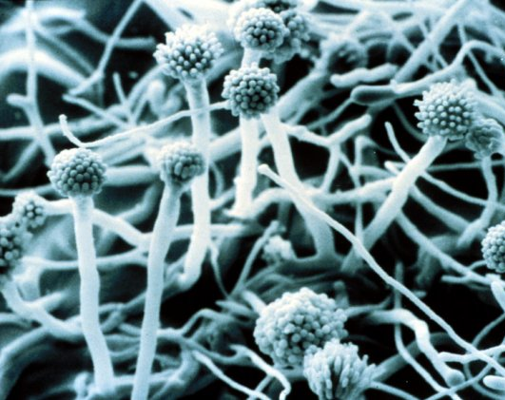
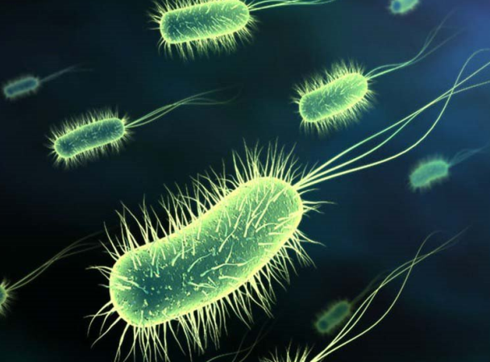
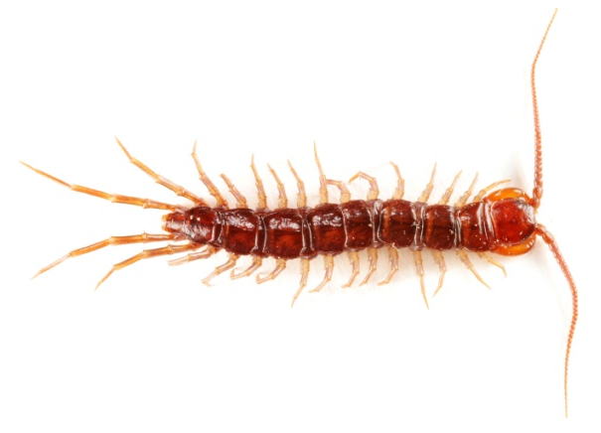
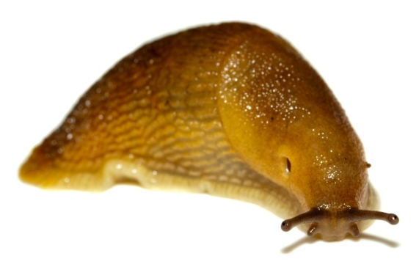
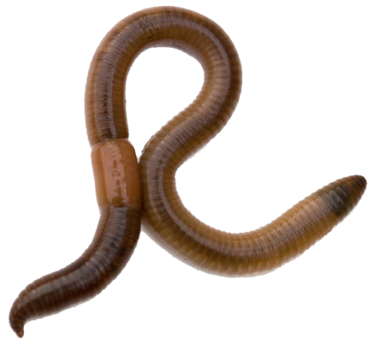
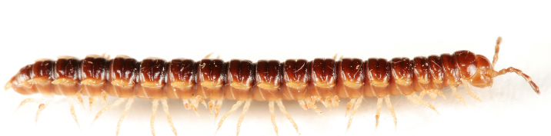
Notes:
Amazing compost micro-organisms and minibeasts eat the materials in the compost bin and recycle it into compost.
Fungi (top left), bacteria (top right) and minibeasts (from left to right: worm, centipede, slug, millipede)

Slide 7
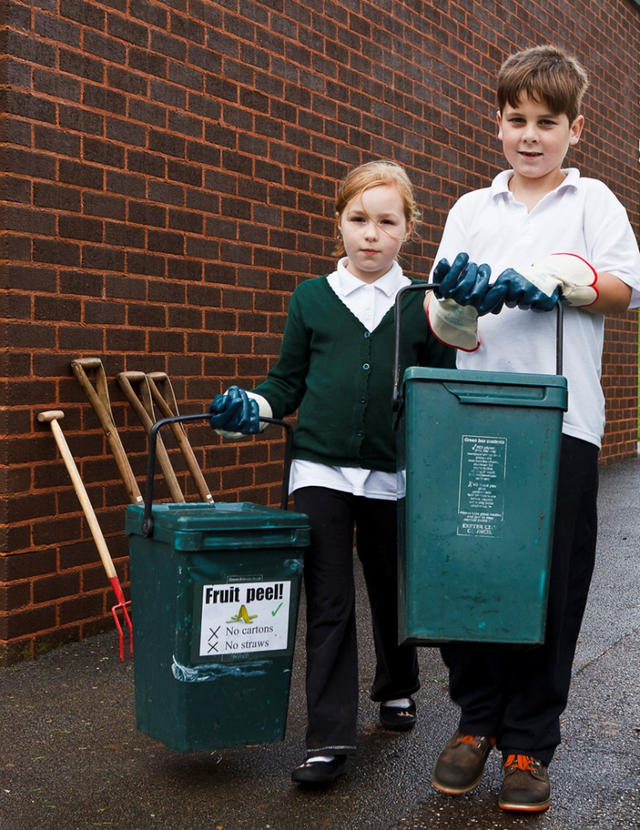
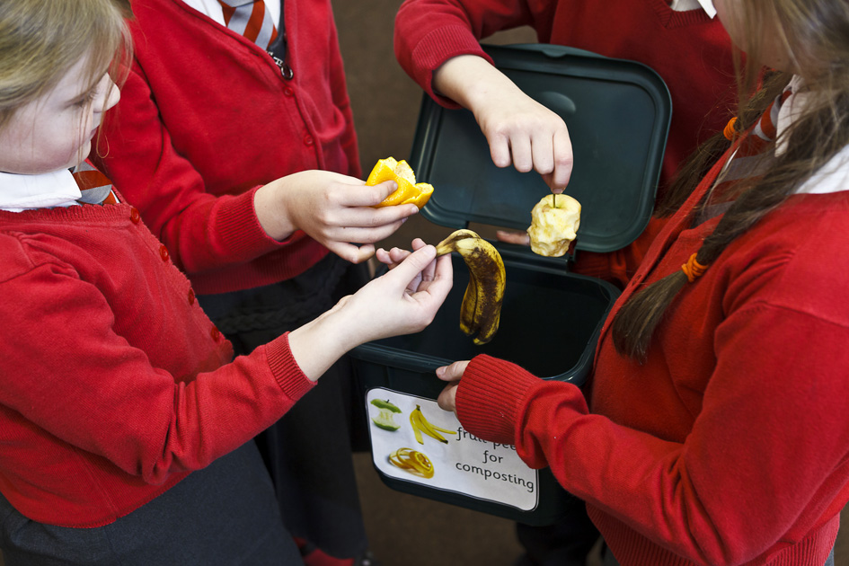
How can everyone get involved?
Add a picture of your school’s composter here.
Notes:
Group 4 (two slides)
Use these slides to show images of your school’s composting equipment and to share key messages. You may want to remind pupils where food waste caddies are located and how to use them. You may invite pupils to join your Eco Team or garden club. Perhaps you are launching a competition to design labels for your compost caddies?

Slide 8
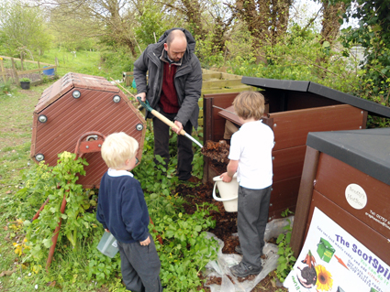
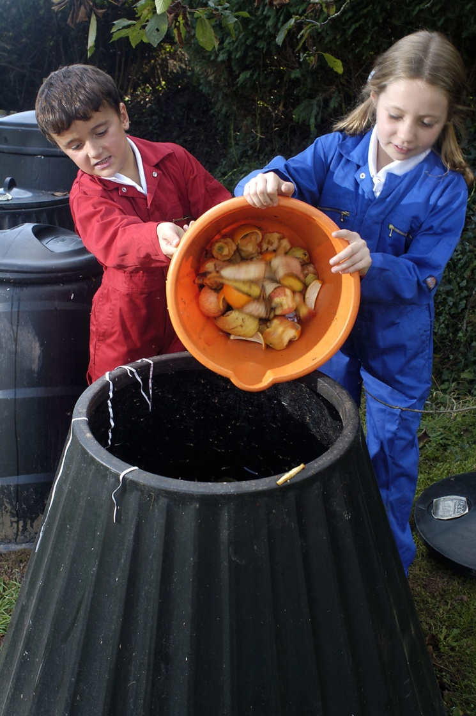

Slide 9
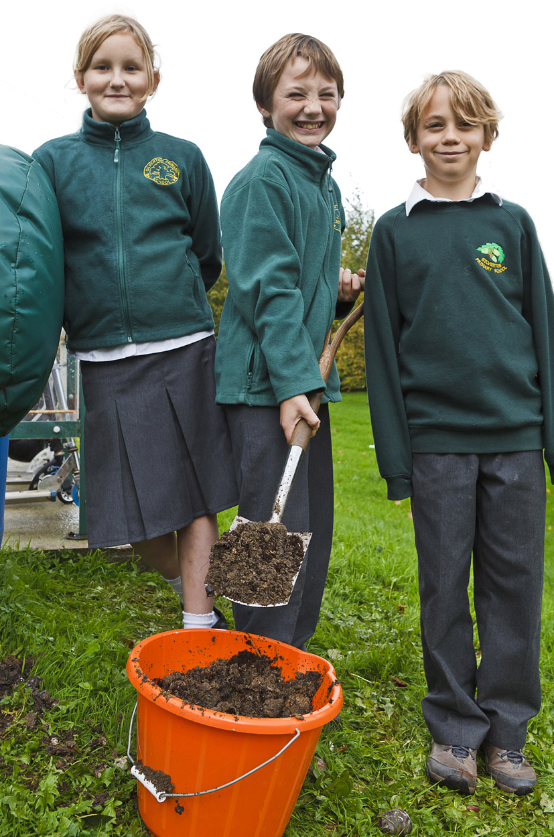
Join in with our compost chant!
Think of all the landfill sites,
Filling up, it’s just not right!
Compost bins are really cool,
In your garden and at school.
Notes:
Group 5 (one slide)
Use this slide for your compost chant – the first two verses are here to help you get started. Try and make the last verse really positive, one option is:
“Work together that’s the plan,
Make a difference? Yes we can!”

