Slide 1

The Textile industry and fast fashion
Media Literacy: Understanding the System

Slide 2
Discussion topic: where do you buy clothes, how often and how much do you spend?
Do you think about where they are made and the conditions of people making them?
Discuss with your neighbour.

Slide 3

Fast fashion Advertisements

Slide 4
Fast Fashion Facts
Fast fashion was developed so stores could quickly turn round high fashion designs from catwalk styles into shops.
A fast fashion garment can take as little as 3 weeks from catwalk to high street shops.
The fashion industry produces 10% of all humanity's carbon emissions (More than most countries do).
It is the second-largest consumer of the world's water supply and pollutes the environment with microplastics (from plastic in clothing like polyester and nylon).
Workers producing garments for fast fashion companies are paid low wages and work in extremely harsh conditions, often in dusty, hot and cramped factories without ventilation.
Workers are often exposed to harmful chemicals and toxic fumes in the bleaching, dyeing and treatment of fabrics.

Slide 5
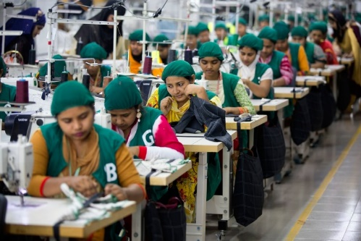
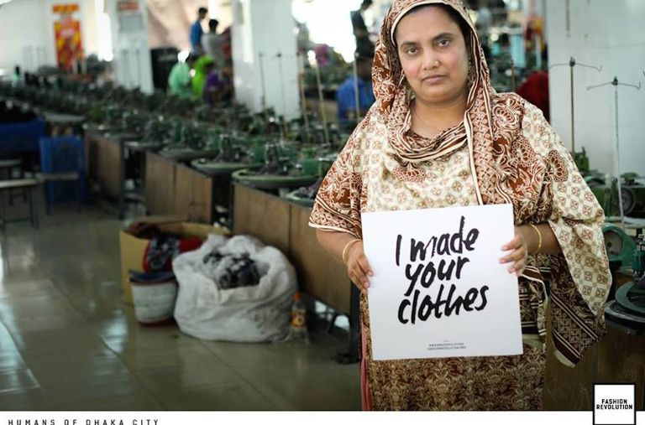
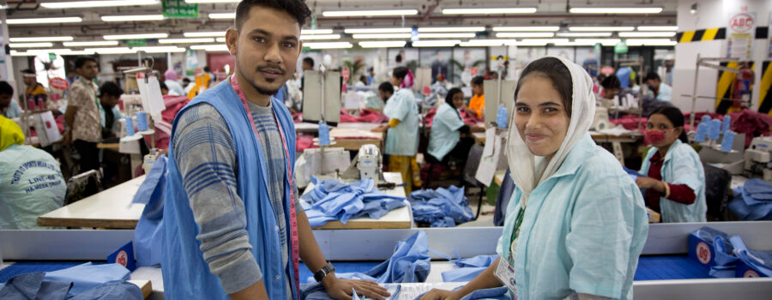
Workers making garments in Bangladesh
Average wage is £0.25 (28 ৳) per hour, though many are paid less than this.
A 1.5l bottle of water costs £0.25 (28 ৳).
Working conditions are often hot, cramped and poorly ventilated.
Use of harmful chemicals and exposure to toxic fumes is widespread, without suitable PPE such as gloves or masks.
Workers are mainly women.
Some have been refused maternity leave.
Children sometimes work in factories.

Slide 6
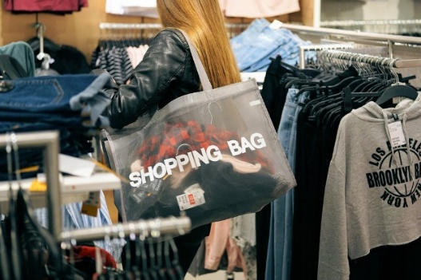
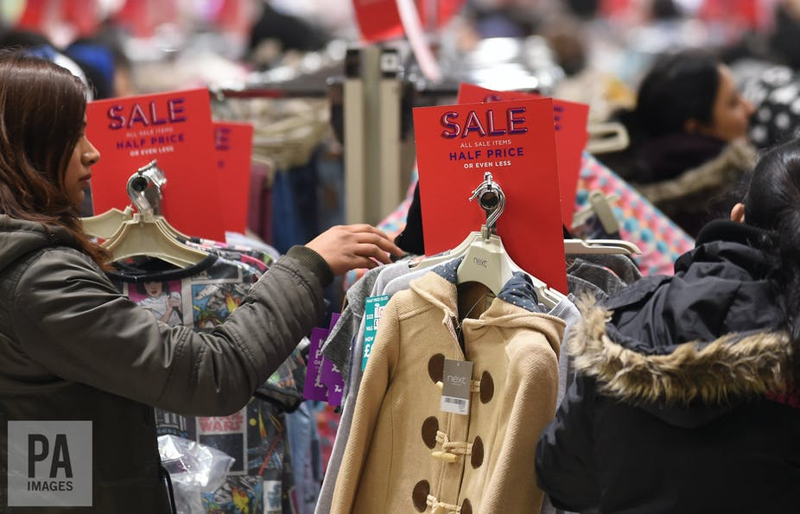
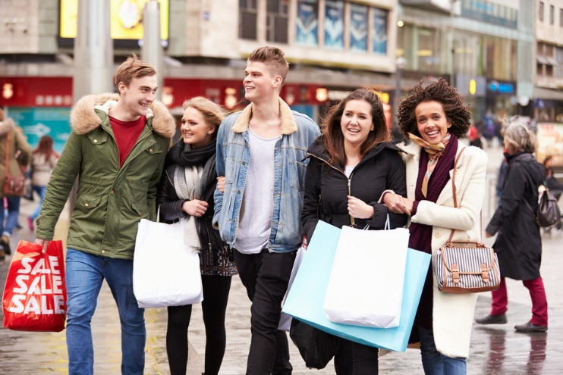
Consumers (people buying clothes) in the UK
If you buy clothes you are already part of this group.
UK consumers spend an average of about £20 per week on clothes.
Clothes are only worn on average 10 times before being disposed.
Half of all fast fashion garments are thrown away after 1 year.
On average clothes are in our wardrobes for only 3 years.
UK adults only wear 44 percent of the clothing they own.

Slide 7
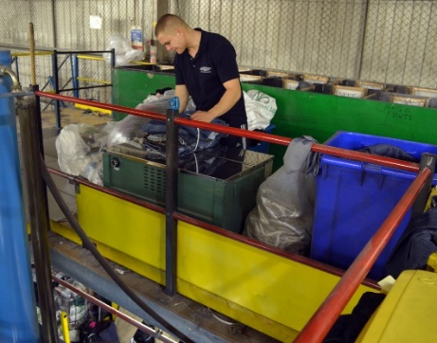
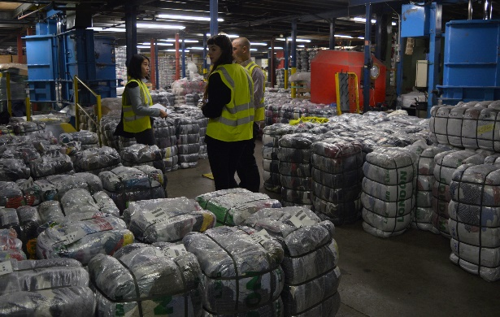
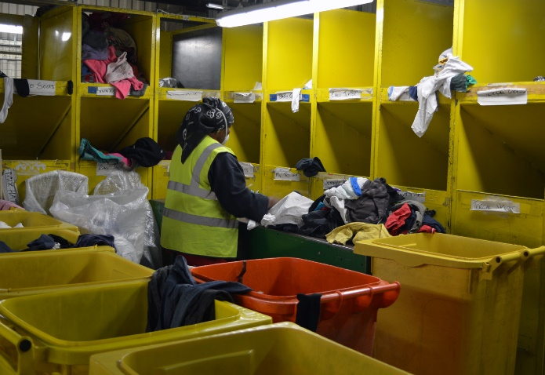
Workers at a sorting line in a clothes recycling centre
Clothes are sorted in recycling centres in the UK.
Jobs in these centres are usually poorly paid compared to other jobs in the UK.
Workers on the sorting line earn about £9 an hour.
As it is considered unskilled labour these jobs are often done by young people or immigrants.
Workers will come across all sorts of things in the waste clothes.
The work is often labour intensive and hard physical work.
The environment can be dusty and dirty.

Slide 8
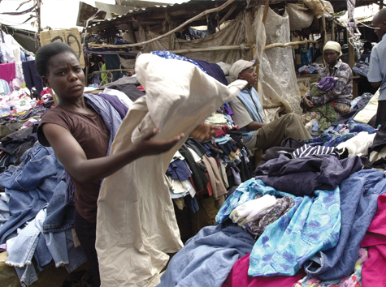
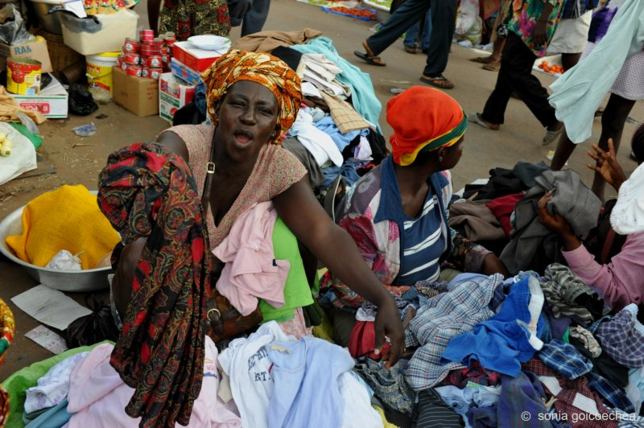
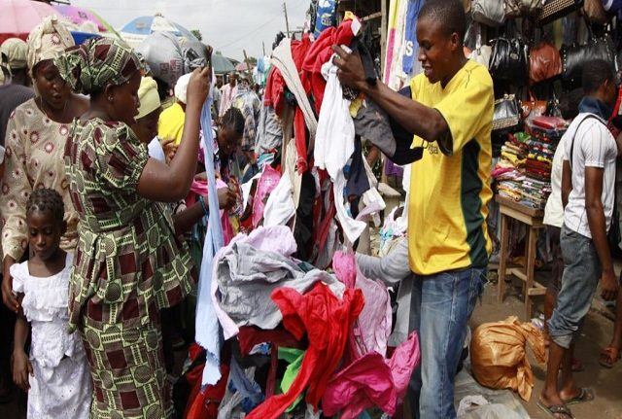
Second hand clothes sellers in Ghana
Most people in Ghana and other parts of
West Africa wear second hand clothes.
Accra is a city of 4 million people.
The markets are busy, noisy and crowded.
Stall holders don’t know what is in the bundle of clothes they purchase from importers.
Income varies depending on the quality of clothes arriving from other countries.
Most people earn just enough to put food on the table.
A bottle of water costs 3 sedis (£0.39).

Slide 9
Plenary Discussion
Think about your group.
What kind of life do they lead?
How do your choices about fashion affect their lives?
What could you do?
Will your behavior change?
Which group would you like to live the life of?

