Slide 1

Material World
Lesson 1:
Introduction to the Material World

Slide 2
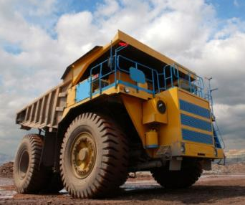
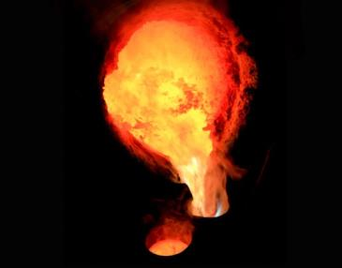
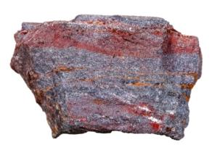
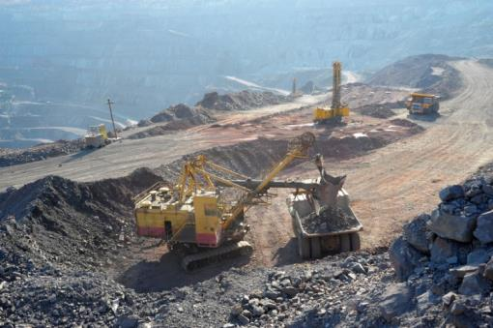
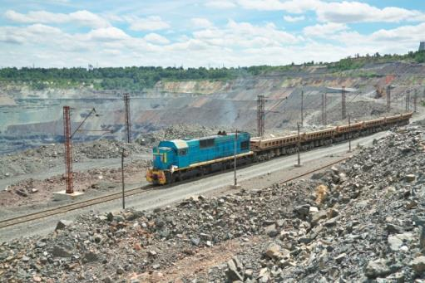
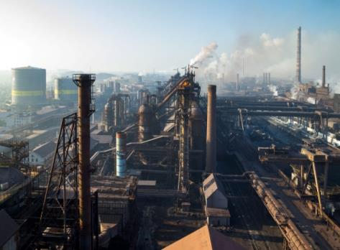
The story of a steel can (part 1)
Steel is made from iron ore. This is mined using enormous drills and sometimes dynamite!
  2 billion tonnes of iron ore are mined each year around the world. Most of this comes from China.
The iron ore is crushed and transported to a smelting works using trucks or trains.
The ore is mixed with limestone and coke and heated to 1,600°C in a blast furnace – this is called smelting.
Notes:
Colour scheme to be updated to tie in with design
Coke is a high-carbon fuel with few impurities, usually made from coal

Slide 3
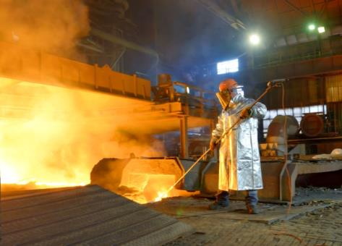
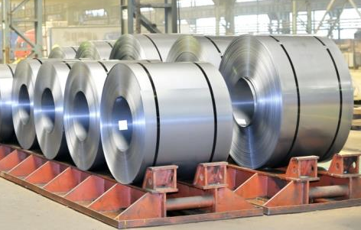
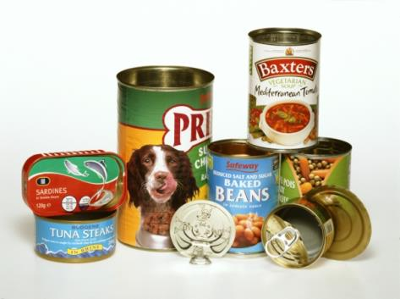
The story of a steel can (part 2)
Oxygen is blown into the molten iron to remove carbon (which has come from the coke.)
This produces steel.
The steel sheets are manufactured into many different objects such as car parts, fridges, cutlery or baked bean cans!
1,665 million tonnes of steel were produced worldwide in 2014 .
The steel is rolled out into thin sheets, ready to be transported to the next factory.
Notes:
Colour scheme to be updated to tie in with design

Slide 4
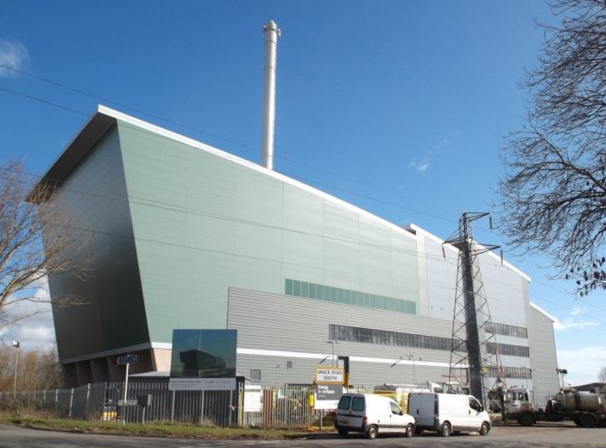
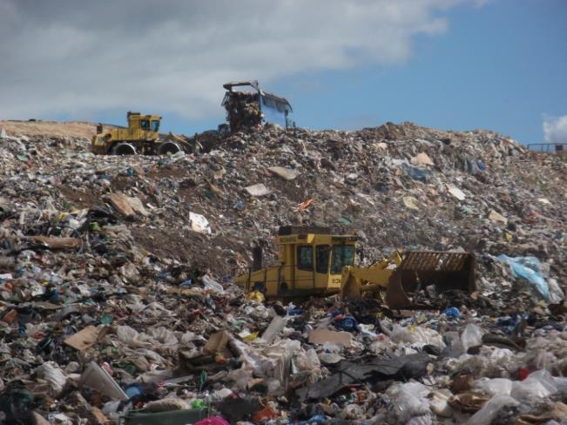
Where does our waste go?
Energy from Waste plant
Landfill site
Notes:
Most rubbish in Devon (31%) goes to an Energy from Waste (EfW) plant where it is incinerated (burnt) at high temperatures to generate electricity. Some rubbish in Devon (14%) is buried in landfill sites. Whichever method of disposal is used, when we burn or bury rubbish we lose valuable resources which could have been preserved and used again.

Slide 5
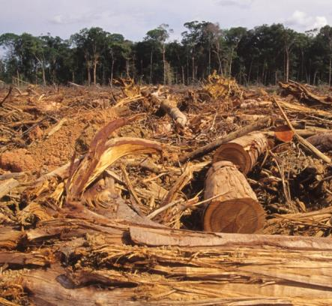
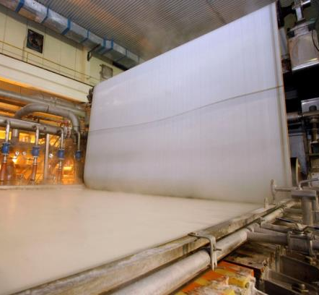
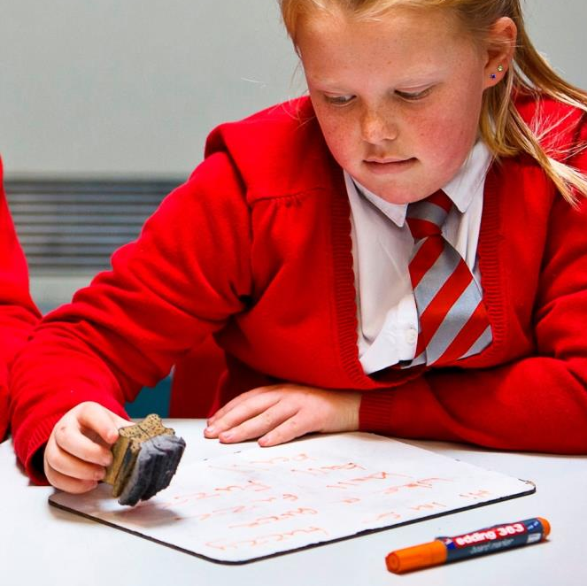
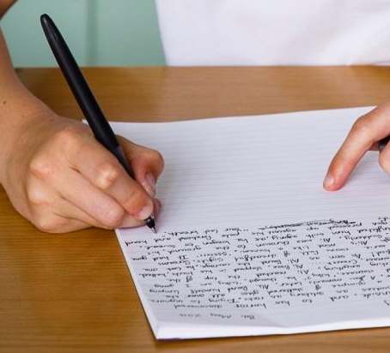
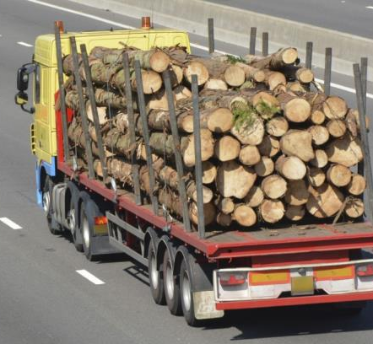
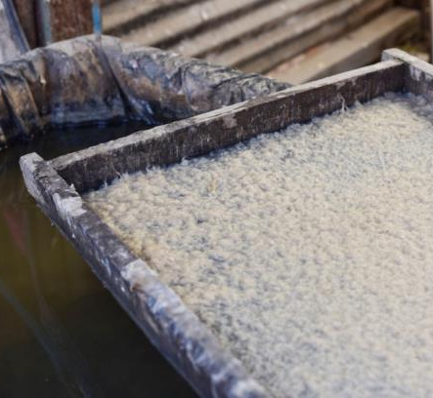
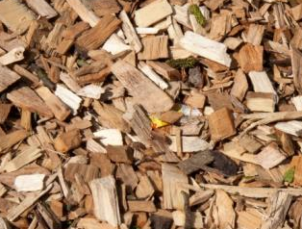
Manufacturing paper
Reducing paper
Notes:
Click 1: replace writing on paper with a child using a wipe-clean whiteboard.
Resources and energy will be needed to manufacture the board and board rubber, but only once. To ensure minimal use of the world’ s resources it is important to keep the lids on whiteboard pens when they are not being used, so they last as long as possible.

Slide 6
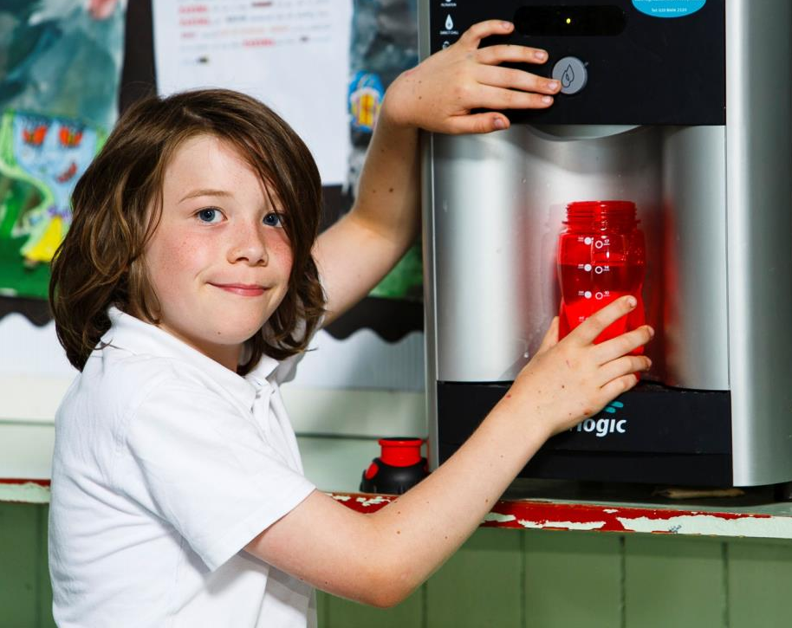
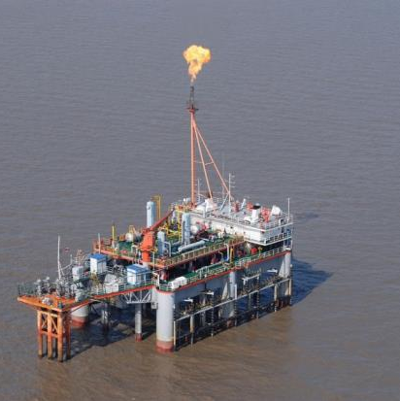
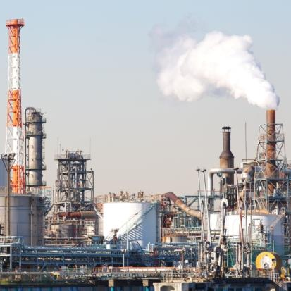
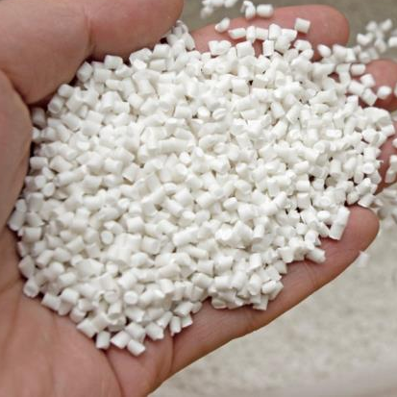
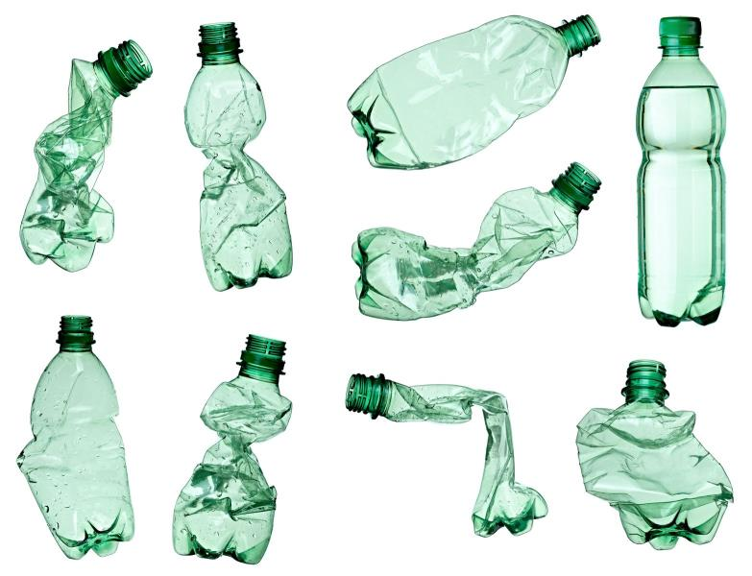
Manufacturing plastic
Reusing plastic
Notes:
Click 1: transform the new plastic bottles into crushed bottles.
In many parts of the country these could be recycled, but the recycling process uses energy so it is better to reuse if possible.
Click 2: replace the manufacturing process with a child reusing a plastic water bottle.
Manufacturing the reusable plastic bottle will use resources and energy, but only once.

Slide 7
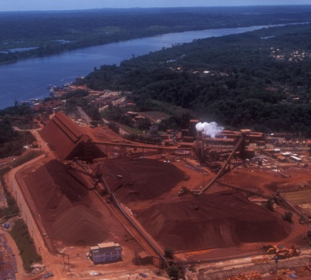
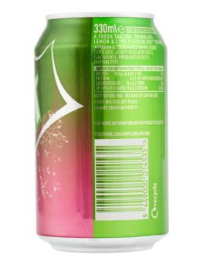
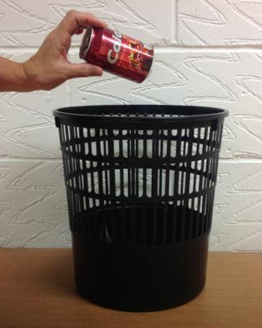
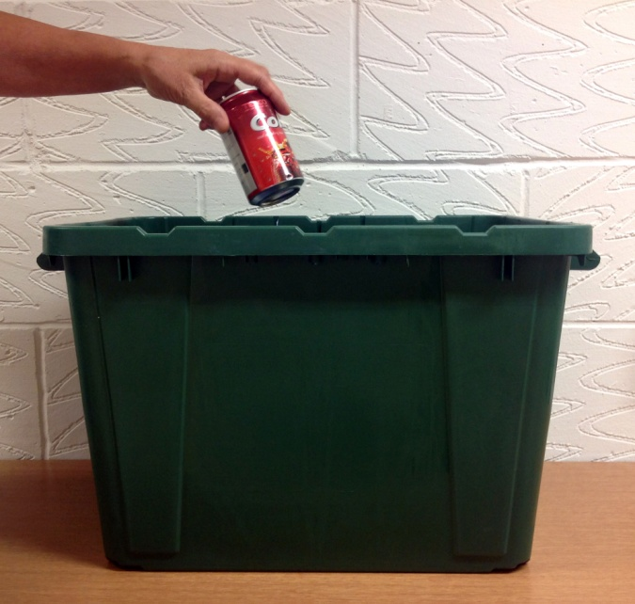
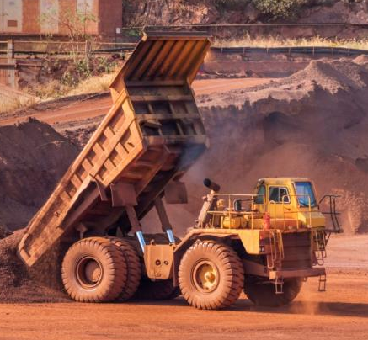
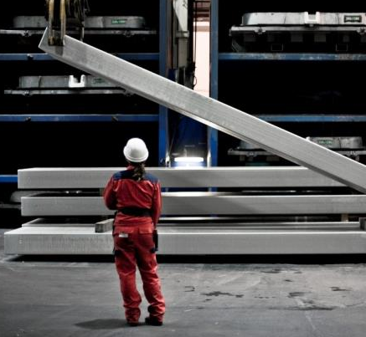
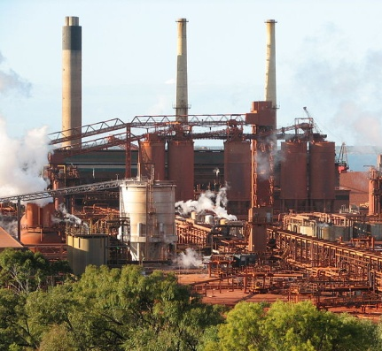
Recycling aluminium
Manufacturing aluminium
Notes:
Click 1: replace the manufacturing process with a recycling box.
Recycling aluminium uses only 5% of the energy used to manufacture it from raw materials.

