Slide 1
The 3Rs:
Reduce, Reuse,
Recycle

Slide 2
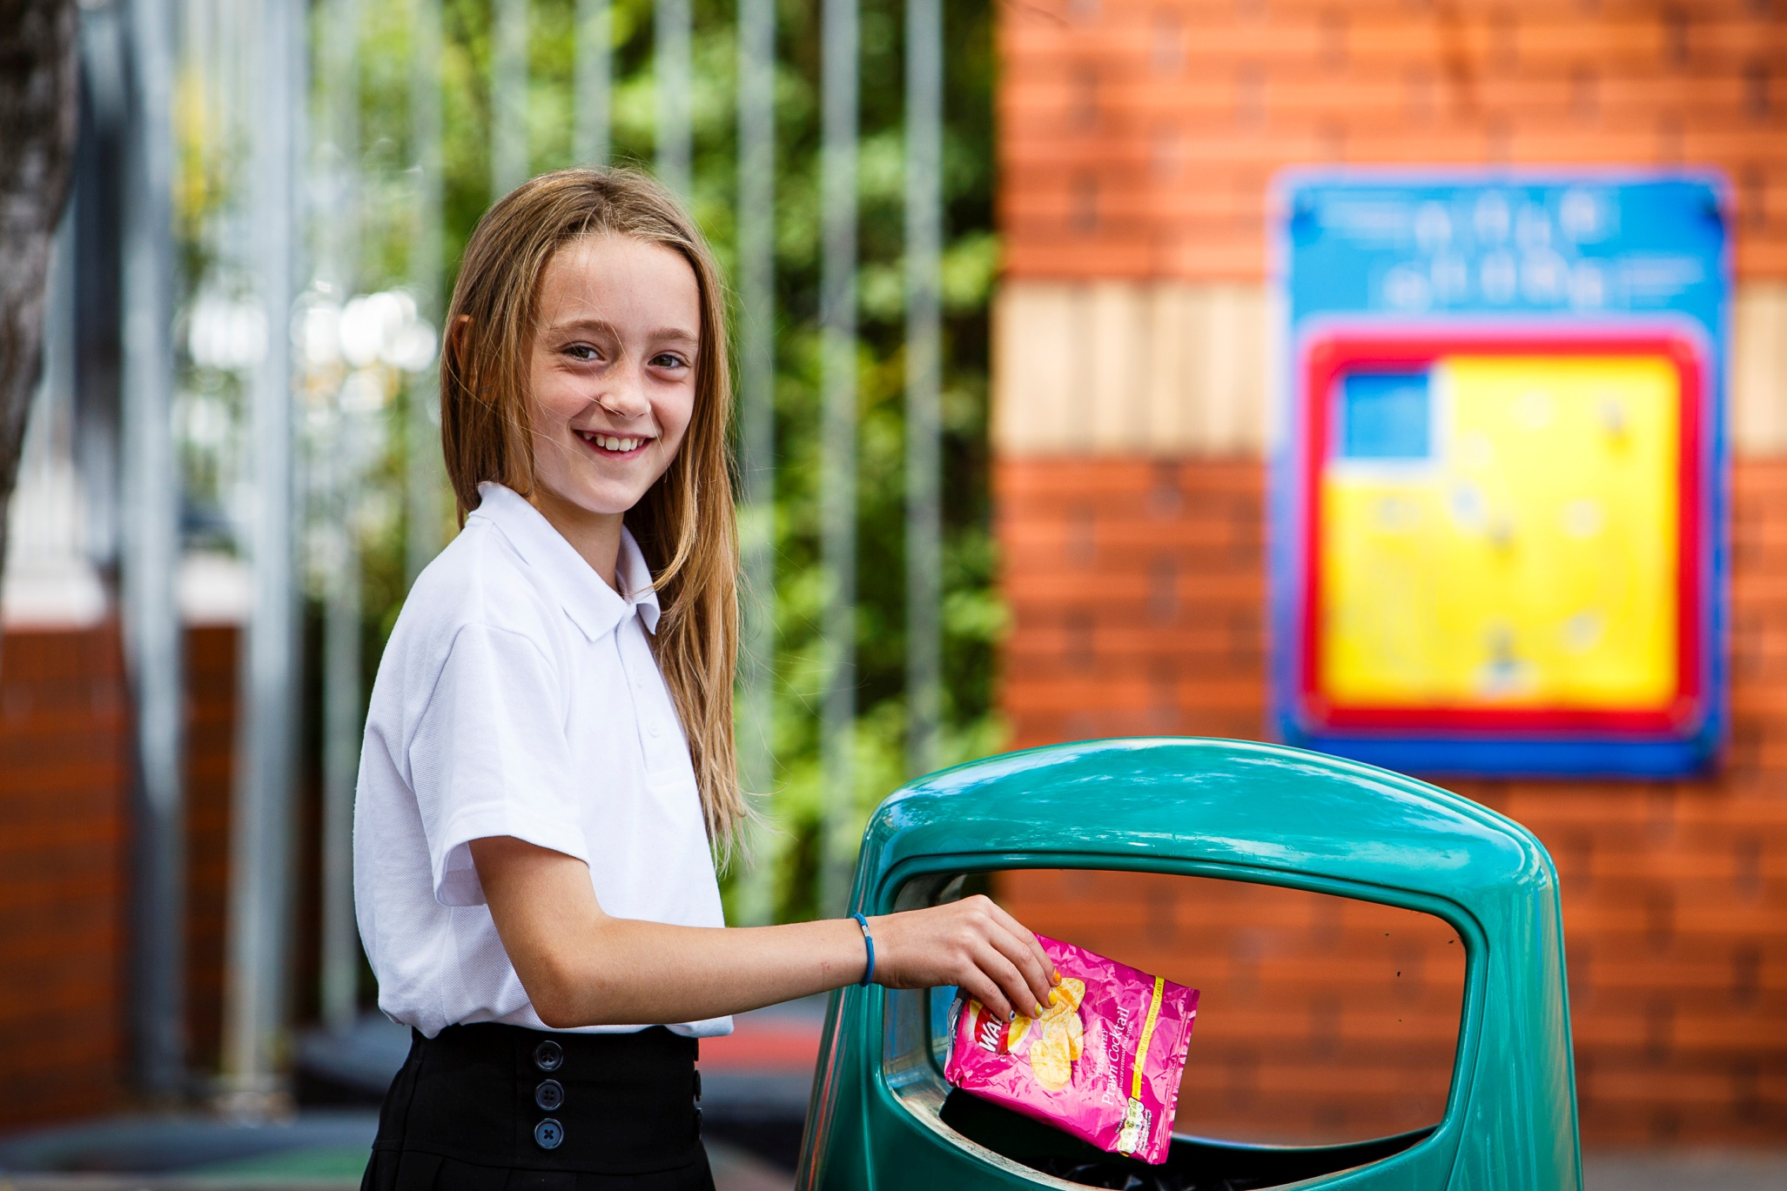
Households in Devon produce more than 360,000 tonnes of rubbish each year. What happens to the waste that we throw in the bin?

Slide 3
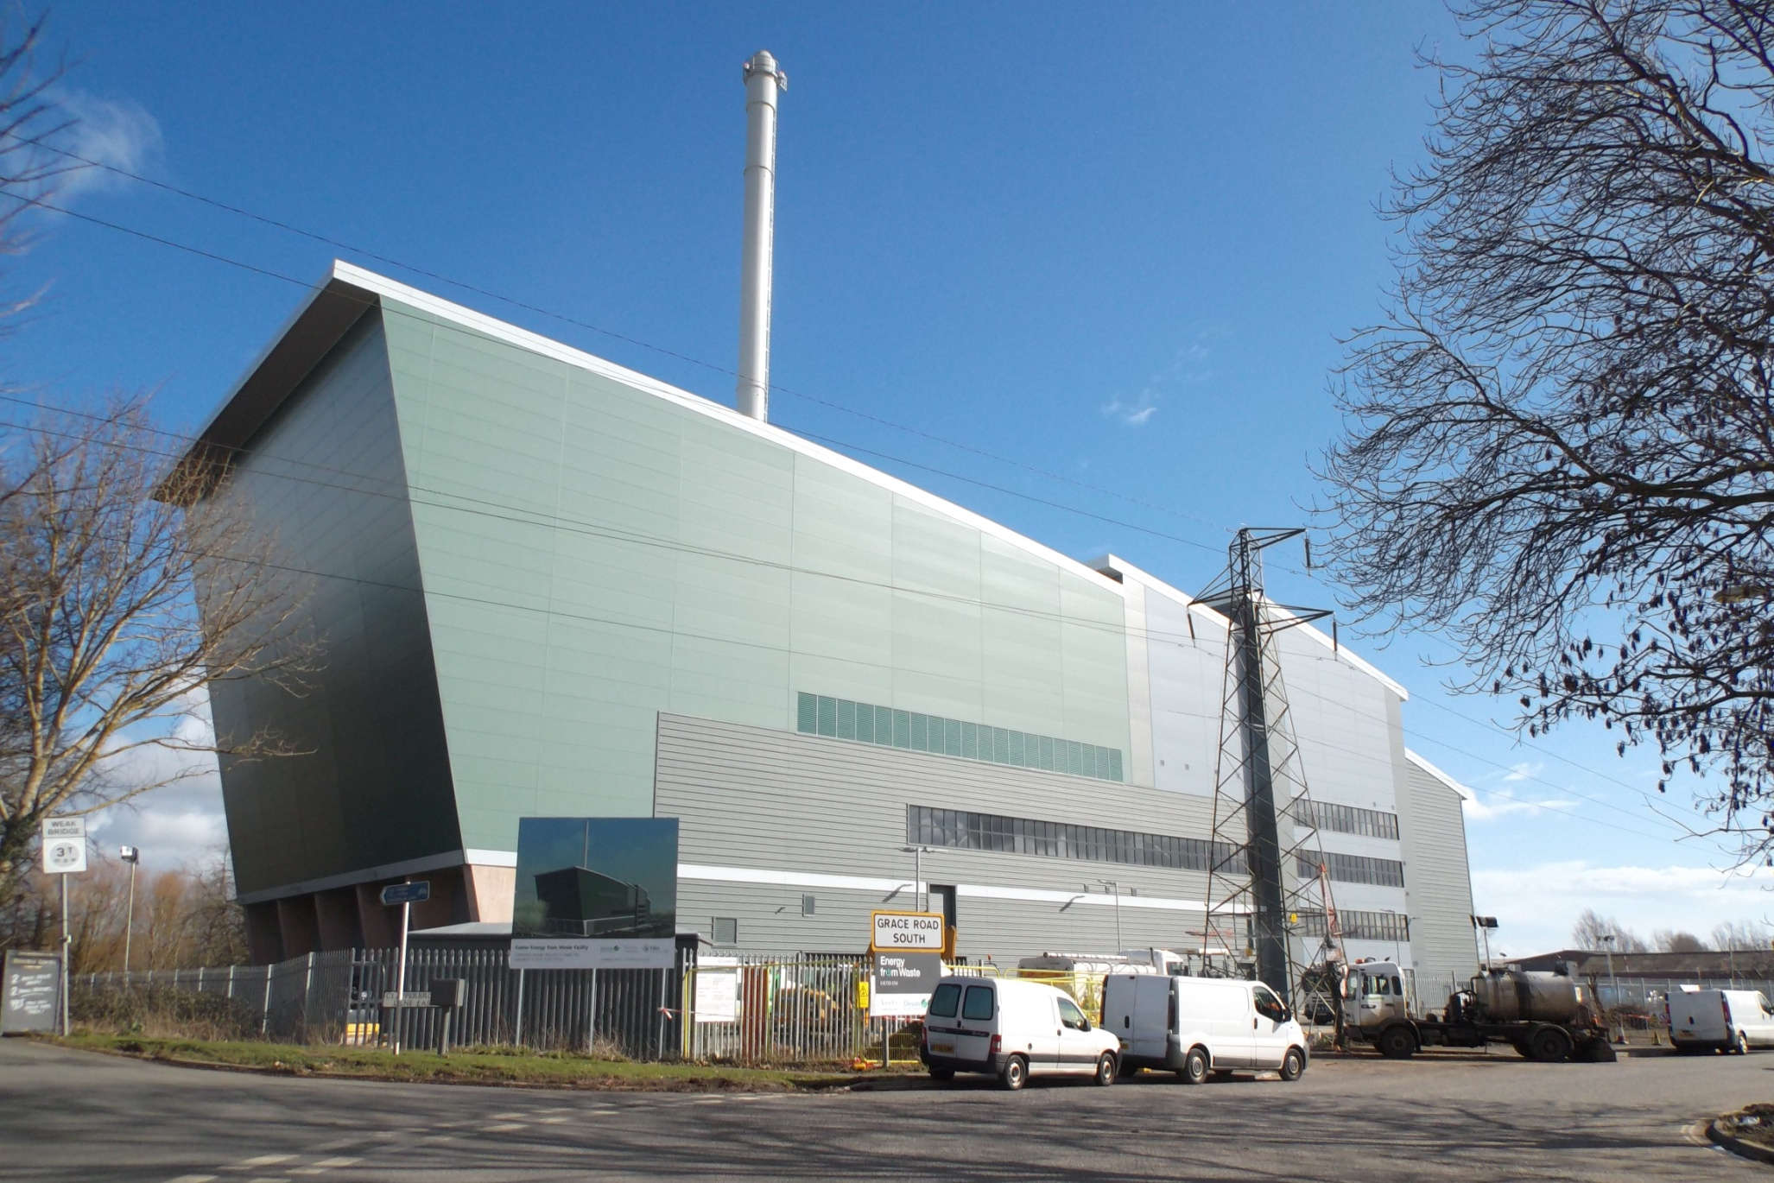
Much of Devon’s rubbish is now taken to an ‘Energy from Waste’ plant where it is incinerated to generate electricity.

Slide 4

Energy from Waste (EfW): facts and figures
Rubbish is incinerated at 850 °C
The generated electricity, and sometimes heat, can be used to power homes, schools and businesses
Gases are cleaned and filtered to prevent pollution escaping into the atmosphere
Strict laws ensure that EfW plants do not harm the environment

Slide 5
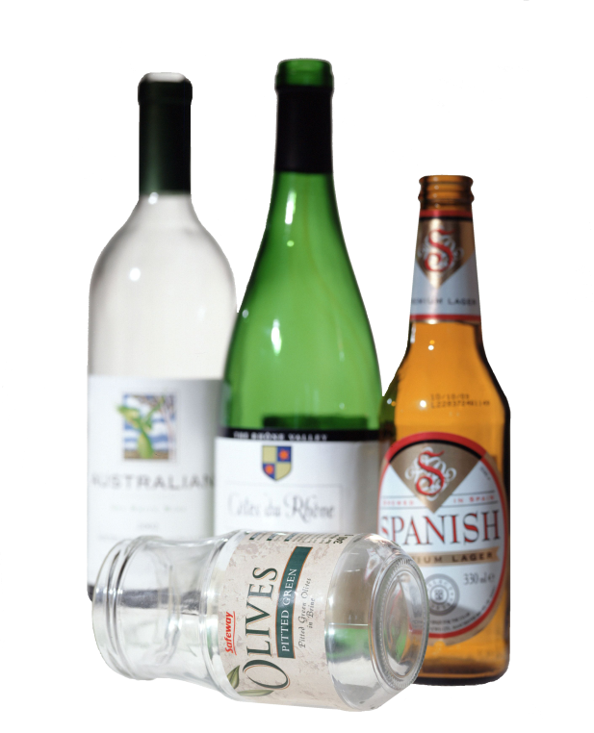
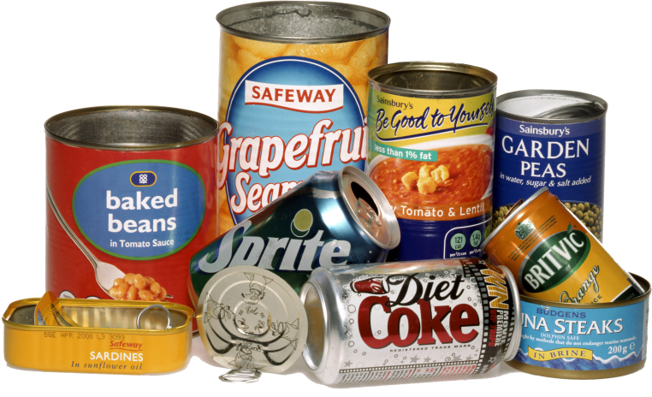
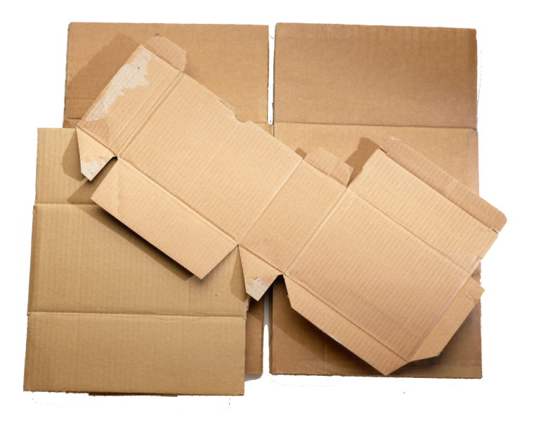

Whether we incinerate our rubbish in an EfW plant, or, as we did in the past, bury it in a landfill site, valuable resources are lost and cannot be used again.

Slide 6
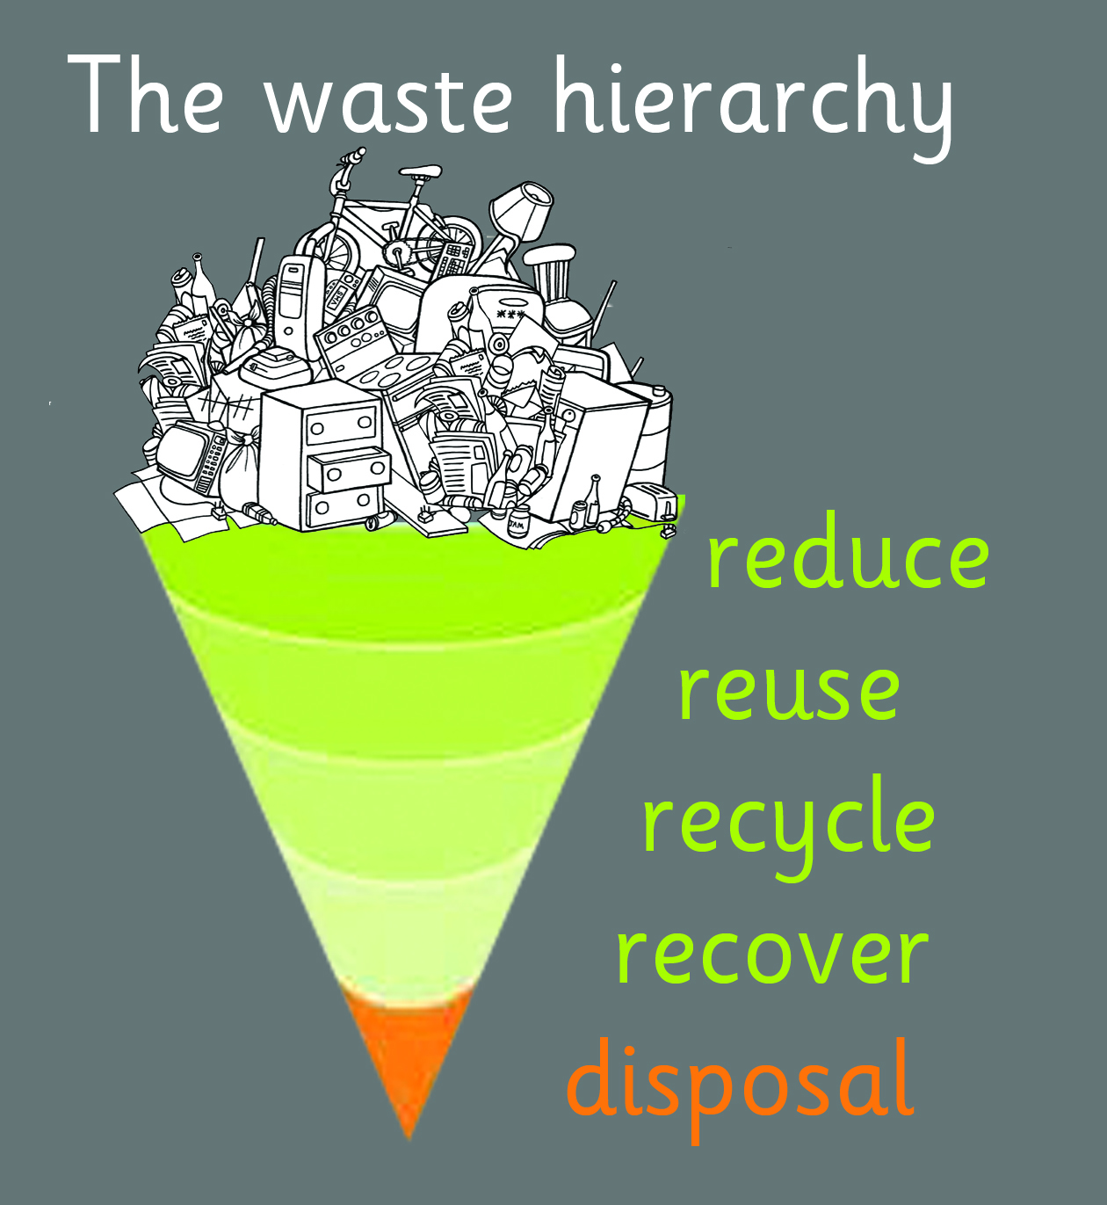
To preserve the world’s natural resources we need to use the 3Rs (Reduce, Reuse, Recycle) whenever possible.

Slide 7
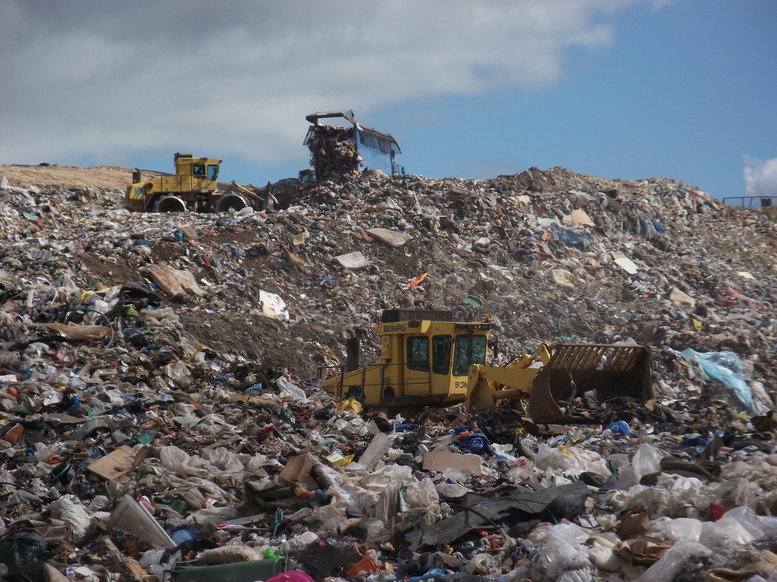
In the past, Devon’s rubbish was taken to landfill sites.
This is Heathfield landfill site, near Kingsteignton, Devon. Now only rubbish from North Devon, Torridge and some from Mid Devon is going to a landfill site, until another solution can be found.

Slide 8
Heathfield landfill site: facts and figures
The site opened in 1980
Its circumference is 2 miles / 3.2km
90 lorries dump rubbish in the landfill site each day
The rubbish is up to 60m deep

Slide 9
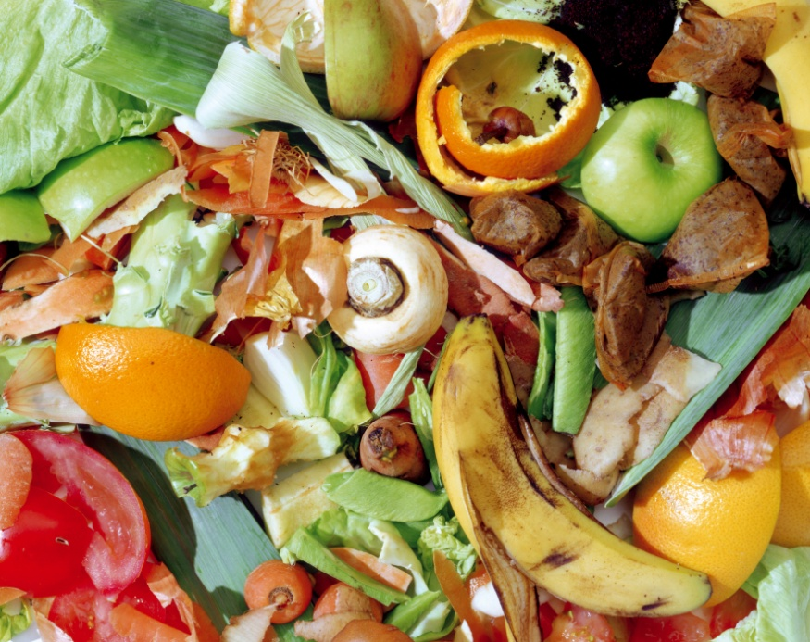
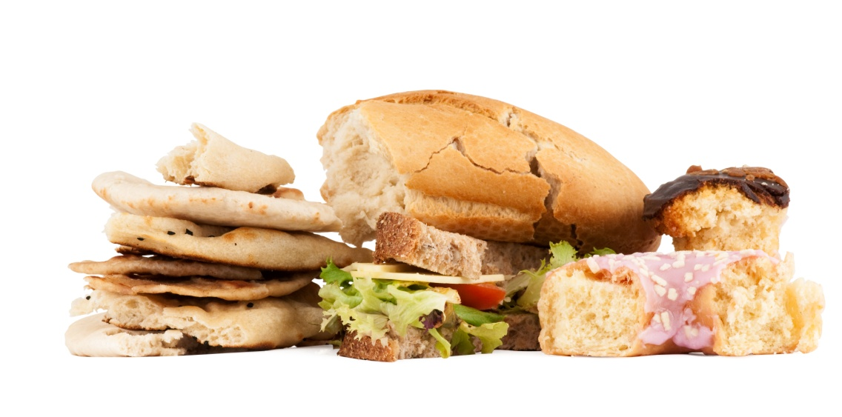
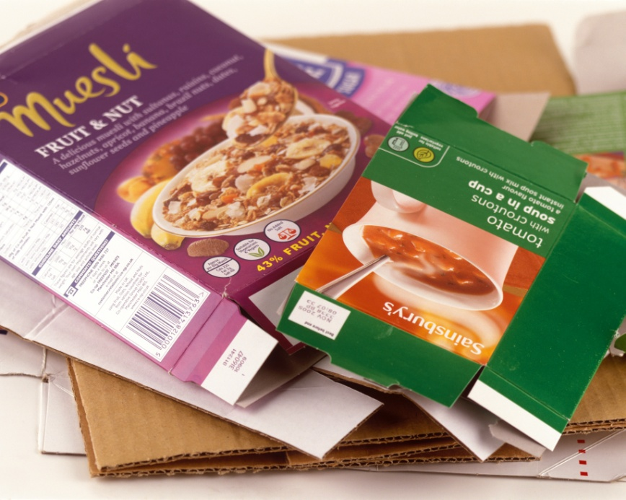
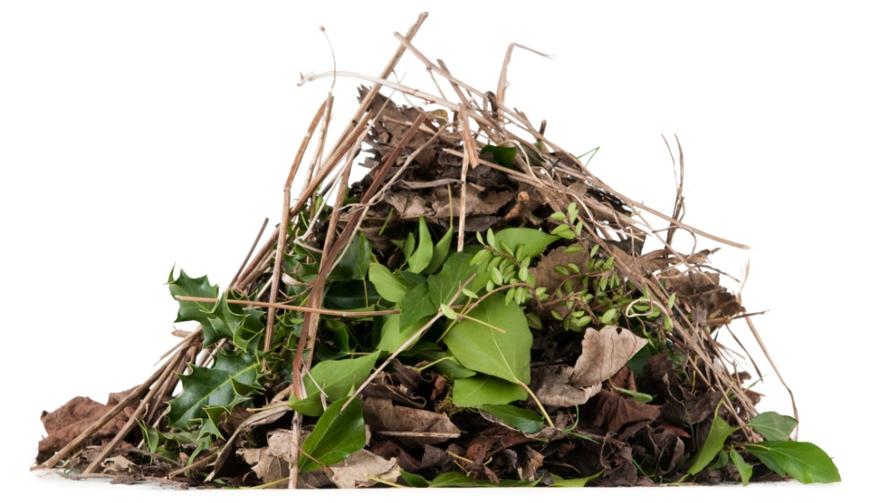
Biodegradable materials rot in the landfill site, producing a gas called methane.

Slide 10
Methane: facts and figures
Methane is produced when materials rot anaerobically i.e. without oxygen
It is a greenhouse gas, which is contributing to climate change
Methane is flammable i.e. it burns
Small power stations near landfill sites burn methane to produce electricity
The power station at Heathfield landfill site produces enough electricity each year to power 8,500 homes

Slide 11
fabric
metal
glass
paper
cardboard
plastic
It is very expensive sending rubbish to landfill sites, and a waste of valuable materials.

Slide 12
Ways that you can Reduce
Buy products with less packaging e.g. loose fruit and vegetables
Buy less – don’t be tempted by special offers or buy things you do not need
Use less e.g. one paper towel to dry your hands instead of three
Avoid things that are used once and then thrown away e.g. disposable plates and cups

Slide 13
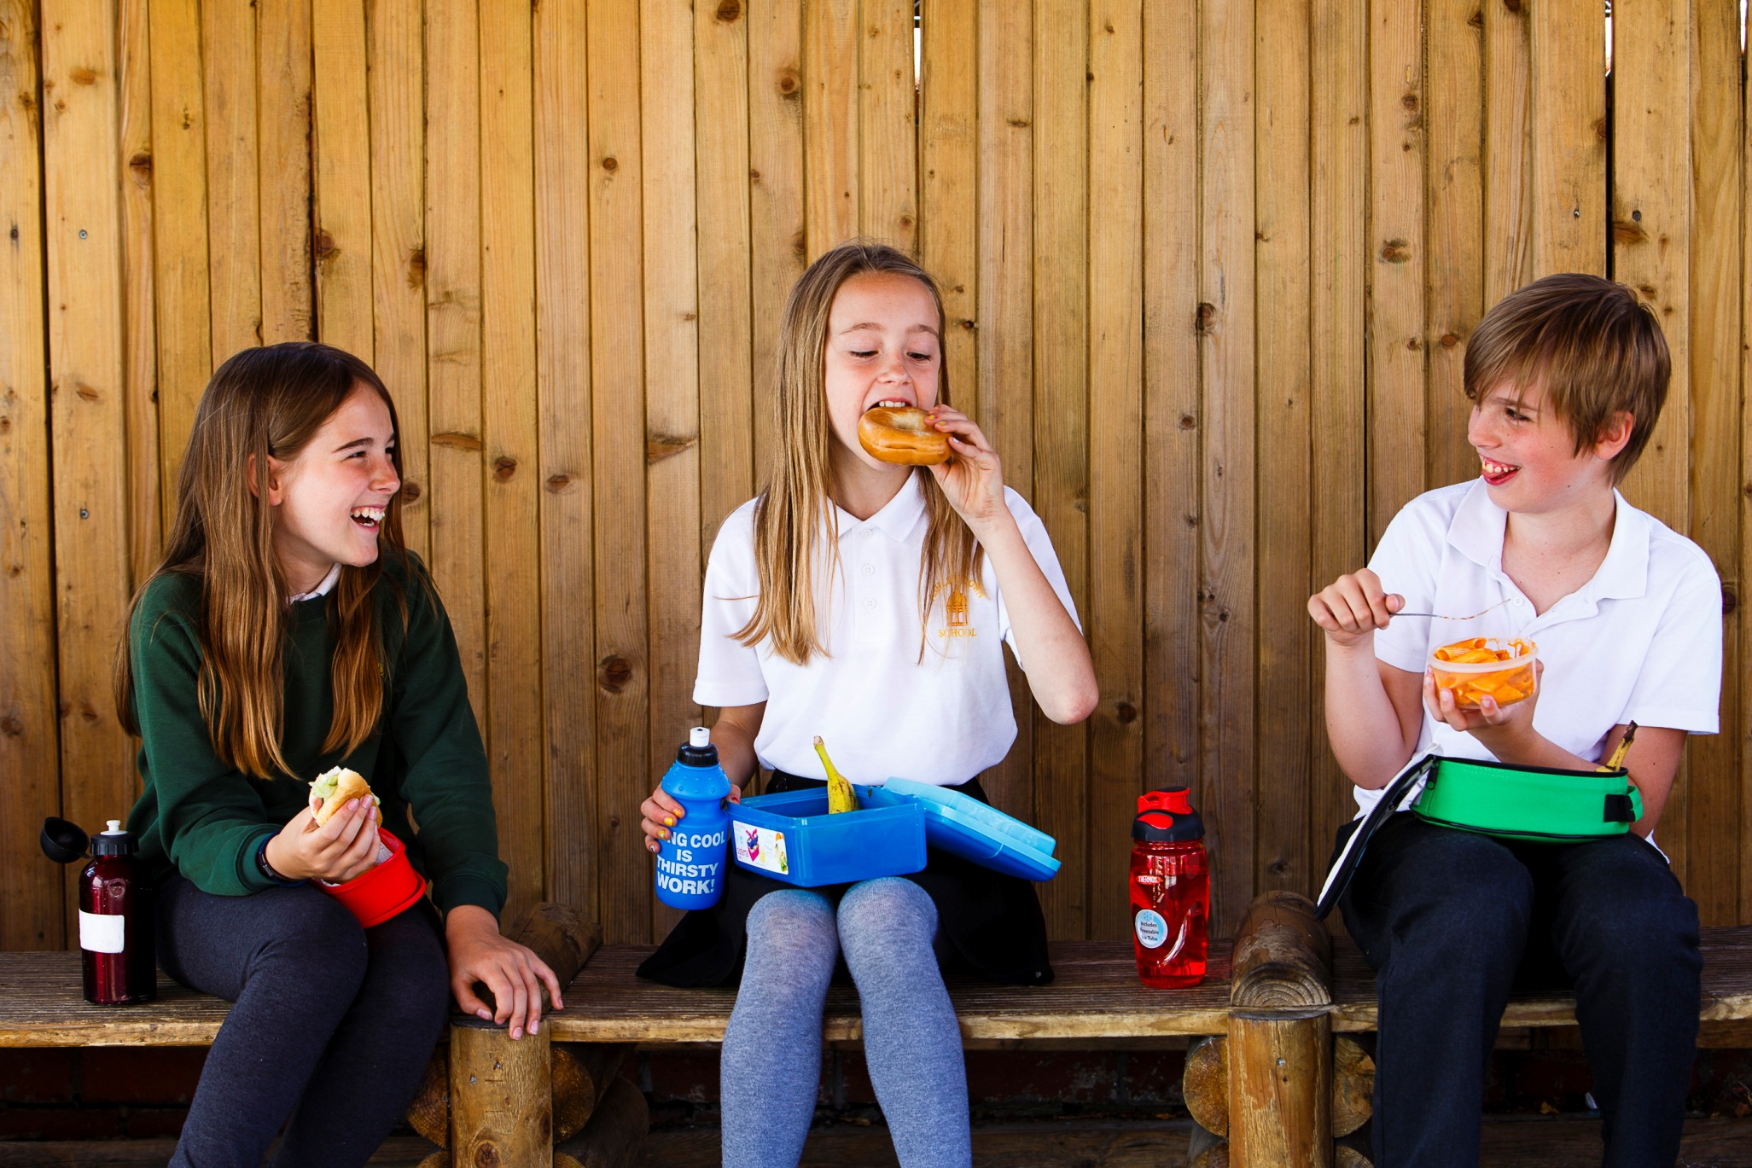
Reusable pasta pot
Refillable bottle
Reusable sandwich box
A good place to start is with picnics and packed lunches.

Slide 14
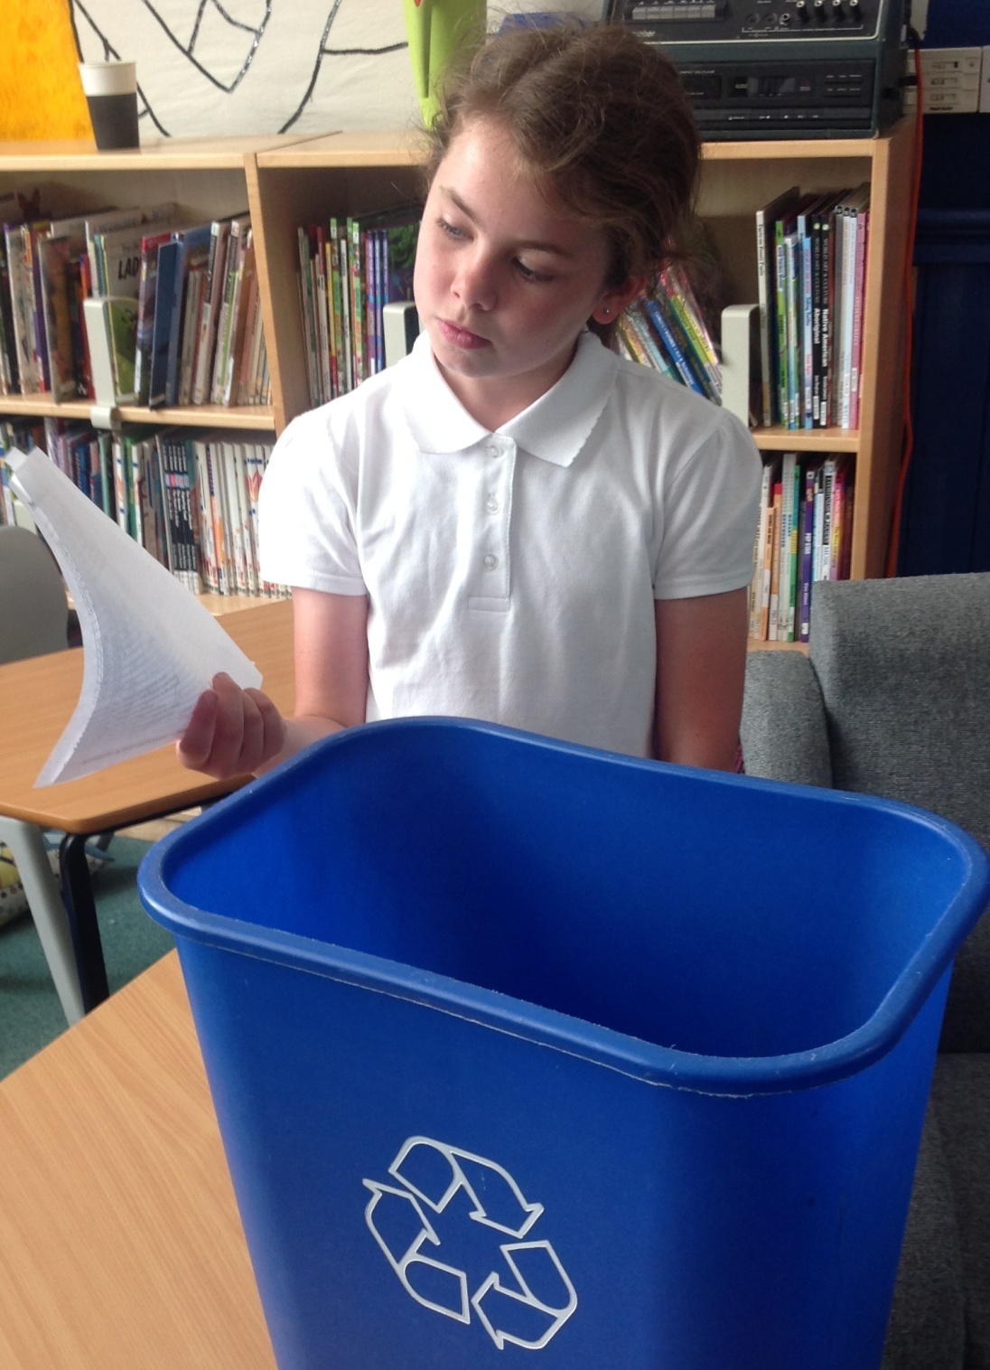
Reuse comes next.
Before you recycle something think “Can I use it again?”

Slide 15
Ways that you can Reuse
Use a scrap paper drawer in the classroom so all paper is used on both sides
Refill your drink bottle
Take clothes that no longer fit to a charity shop, or give them to friends or family
Take bags with you to the shops and use them over and over again
Put leftover food in margarine or ice cream tubs, then store it in your fridge or freezer

Slide 16
Ways that you can Recycle
Make sure every classroom and office in your school has a container for recycling paper
Help at home by washing cans or plastic bottles before putting them in your recycling container
Use a compost bin to recycle fruit and vegetable peels into compost
Buy products made out of recycled materials e.g. toilet paper, kitchen roll

Slide 17
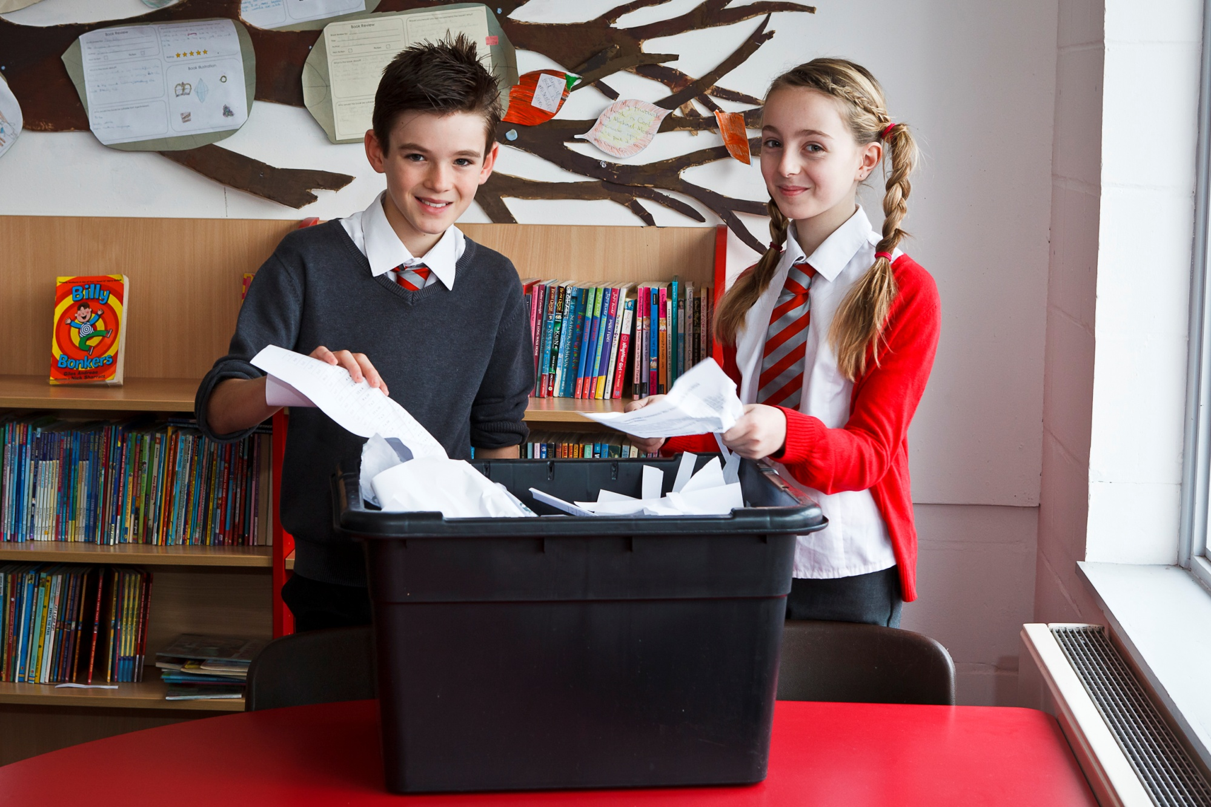
Recycling is the third of the 3Rs. In Devon we are lucky - it is really easy to recycle at home and at school.

Slide 18
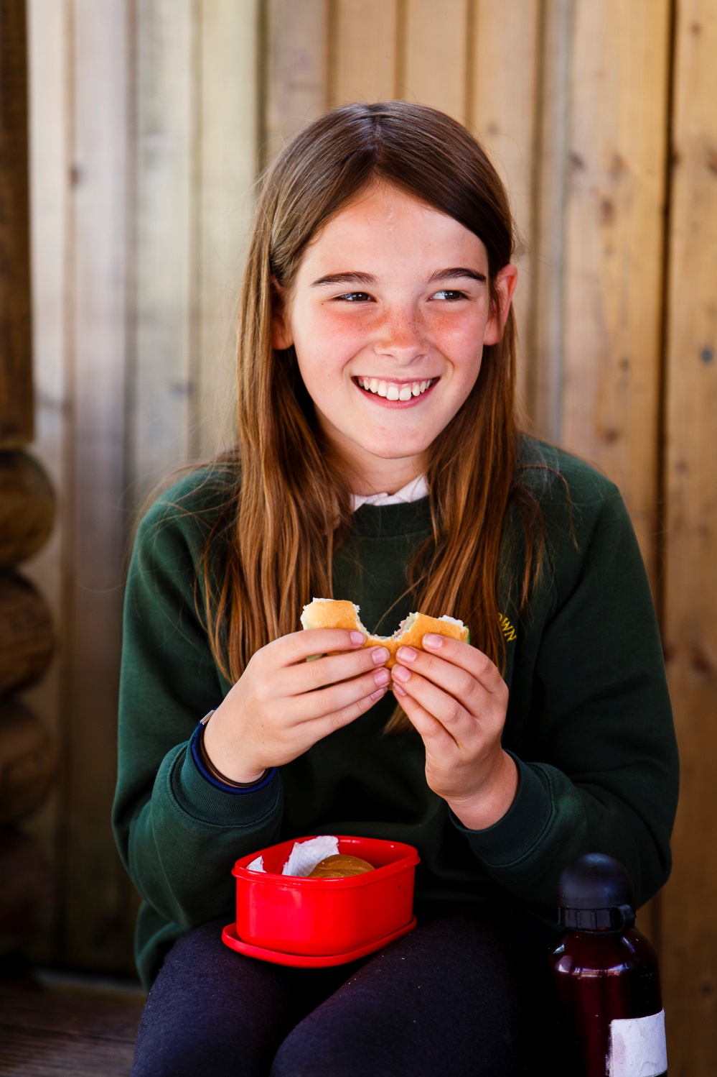
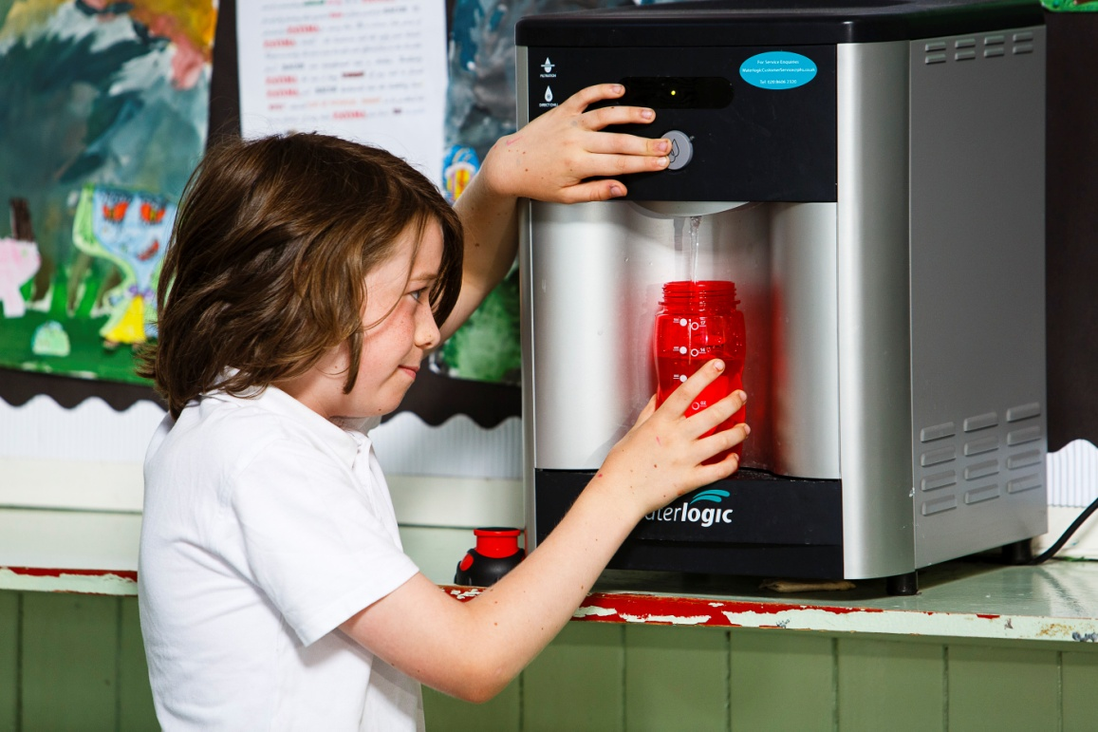
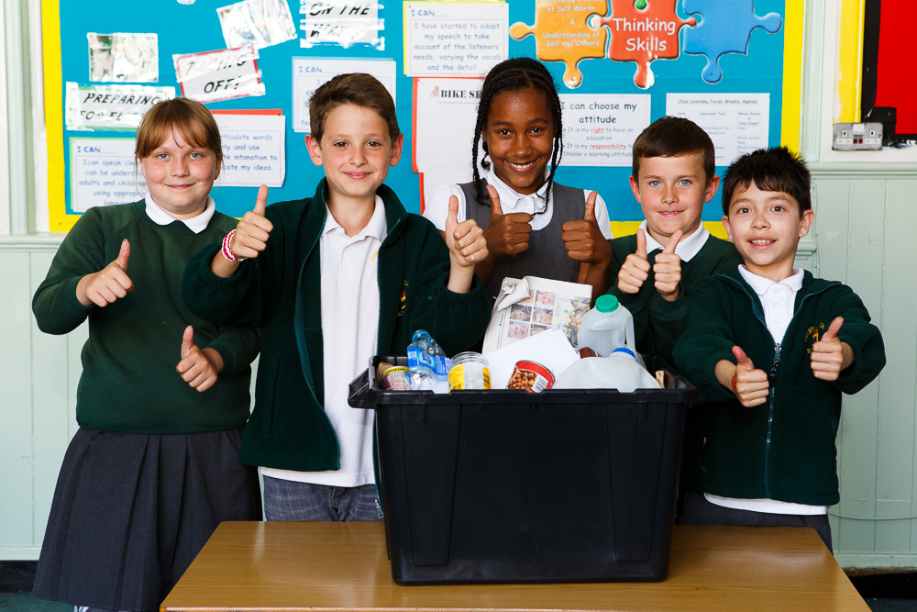
Reduce
Reuse
Recycle

Slide 19
This PowerPoint is part of ‘What about Waste?’, a Literacy teaching resource for Year 3/4 and Year 5/6.
To download the full resource visit: zone.recycledevon.org/teachers
This resource is available free of charge to Devon school teachers.
‘What about Waste?’ was produced by Resource Futures as part of the Devon County Council Sustainability Education Programme.
All facts and data used in this PowerPoint were correct in March 2015.

