Slide 1


Floating and sinking
KS3-4 Science

Slide 2

Introduction to Activity
Liquid layers

Slide 3
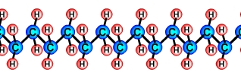
Chemical structure of polymers
Picture from: Introduction to Plastics (design-and-technology-education.com)

Slide 4
Properties of Plastics
chemically unreactive
solids at room temperature
plastic – they can be moulded into shape
electrical insulators
strong and hard-wearing

Slide 5
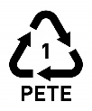






Plastic polymer chart
Plastic icon | Acronym | Polymer name | Uses | Density range (g/cm³)
 | PETE | Polyethylene terephthalate | Soft drink bottles, mineral water bottles, fruit juice and cooking oil containers. | 1.4
 | HDPE | High-density polyethylene | Milk bottles, shampoo bottles, laundry detergents and washing-up liquid bottles. | 0.95
 | PVC | Polyvinyl chloride | Packaging for sweets or fruit, bubble wrap. | 1.29
 | LDPE | Low-density polyethylene | Plastic bags, film plastic, plastic wrap. | 0.92
 | PP | Polypropylene | Furniture, toys, suitcases, plastic storage boxes, car bumpers, dashboards. | 0.90
 | PS | Polystyrene | Toys, packaging materials, refrigerator trays, costume jewellery, CD cases, disposable cups. | 1.07
 | Other | Other plastic polymers | Including lycra, acrylic, PLA, nylon, fibreglass, polycarbonate. | Variable
Values for plastic density from Polymer Academy website: https://polymeracademy.com/density-of-various-plastic/ Accessed 8 Feb 2020

Slide 6
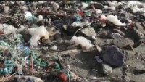
microplastics
75% of all plastics float, while 25% sink. Plastics never fully degrade in natural environments like the sea. Small pieces of plastic called microplastic are now present everywhere on Earth. They have even been found high up on Mount Everest and even in the centre of Antarctica.

Slide 7
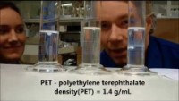
Microplastics – floating and sinking experiments

Slide 8
Solutions?
Ocean Cleanup Project - https://youtu.be/qRsQUALOfQI
Plastic eating bacteria - https://youtu.be/DDhPuyrSq3E
Other ideas - https://youtu.be/FWFb-8hFutY

