Slide 1


Comparing recycling with extracting metals
KS3/4 Chemistry

Slide 2

Lesson objective
Students will learn about how iron and aluminium are extracted from rocks and why it is more carbon and resource efficient to recycle these metals.

Slide 3
aluminium cans
Journey from rock to pop

Slide 4
Aluminium cans - from rock to pop
Bauxite rock mined in Australia, Jamaica, Guinea, Brazil and Russia.
01
Alumina processing to produce pure aluminium oxide (Al₂O₃).
02
Cans moulded and extruded from aluminium ingots, ready to be filled with pop.
04
Alumina processed via electrolysis to produce molten aluminium and carbon dioxide.
03

Slide 5
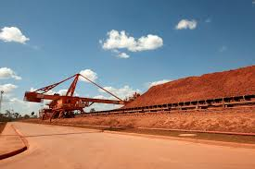
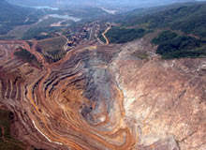
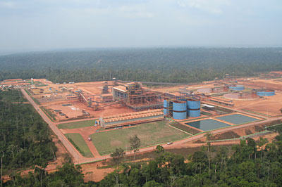
Open Cast
Bauxite Mining
Norsk Hydro Paragominas Mine in Northern Brazil
One of the largest open cast mines is in Northern Brazil.

Slide 6
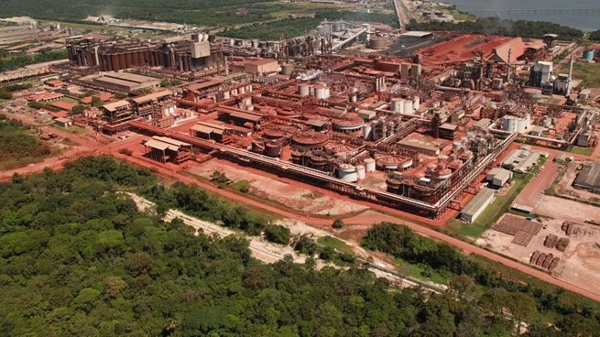
Alumina processing
Alumina or aluminium oxide (Al₂O₃) is the key raw material for producing aluminium.
It is a white powder extracted from bauxite through the Bayer process.
Hydro Alunorte is the world's largest alumina refinery and is located in Pará, northern Brazil.
The plant produces 6.2 million tonnes of alumina (Al₂O₃) per year.
Then shipped worldwide for further processing into aluminium.

Slide 7
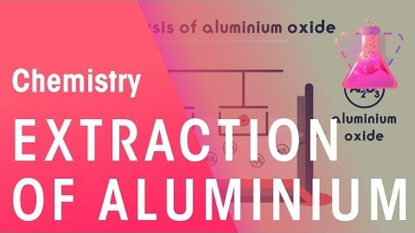
Electrolysis of aluminium
Requires massive amounts of electricity
Cathodes need replacing regularly (graphite/carbon)
Between 12-17 tonnes of carbon dioxide per tonne of Aluminium produced.

Slide 8
Electrolysis of Aluminium: Chemical Equations
Overall reaction:
                2Al₂ O₃ (l) → 4Al (l) + 3O₂ (g)
At the negative cathode - the aluminium ions from the molten aluminium oxide-cryolite mixture are reduced (gain electrons):
                Al³⁺ + 3e⁻ → Al
At the positive anode – the carbon of the graphite reacts with the oxygen to form carbon dioxide:
                C (s) + 0₂ (g) → CO₂ (g)

Slide 9
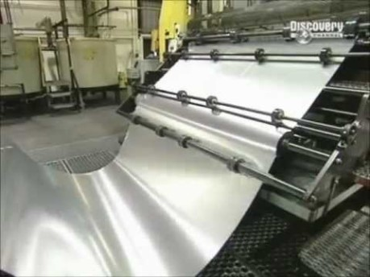
Making aluminium cans

Slide 10
Summary
Bauxite rock mined in Australia, Jamaica, Guinea, Brazil and Russia.
01
Alumina processing to produce pure aluminium oxide (Al₂O₃).
02
Cans moulded and extruded from aluminium ingots, ready to be filled with pop.
04
Alumina processed via electrolysis to produce molten aluminium and carbon dioxide.
03

Slide 11
Steel cans
The journey from rock to beans

Slide 12
Steel cans - from extraction to baked beans
Iron Ore (Rocks) mined as deposits of magnetite and haematite in USA, Canada, Australia, Brazil and Russia.
01
Iron oxide reacts with carbon in a blast furnace to leave iron and carbon dioxide
02
Iron turned into steel cans using carbon and an extrusion and moulding process
03

Slide 13
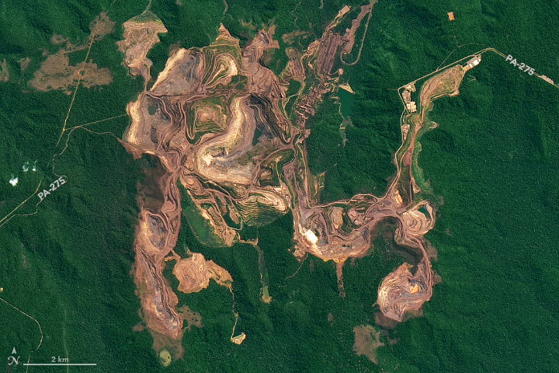
Open Cast Iron Ore Mining in Brazil
The red-brown earth exposed by open pit mines contrast with the greens of the surrounding Amazon forest.
Image of the day at Nasa’s earth observatory on February 23, 2019

Slide 14

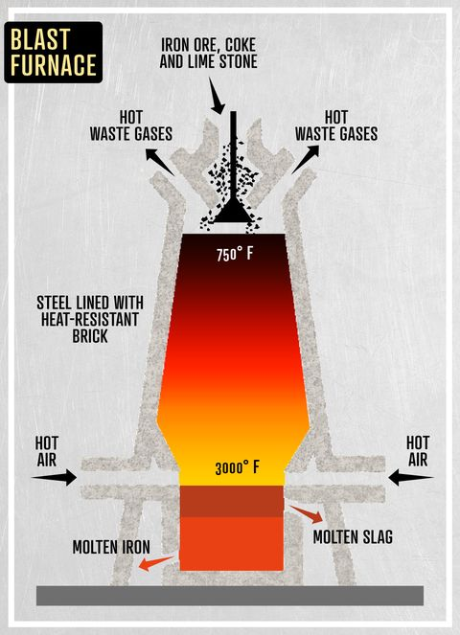
Blast Furnace

Slide 15
Blast Furnace – Chemical Equations
The coke burns:
                C + O₂ → CO₂
The carbon dioxide then reacts with more coke to give carbon monoxide:
                CO₂ + C → 2CO
The limestone is thermally decomposed:
                CaCO3 → CaO + CO₂
Carbon monoxide reduces iron oxide to leave iron and carbon dioxide:
                Fe₂O₃ + 3CO → 2Fe + 3CO₂
Impurities are removed by the calcium oxide combining with sand to form liquid slag which floats on top of the liquid iron.
                CaO + SiO₂→ CaSiO₃

Slide 16
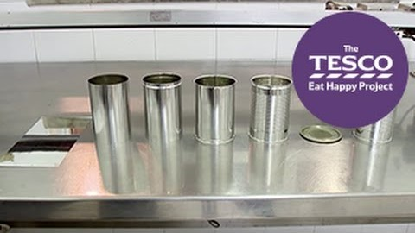
Making steel cans

Slide 17
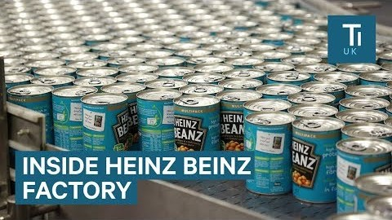

Slide 18
Steel cans - from extraction to baked beans
Iron Ore (Rocks) mined as deposits of magnetite and haematite in USA, Canada, Australia, Brazil and Russia.
01
Iron oxide reacts with carbon in a blast furnace to leave iron and carbon dioxide
02
Iron turned into steel cans using carbon and an extrusion and moulding process
03

Slide 19
Recycling process
Steel and aluminium are collected at the kerbside and recycled in the UK.

Slide 20
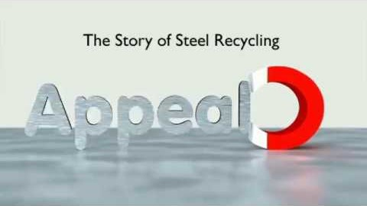
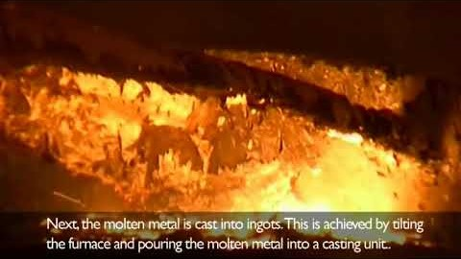
Steel and aluminium recycling process in Devon

Slide 21
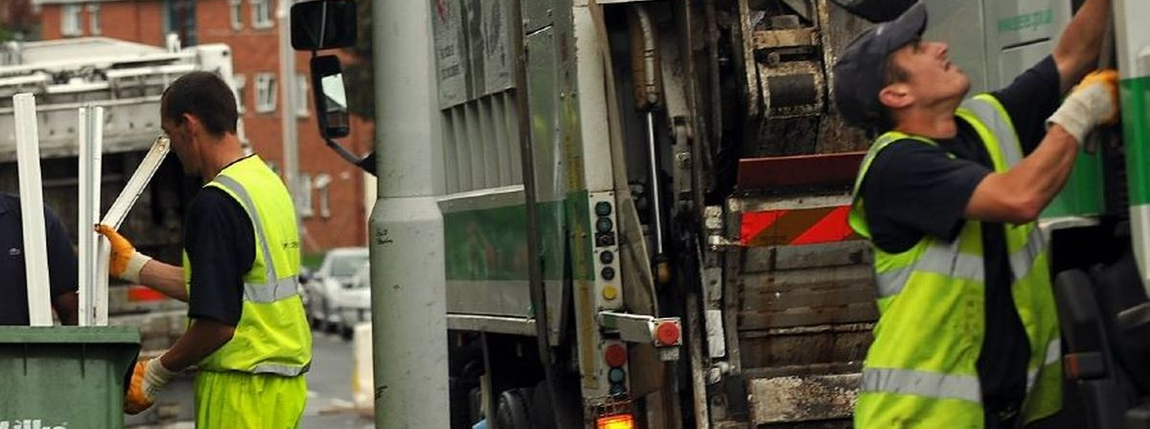
Collection

Slide 22

Separation
What do you know about the properties of steel and aluminium that could help separate them?
That’s right! Magnetism!
Huge electromagnets separate steel cans from aluminium ones.

Slide 23
Aluminium Recycling Facts
Almost 70% of all drinks cans are recycled – making it the most recycled drinks container on earth, according to global figures from the International Aluminium Institute (IAI).
90% of all drinks cans sold in the UK every year are made of aluminium.
The average household uses 3.2kg of aluminium cans a year - that's about 208 cans.
You can make 20 cans from recycled aluminium with the energy and raw materials it takes to make one from scratch.
Recycling 1 kg of aluminium saves 8kg of bauxite, 4kg of chemical products and 14 Kilowatts of electricity.
Used aluminium drink cans can be recycled and back on supermarket shelves as new drink cans in as little as 60 days.
Facts from: https://www.recycle-more.co.uk/household/recycling-facts &
Circular Online (22/10/20)

Slide 24
Recycling Steel facts
The average UK household uses around 600 steel cans every year.
There are over 2.5 billion cans recycled in the UK each year, that's a saving of 125,000 tonnes of solid waste every year.
Steel is the most recycled metal in the UK – and in the world.
All steel cans are 100% recyclable. They can be recycled over and over again, into anything from cars and bicycles to more steel cans.
All steel cans contain around 25% recycled steel.
Facts from: https://www.recycle-more.co.uk/household/recycling-facts

Slide 25
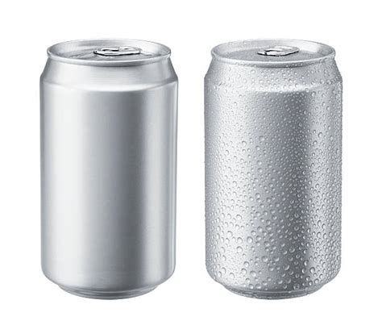
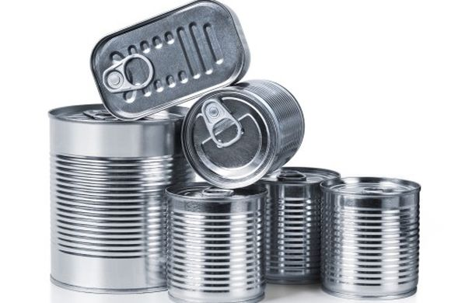
Back to the consumer…

Slide 26
Comparing metal extraction from ore with the recycling process
Travel and carbon footprint for metal ore mining and extraction compared to the recycling of metal packaging.

Slide 27
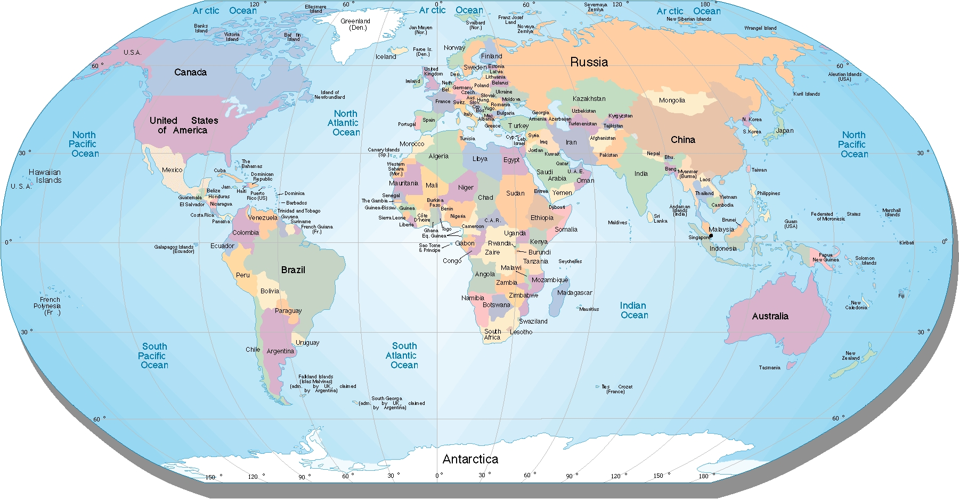
Using world maps to track carbon footprints in life cycle analysis of aluminium and steel can processing.

Slide 28



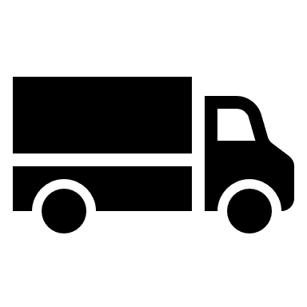



Life Cycle Analysis
Raw Material Extraction
Material Processing
Recycling
Life cycle analysis is an investigation into the environmental impacts of the process of creating something right from the start, where the raw materials of the product are mined from the ground through to it’s disposal – this is called cradle to grave.
In the circular economy it is more important to consider this as cradle to cradle.
Product use
Distribution
Assembly
Manufacturing

Slide 29
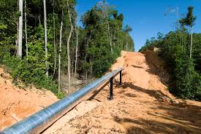
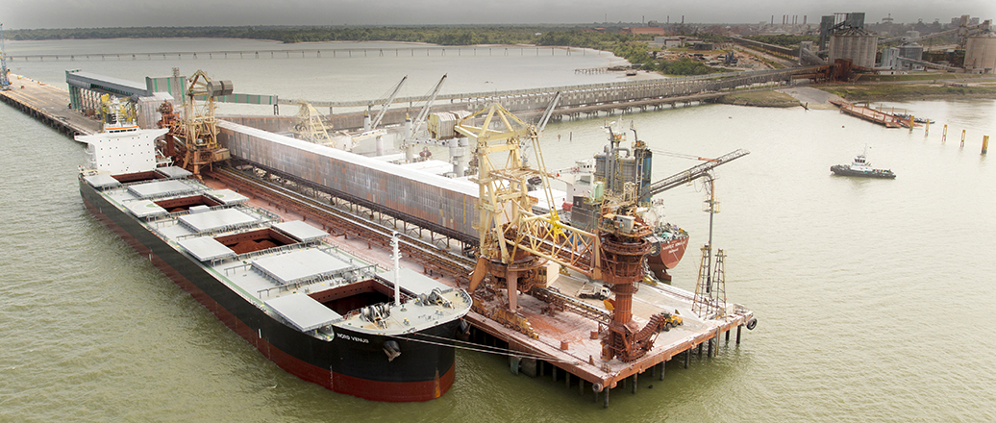
Aluminium Production - travel
Mined as bauxite in northern Brazil
Transported via a long distance bauxite slurry pipeline
Bauxite refined into alumina in northern Brazil
Alumina powder shipped to Bahrain for processing

Slide 30
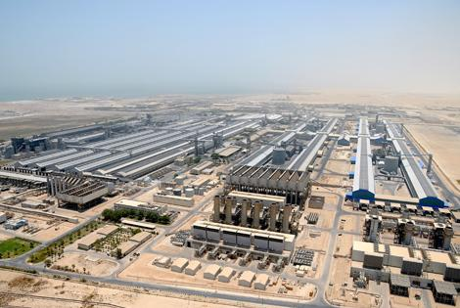
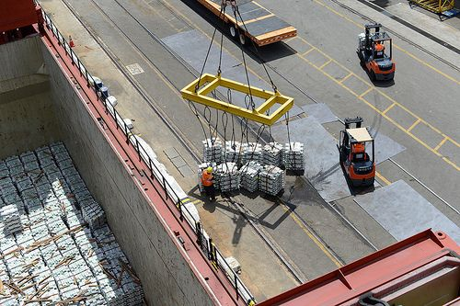
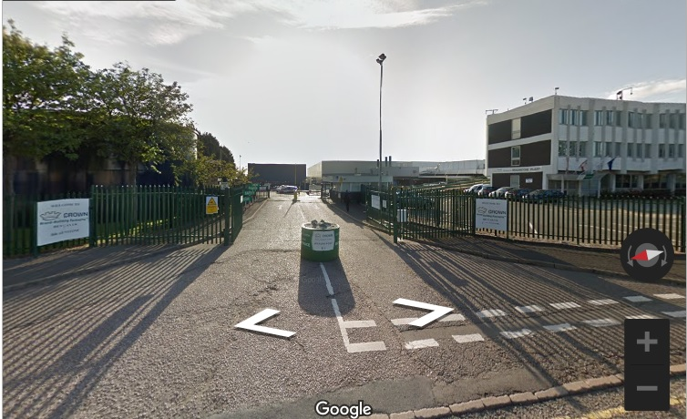
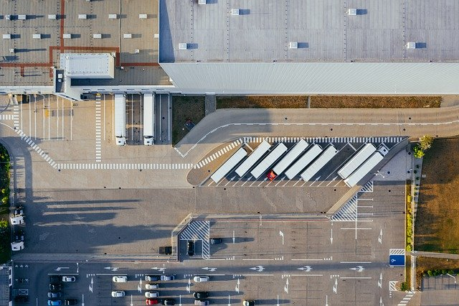
Aluminium Can Production - travel
Processed via electrolysis in Bahrain into ingot of aluminium.
Transported via ship to a rolling factory in the UK, then transported by lorry to can factory in the UK.
Turned into cans for fizzy drinks in beverage can factory in Leicester. Filled with drinks at a separate factory.
Transported to warehouses then distributed to shops by lorry.

Slide 31
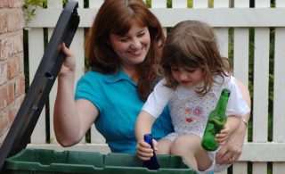
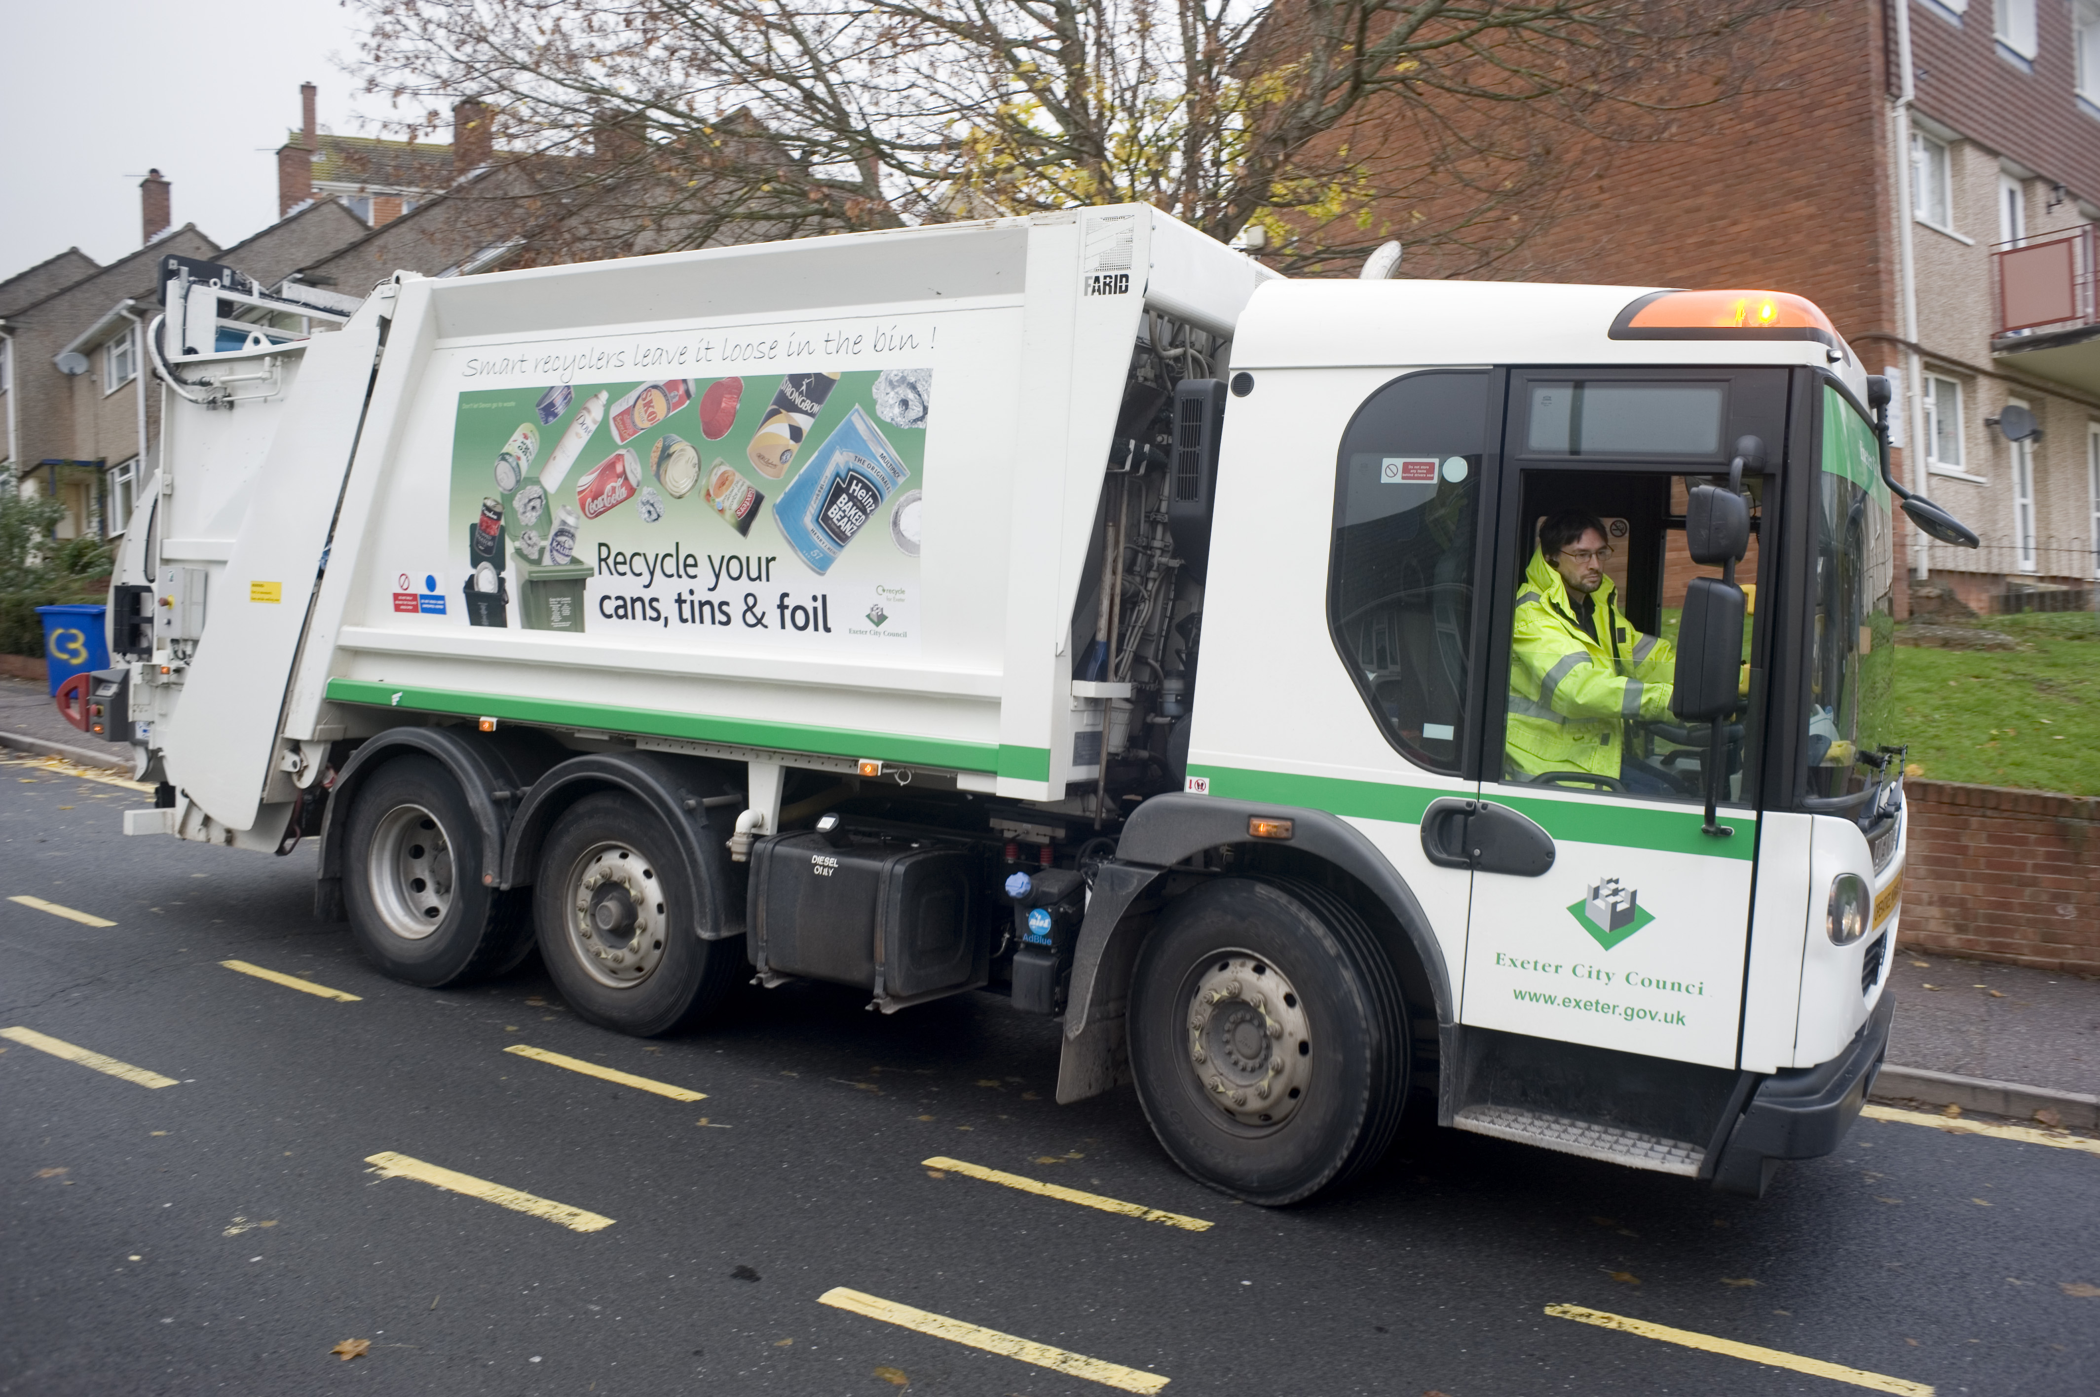
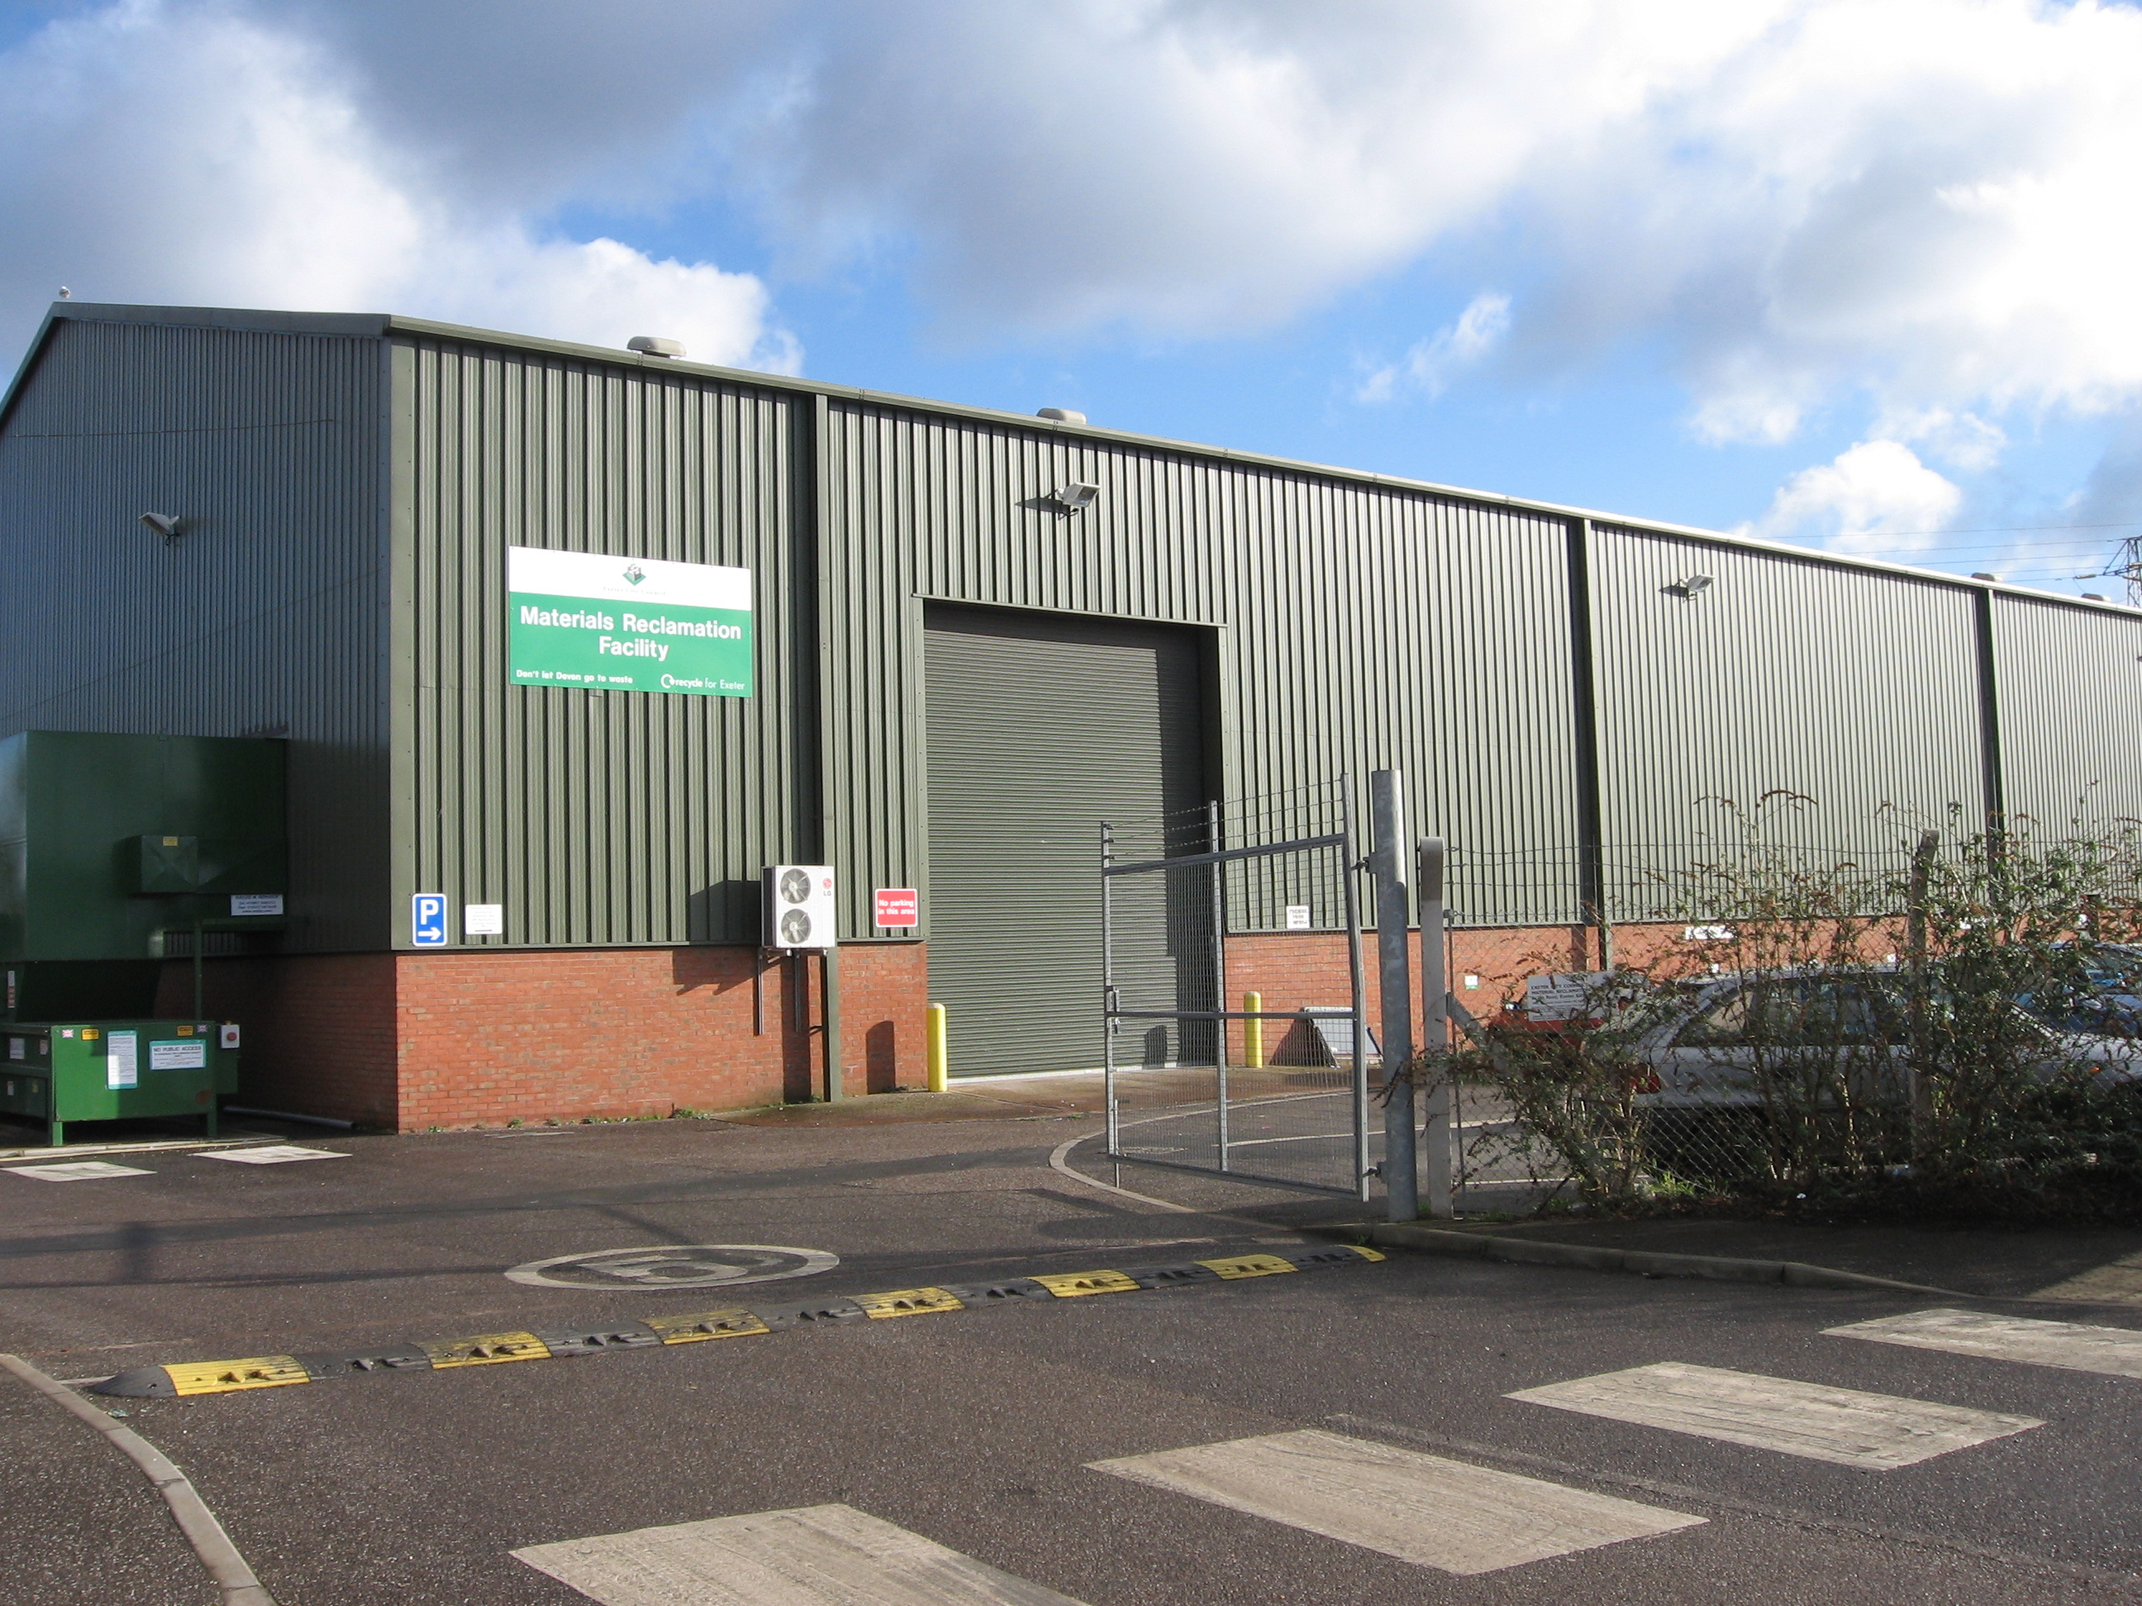
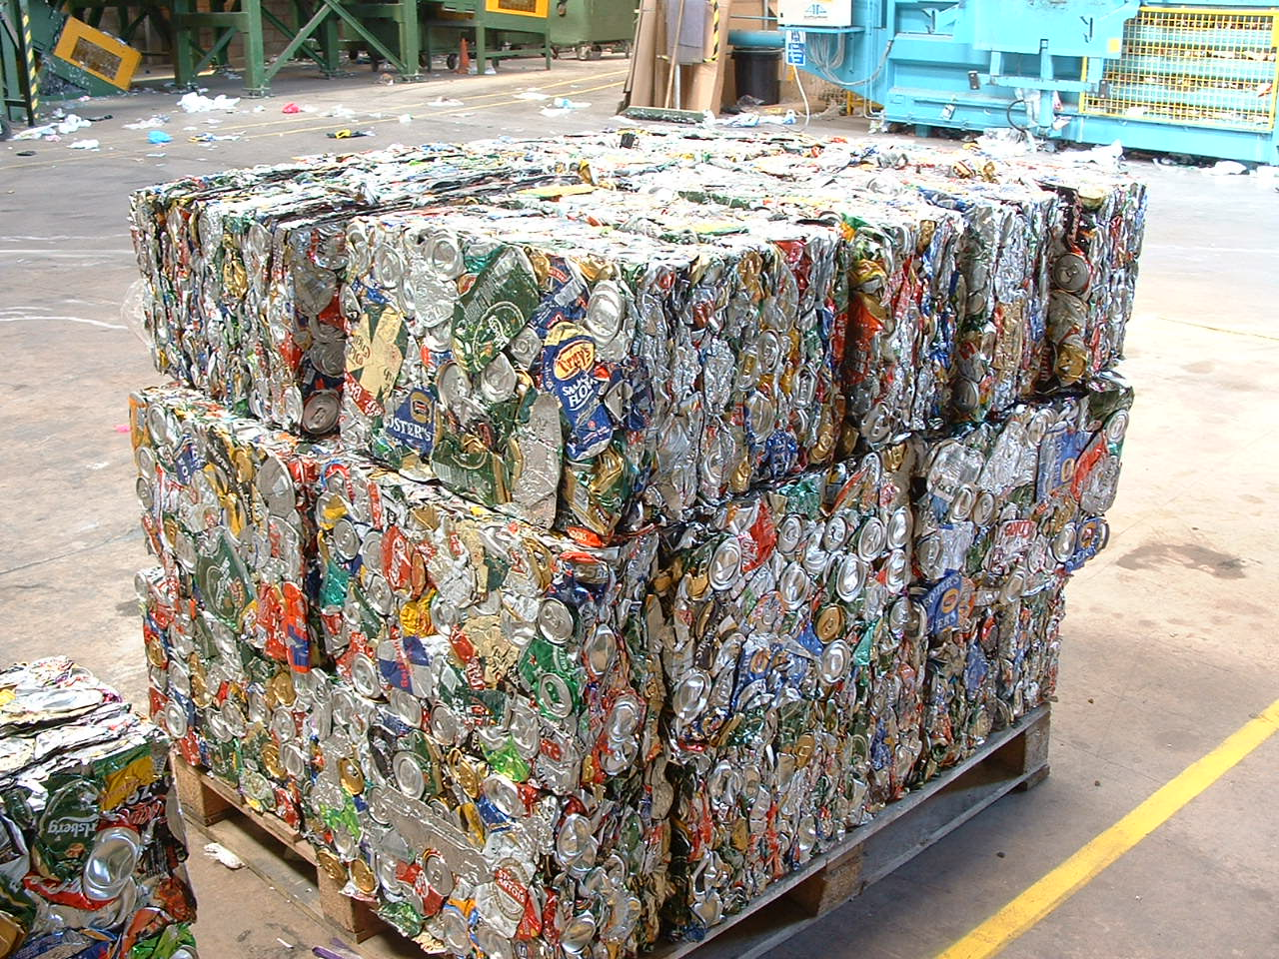
Aluminium Can Recycling – can to can
Recycled by consumer at kerbside
Transported via recycling truck to sorting facility
Transported by truck to recycling facility in Warrington
Turned into cans for fizzy drinks in beverage can factory in Leicester. Filled with drinks at a separate factory.
Transported to warehouses then distributed to shops by lorry.

Slide 32
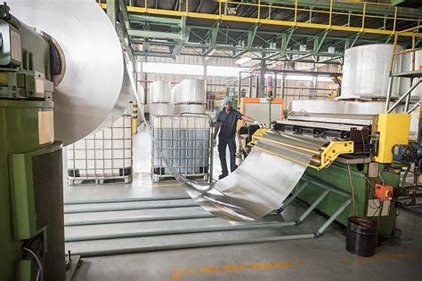
Aluminium Can Recycling – can to can
Turned into cans for fizzy drinks in beverage can factory in Leicester.
Filled with drinks at a separate factory.
Transported to warehouses then distributed to shops by lorry.

Slide 33
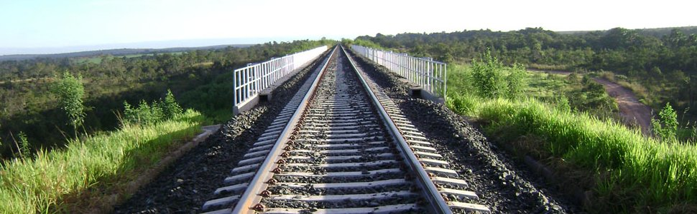
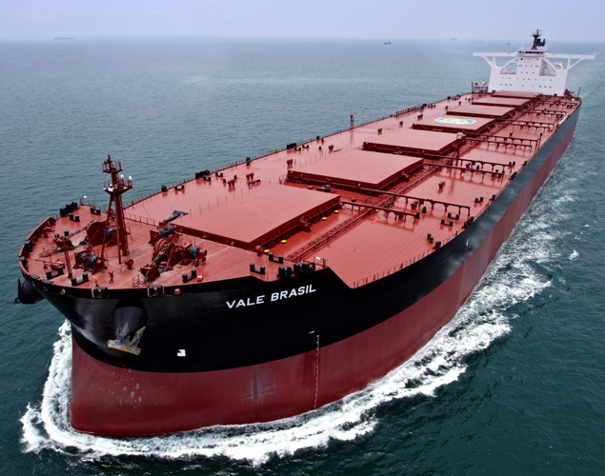
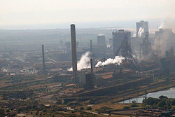
Iron Extraction and Steel Production - travel
Mined as iron ore at Carajás mine in northern Brazil.
Iron ore pellets transported via railway to to the coast at São Luis.
Iron ore pellets shipped to the UK for processing into steel sheets for packaging.
Iron ore pellets processed into steel in a series of blast furnaces at Port Talbot steelworks in South Wales.

Slide 34
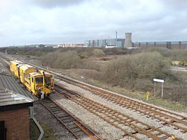
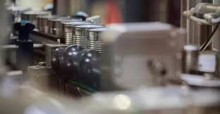
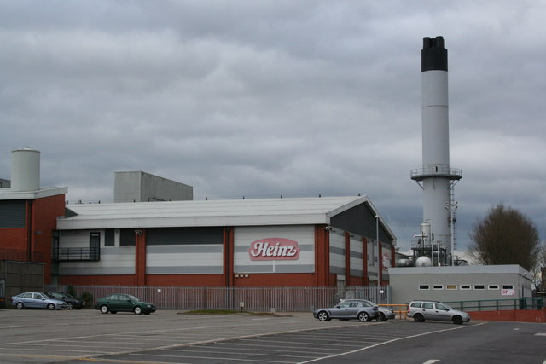
Steel Can Production - travel
Hot rolled steel from Port Talbot steelworks is transported via train or truck to Trostre steel packaging plant in Llanelli.
The packaging steel plate is taken to Wisbech, Cambs, turned into cans and then transported to factories like Heinz in Wigan by truck.
Filled with baked beans at a factory like the biggest in the world owned by Heinz in Wigan.
The filled cans are transported to warehouses then distributed to shops by lorry.

Slide 35
Steel Can Recycling
Recycled by consumer at kerbside
Transported via recycling truck to sorting facility
Sorted at a recycling plant
Transported by truck to recycling facility in South Wales

Slide 36
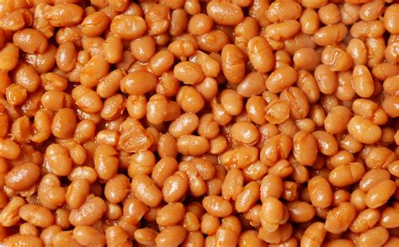
Steel Can Recycling
Turned into cans for baked beans (again) in can factory in Wisbech.
Filled with more baked beans at a separate factory.
Transported to warehouses then distributed to shops by lorry.

Slide 37
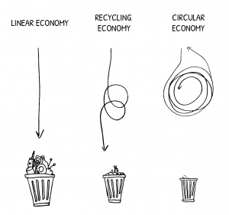
Circular economy
A circular economy is a substitute for our current linear economy.
This means we keep using our resources within our system for as long as possible.
Reuse many times before we discard items;
Then recycle and regenerate products at the end of their life.
This keeps the energy and resources within our system

Slide 38

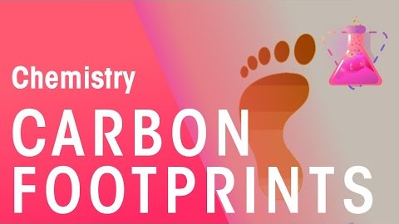
Carbon Footprints

Slide 39
Distance travelled from raw material to consumer
Can you add up the miles travelled at each stage before it reaches the consumer?
Product | Stage | Country | Miles travelled to reach next stage | Method of travel to reach next stage
Aluminium can (from raw materials) | Bauxite mining | Brazil |  | Pipeline
 | Alumina processing | Brazil |  | Ship
 | Aluminium extraction (electrolysis) | Bahrain |  | Ship
 | Aluminium plate manufacture | UK |  | Truck
 | Can manufacture | UK |  | Truck
 | Can filling | UK |  | Truck
 | Consumer | UK | 2.3 | Car
Notes:
The average distance UK consumers travel to a supermarket is 2.3 miles.

Slide 40
Distance travelled from recycling to new can
Can you add up the miles travelled at each stage before it reaches the consumer?
Product | Stage | Country | Miles travelled to reach next stage | Method of travel to reach next stage
Aluminium can (from recycled materials) | Consumer recycles can at kerbside | UK |  | Dustbin lorry
 | Collection & sorting of recycling by Council | UK |  | Truck
 | Aluminium recycling | UK |  | Truck
 | Aluminium plate manufacture | UK |  | Truck
 | Can manufacture | UK |  | Truck
 | Can filling | UK |  | Truck
 | Consumer | UK | 2.3 | Car

Slide 41
Distance travelled from raw material to consumer
Can you add up the miles travelled at each stage before it reaches the consumer?
Product | Stage | Country | Miles travelled to reach next stage | Method of travel to reach next stage
Steel can (from raw materials) | Iron Ore Processing (pelletisation) | Brazil |  | Train then ship
 | Iron/Steel Extraction | UK |  | Train
 | Steel plate manufacture | UK |  | Truck
 | Can manufacture | UK |  | Truck
 | Can filling | UK |  | Truck
 | Consumer | UK | 2.3 | Car

Slide 42
Distance travelled from recycling to new can
Can you add up the miles travelled at each stage before it reaches the consumer?
Product | Stage | Country | Miles travelled to reach next stage | Method of travel to reach next stage
Steel can (from recycled materials) | Consumer recycles can at kerbside | UK |  | Dustbin lorry
 | Collection & sorting of recycling by Council | UK |  | Truck
 | Steel recycling | UK |  | Truck
 | Steel plate manufacture | UK |  | Truck
 | Can manufacture | UK |  | Truck
 | Can filling | UK |  | Truck
 | Consumer | UK | 2.3 | Car

Slide 43
Carbon costs
Different transport types have different carbon costs
Why do you think there are differences?
Mode of Transport | Amount of CO₂ per Ton-Mile (kg) | Size of load (tonnes)
Air cargo | 0.8063 | 20-40 tonnes
Truck | 0.1693 | 44 tonnes
Train | 0.1048 | Up to 10,000 tonnes
Sea freight | 0.0403 | Iron ore: 400,000 tonnes Alumina: 20,000 tonnes
Data from: https://en.wikipedia.org/wiki/Environmental_impact_of_transport

