Slide 1

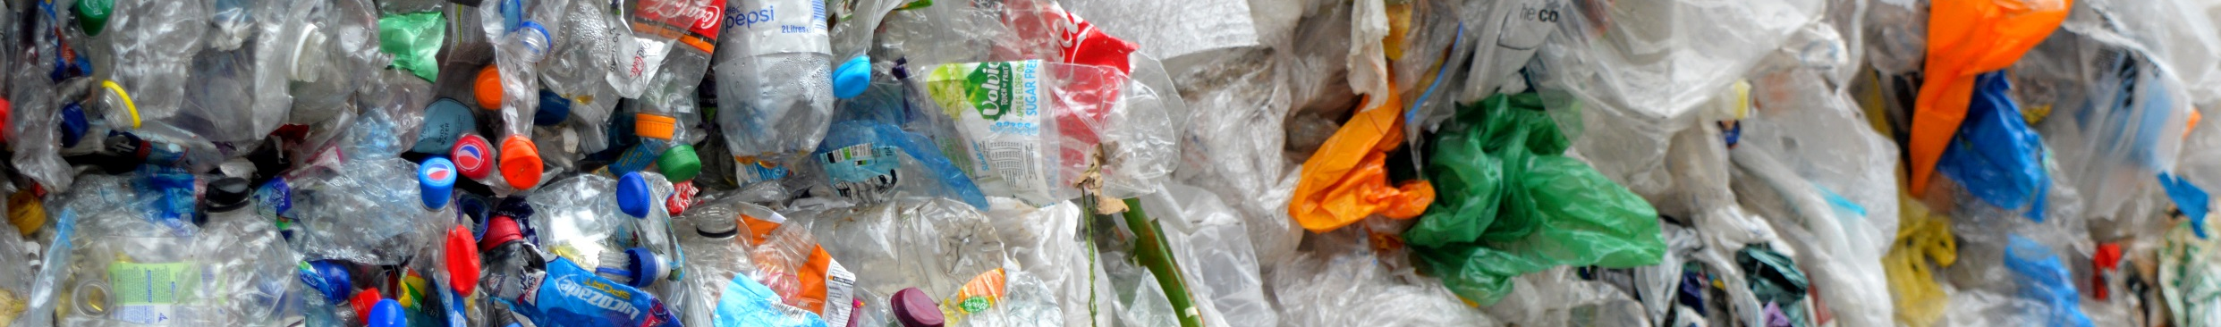

Together, we can make plastic pollution a thing of the past.

Slide 2
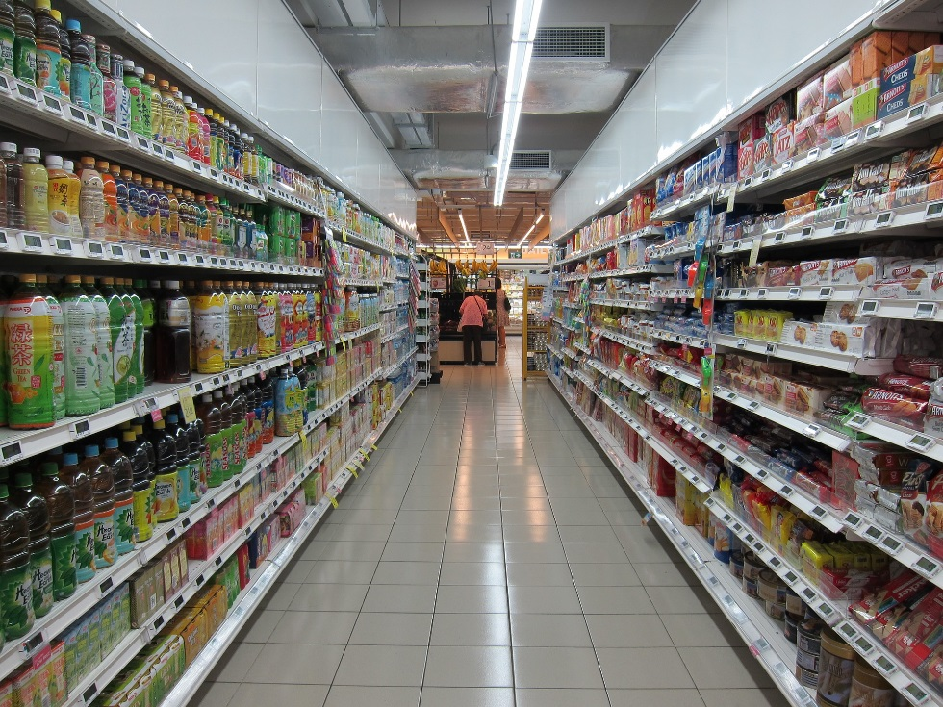
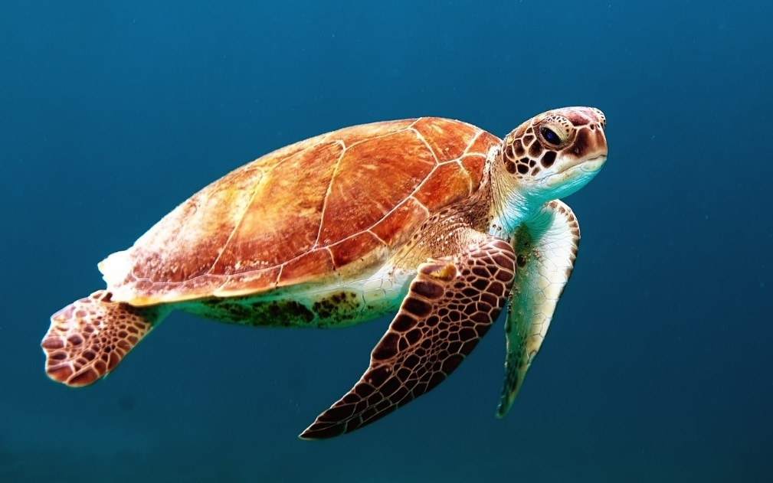

What’s the connection?
Notes:
This question is aimed at getting the class engaged and thinking. Give them a few minutes to put up their hand and suggest what they think the connection could be. Answers on the next slide.

Slide 3

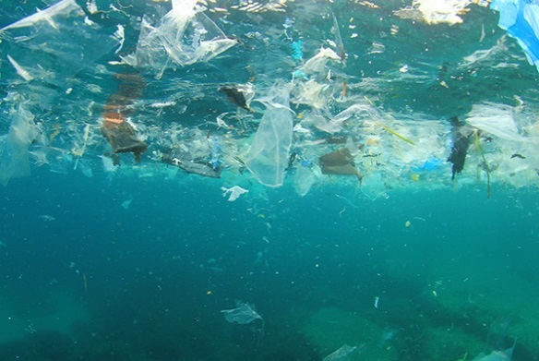
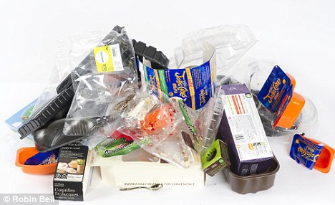
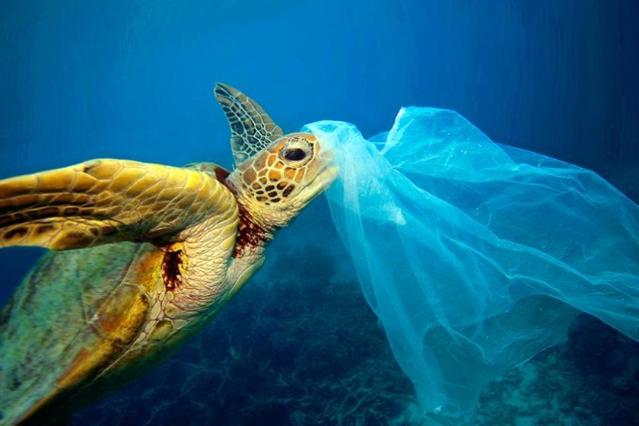

What’s the connection?
Notes:
Answer for the question will appear one step at a time. If the class haven’t guess the connection try and get them to continue guessing as each stage appears. From the supermarket people by food which is wrapped in plastic packaging. This can end up in the ocean which is were turtles live. Turtles can get confused and think that plastic is food. They can eat it which makes them ill.

Slide 4
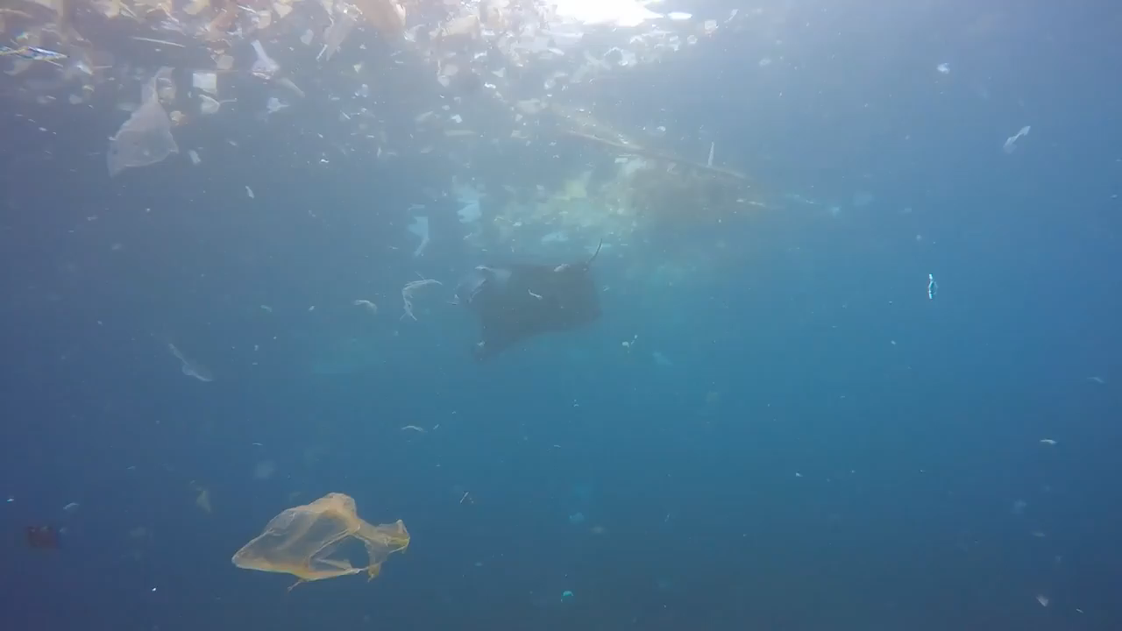
How does it make you feel?
Notes:
After watching the video ask the class to write on their white boards: first how it makes them feel, second how the manta ray might feel.

Slide 5

What is microplastic?
Notes:
Microplastic are small pieces of plastic (0.5cm). They can be made by big pieces of plastic breaking up into small pieces, or plastic that are made to be small like beads. These tiny pieces of plastic can be dangerous because animals can eat them which makes them sick. Has anyone ever seen microplastic?

Slide 6
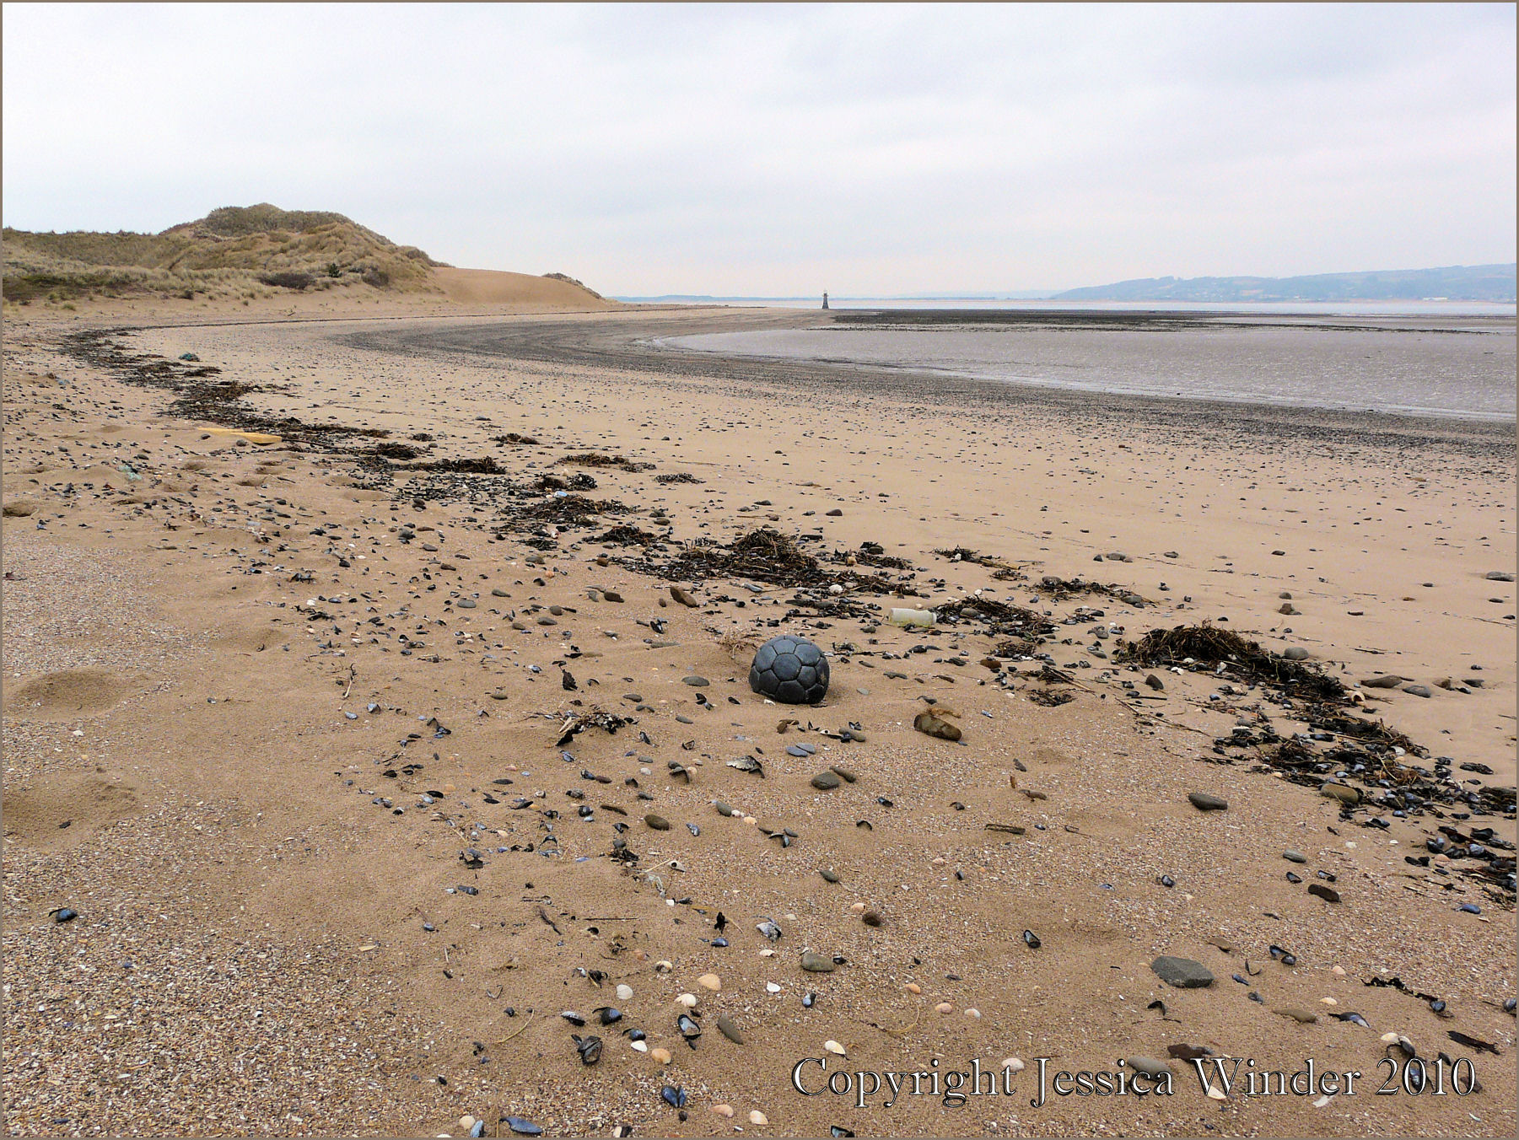
Microplastic Survey
5m
Notes:
Carrying out a survey is a way that scientists can estimate how much plastic in on a beach. A 1mx1m quadrat is used (make sure to explain what a quadrat is) it is placed on the sand along the strandline to mark out the survey area. The strandline is the place on a beach where the sea deposits most of things it is carrying, it can be spotted by looking for a line of seaweed along the beach. This is also where most plastic is usually found. Once the quadrat has been placed on the sand a small quadrat that is 10cmx10cm is used to take smaller samples, five small samples are taken inside the big quadrat. Then five metres is measured out, the big quadrat put down and this is repeated five times. The class is going to help analyse the results.

Slide 7
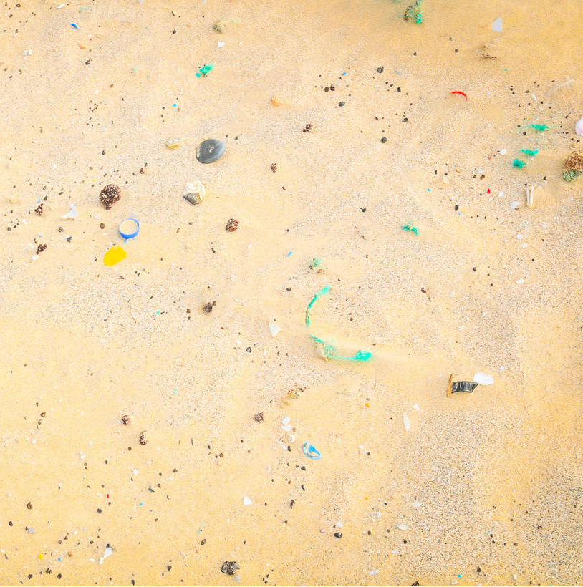
Microplastic Survey
Notes:
This is an example of the five smaller quadrats inside the big one. These are all 10cm² and let scientists work out the mean amount of plastic in 1m² which they can then use to work out the mean amount of plastic on the beach.

Slide 8
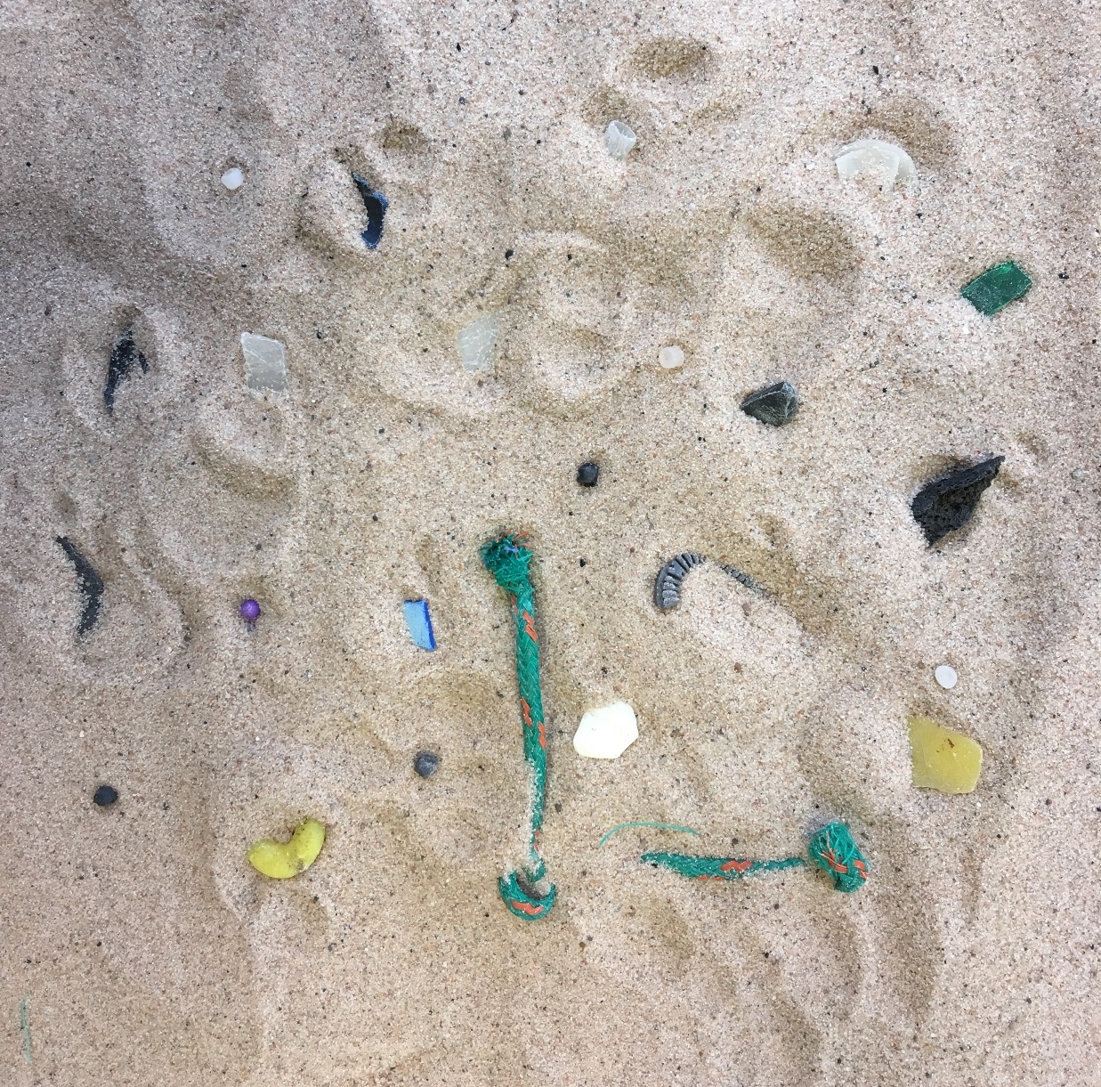
Microplastic Survey
Notes:
Each table in the room represents a 1m2 quadrat and on each table are 5 sheets which represent the 10cm2 quadrats. What you need to do is go around each quadrat and count how many pieces of microplastic there are in each quadrat and then write it on your sheet. Once you have been around to all of the quadrat there are some maths questions so that you can work out the mean amount of plastic on the beach.

Slide 9
Microplastic Survey
Calculations
Example:
5+8+7+4=24
24÷4=6
To find the mean, add all the numbers and then divide them by how many numbers there are.
In 1m² there are 100 lots of 10cm²
The strandline on the beach we surveyed is 150mx1m, how many 1m² is this?
Notes:
Here are some calculations that will help you with the worksheet. Leave this slide up for the duration of the activity, once the class have finished then move to the next slide.

Slide 10
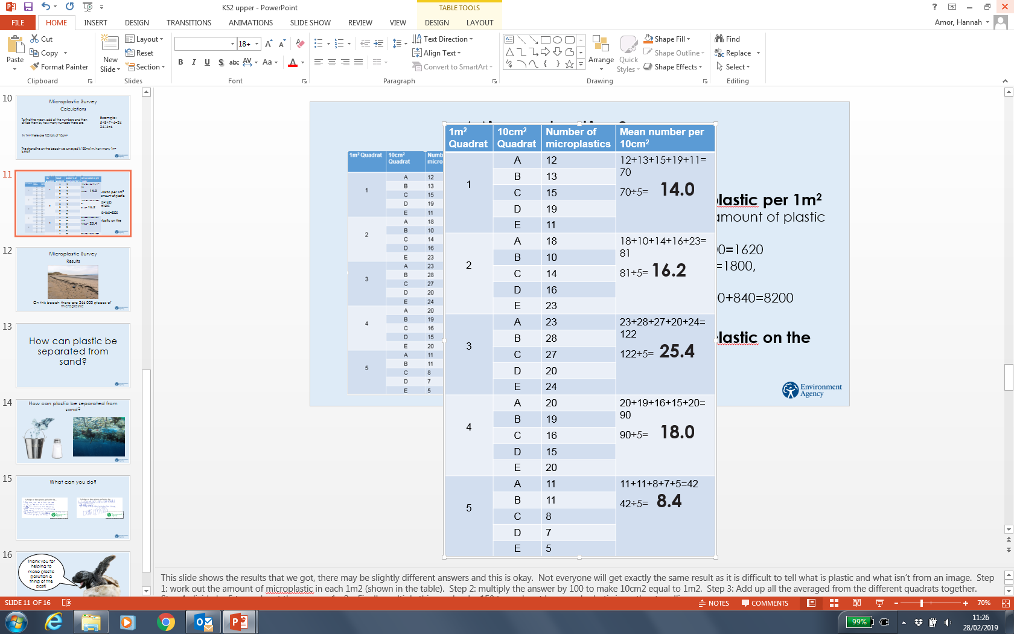
Microplastic Survey
Results
Mean amount of microplastic per 1m²
Step 1: Work out the mean amount of plastic in each 1m²
Step 2: 14x100=1400, 16.2x100=1620 25.4x100=2540,18x100=1800, 8.4x100=840
Step 3: 1400+1620+2540+1800+840=8200
Step 4: 8200÷5=1640
Mean amount of microplastic on the strandline
1640x150=246,000
Notes:
This slide shows the results that we got, there may be slightly different answers and this is okay. Not everyone will get exactly the same result as it is difficult to tell what is plastic and what isn’t from an image. Step 1: work out the amount of microplastic in each 1m2 (shown in the table). Step 2: multiply the answer by 100 to make 10cm2 equal to 1m2. Step 3: Add up all the averaged from the different quadrats together. Step 4: divide by 5 to work out the average 1m2. Finally multiply this number by 150 to work out how much plastic is on the strandline.

Slide 11

Microplastic Survey
Results
On this beach there are 246,000 pieces of microplastic
Notes:
So on this beach there are 246,000 pieces of microplastic. Where might these have come from? What problems might they cause?

Slide 12
How can plastic be separated from sand?
Notes:
This is a thinking activity. Explain it to the class before they divide into groups. In groups of 4 they should discuss how they could separate sand from plastic if they were going to do the microplastic survey in real life on the beach. They should draw our their method on a piece of paper. They have 10 minutes to complete the task. Do not move to the next slide unless everyone is really struggling.

Slide 13
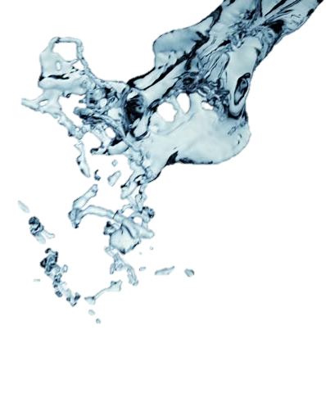
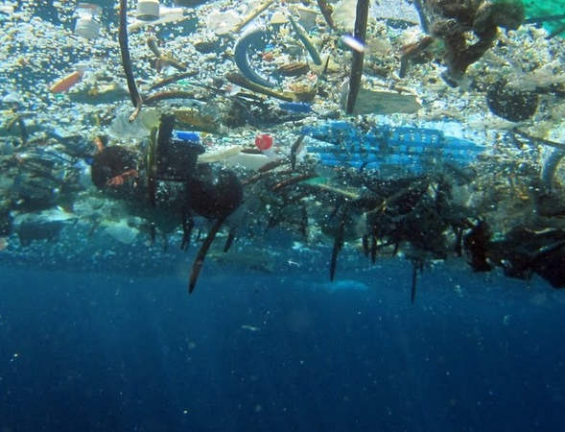
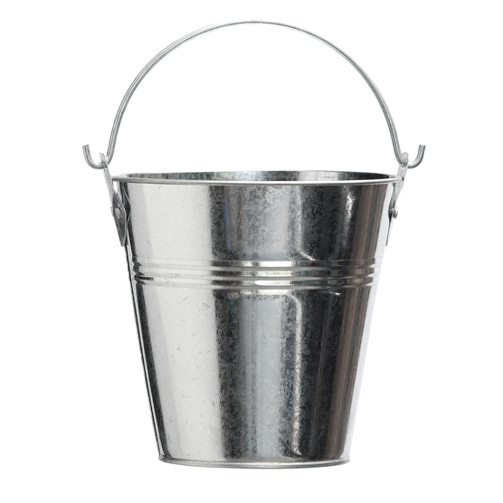
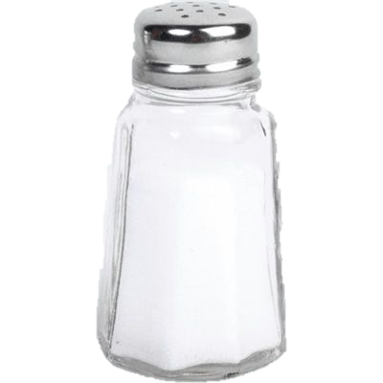
How can plastic be separated from sand?
©NOAA
Notes:
After 10 minutes ask the children to stop and get some groups to feedback their ideas to the class. Some reflection questions: Why can plastic and sand be separated like this? What does this mean in the ocean? Why would this be bad?

Slide 14
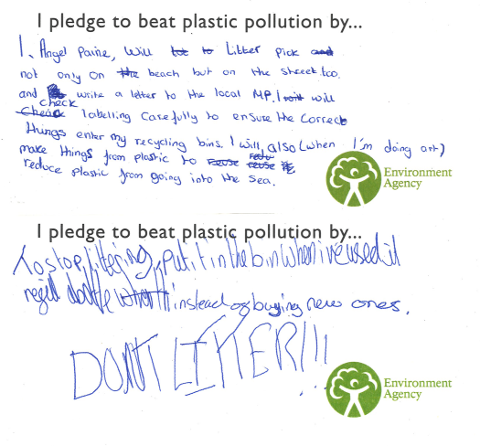
What can you do?
Notes:
Ask all the children to think of something that they could do at home, school or in a club. Here are some examples of pledges we have received (you can change these for some of your own) read these out to the class to give them ideas. They can then write this on a pledge card, these can either be put up in the classroom or sent to the Plastics and Sustainability team.

Slide 15
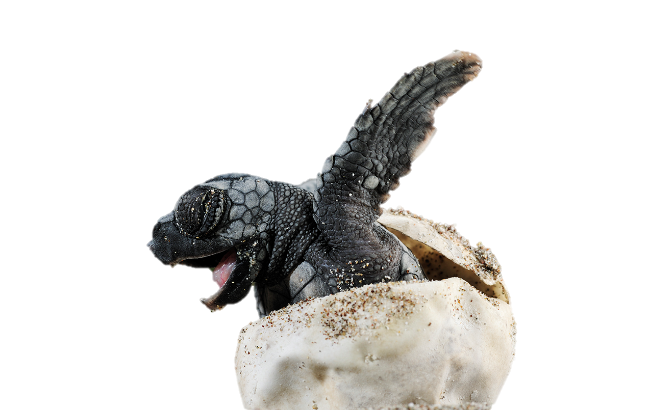
Thank you for helping to make plastic pollution a thing of the past!
Notes:
Thank all the children for listening and doing so well. Ask if there are any more questions.
Then get the children to come up to the front and hand in their pledge.

