Slide 1

Welcome to the
Plymouth EfW
Quiz
KS2 v1

Slide 2
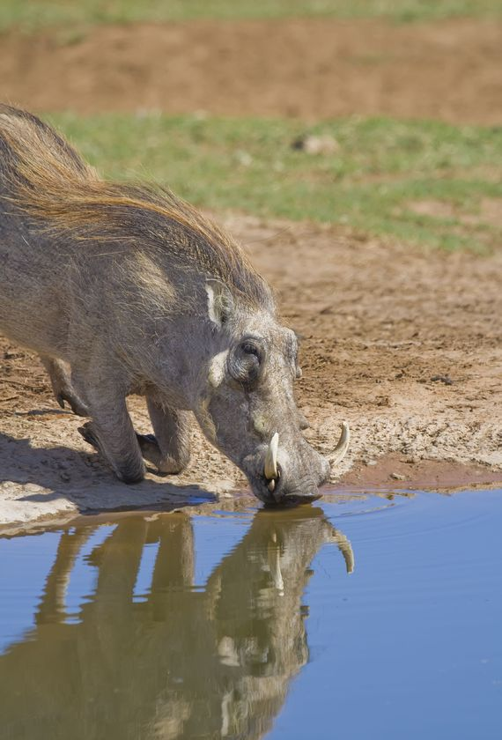

What does EfW stand for?
Electricity from Water
Energy from Waste
Environment for Warthogs
Energy free World

Slide 3
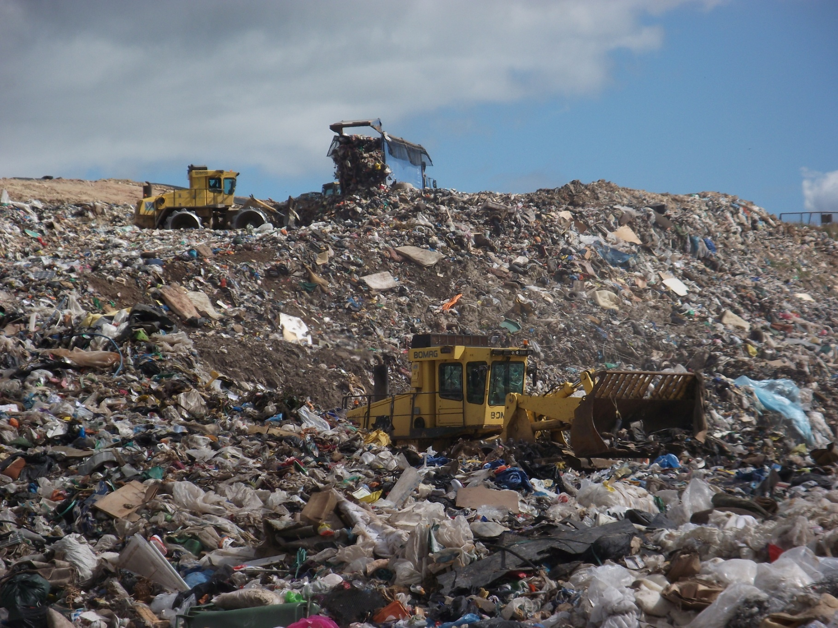
What is the technical name for the big hole where our rubbish used to be buried?
rubbish dump
landfill site
junk yard
the tip
Notes:
2015: North Devon, Torridge and Mid Devon are still sending their residual to landfill until another option is found.

Slide 4
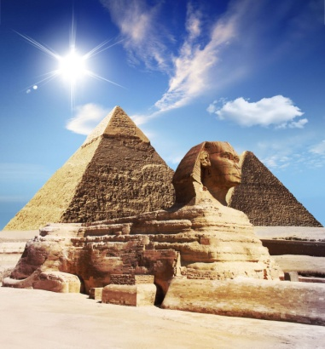
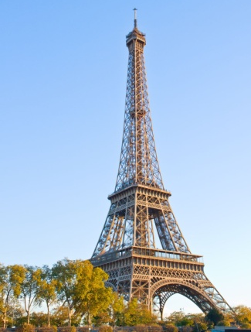
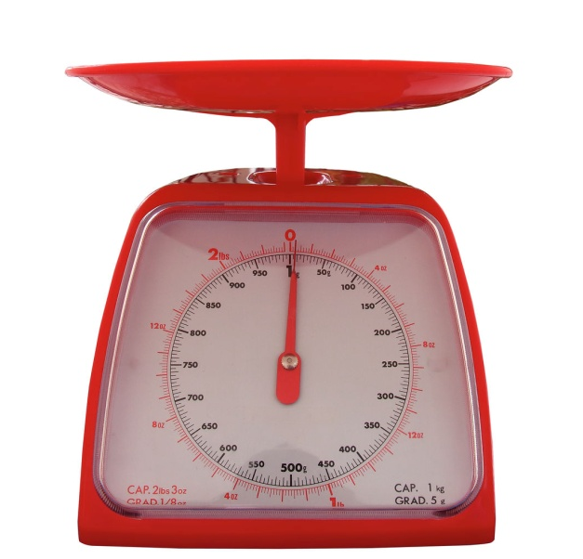
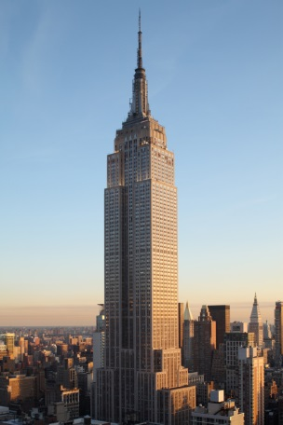
Approximately how much rubbish, compost and recycling did people in Devon throw away last year?
This is the same weight as...
the Great Pyramid of Giza
the Eiffel Tower
the Empire State Building
350 grams
3,500 kilograms
350,000 tonnes
Notes:
Empire State Building – 365,000T - 381m high – limestone, granite, 10million bricks, alu and steel
Pyramid of Giza – 5,900,000T - 139m high - oldest of the Severn wonders of the world, constructed 2560BC
Eiffel Tower – 7,300T - 301m high – metal girder structure
350,000 tonnes is an approximate figure for Devon EXCLUDING Plymouth and Torbay

Slide 5

200,000 tonnes of waste from Plymouth, Torbay and parts of Devon is sent to the Plymouth EfW plant each year. This is the same weight as how many blue whales?
153
1,053
6,053
Notes:
The blue whale is the heaviest animal ever to have lived (even heavier then any dinosaurs!); the heaviest adult blue whale ever recorded weighed 190 tonnes.
Source: http://www.guinnessworldrecords.com/world-records/largest-mammal
Answer: 200,000/190 = 1,053 tonnes (rounded up)

Slide 6
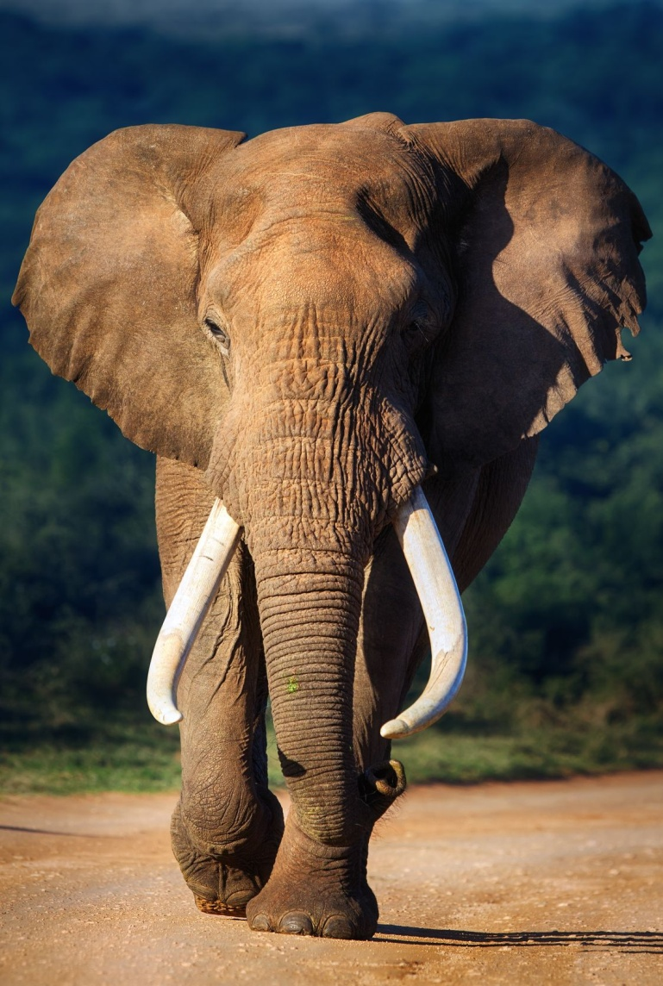
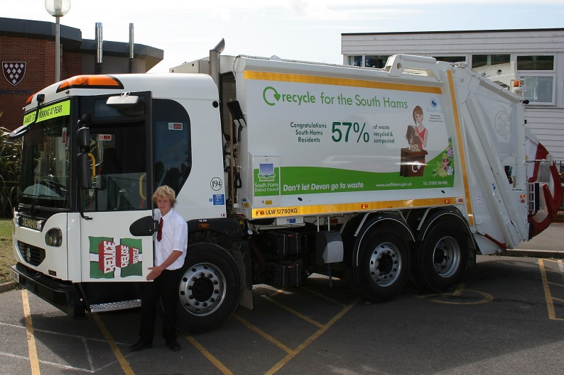
Each lorry delivers about 6½ tonnes of waste. That’s the same weight as...
a meerkat
a blue whale
a guinea pig
an African elephant
Notes:
6.5 tonnes is the average weight of an ordinary Refuse Collection Vehicles (RCV) used to collect household waste.
Plymouth has a wide range of different sized vehicles delivering between 6 – 21 tonnes of waste per load.

Slide 7
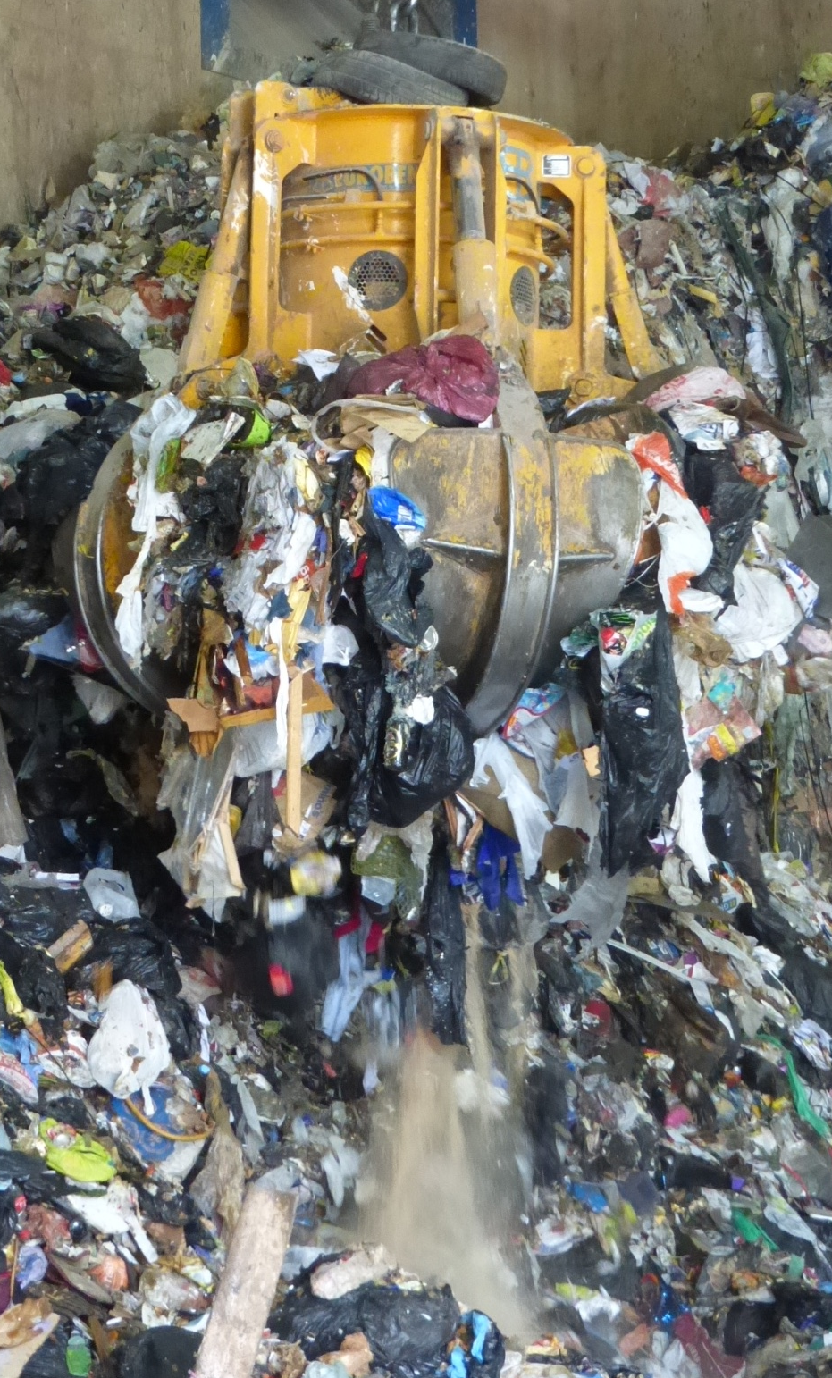
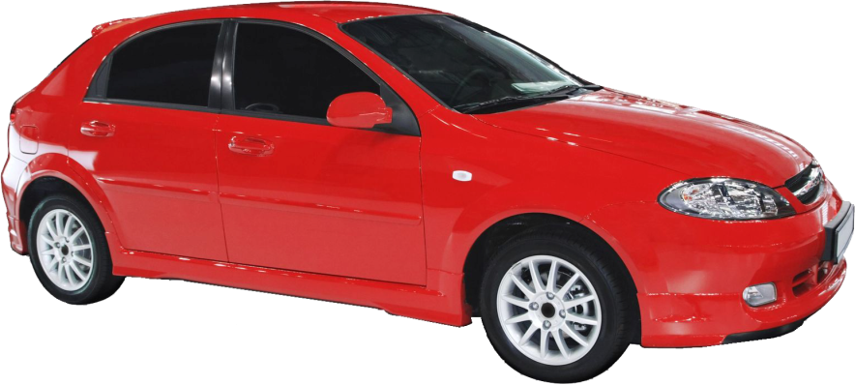
The grabber can lift 8 tonnes of waste.
That’s the weight of...
8 scooters
8 motorbikes
8 aeroplanes
8 small cars

Slide 8
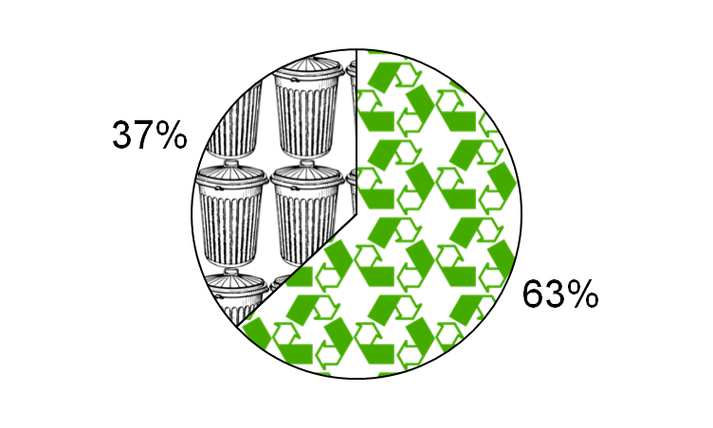
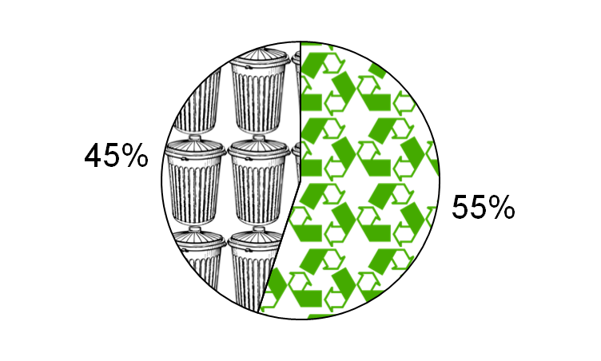
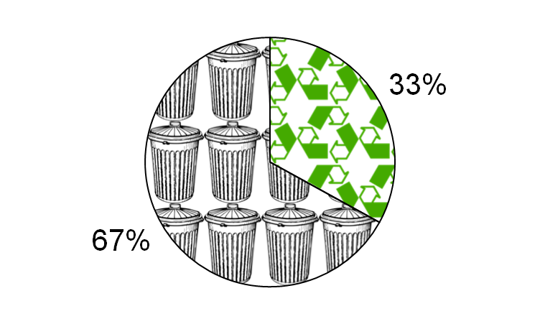
Which pie chart shows how much of Devon’s waste is currently recycled / composted?
A
B
C
Notes:
A is Austria’s recycling rate, the best in Europe. (If they can do it in Austria, we can do it in Devon!)
C is Devon’s recycling / composting rate from 2004/5 (Haven’t we done well to improve in the last 10 years?)

Slide 9
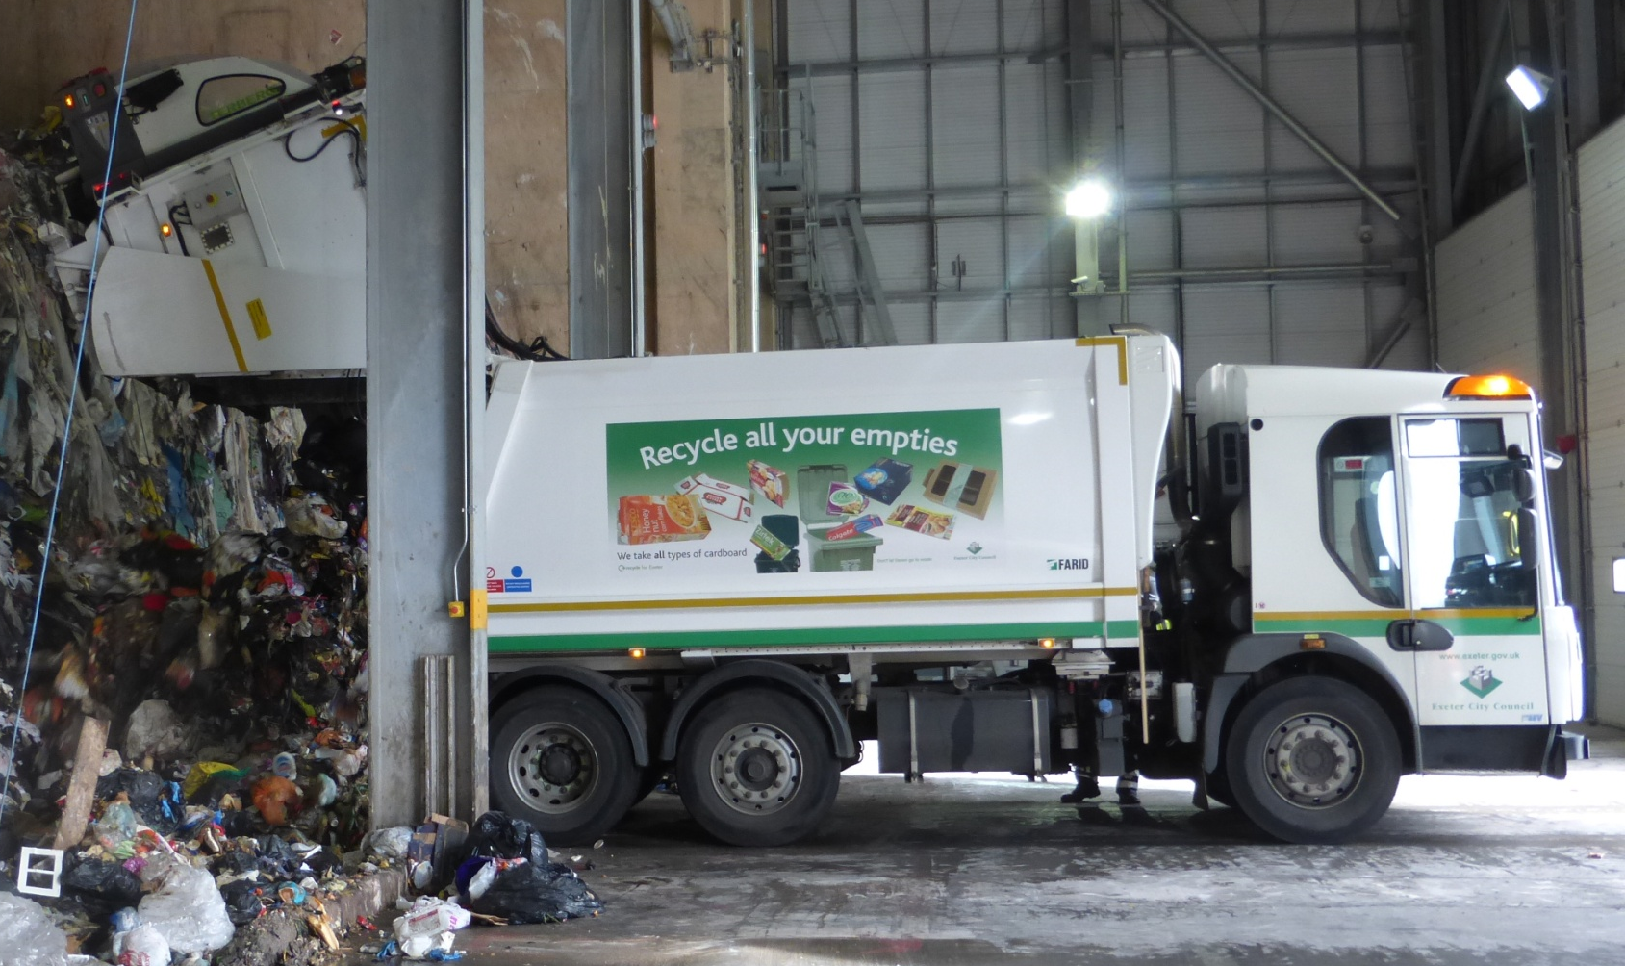
How many lorry loads of waste are delivered here each week?
7
That is 15,600 lorries each year!
91
173
300
Notes:
Figure of 300 lorries per week supplied by MVV. 300 lorries x 52weeks = 15,600 lorries per year
.

Slide 10
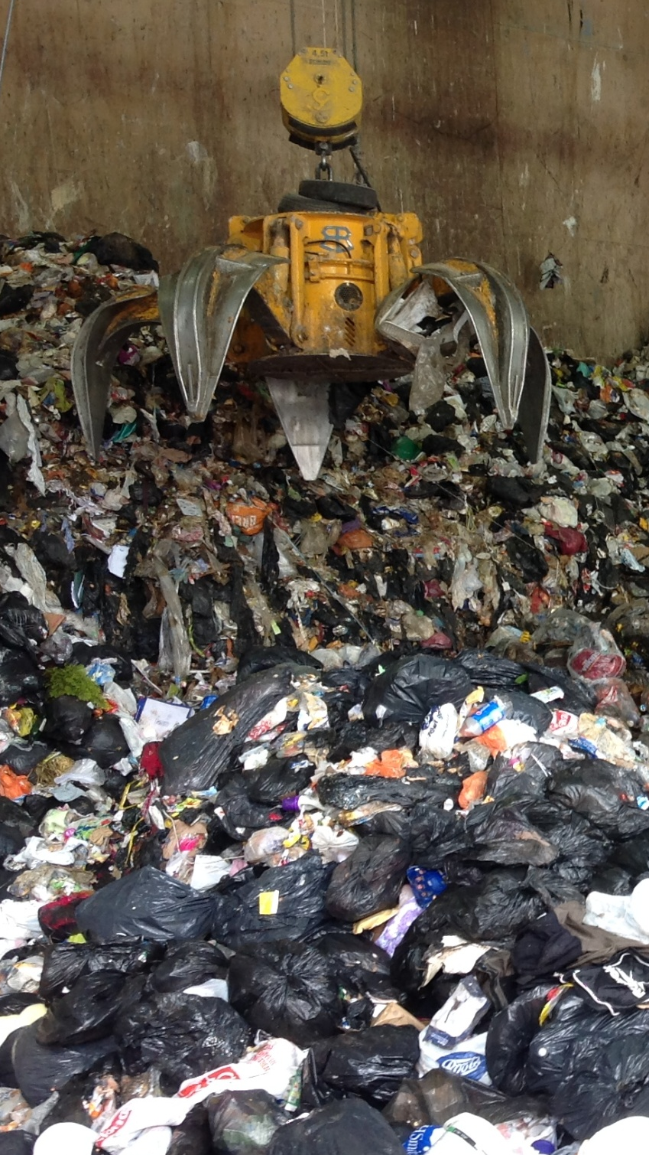
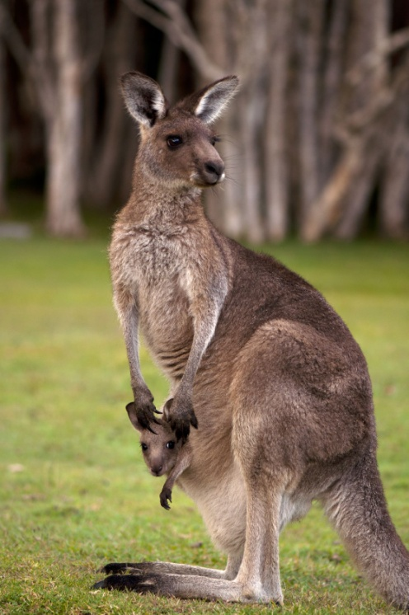
The waste is picked up using a grabber and dropped into a...
runner
hopper
skipper
jumper

Slide 11
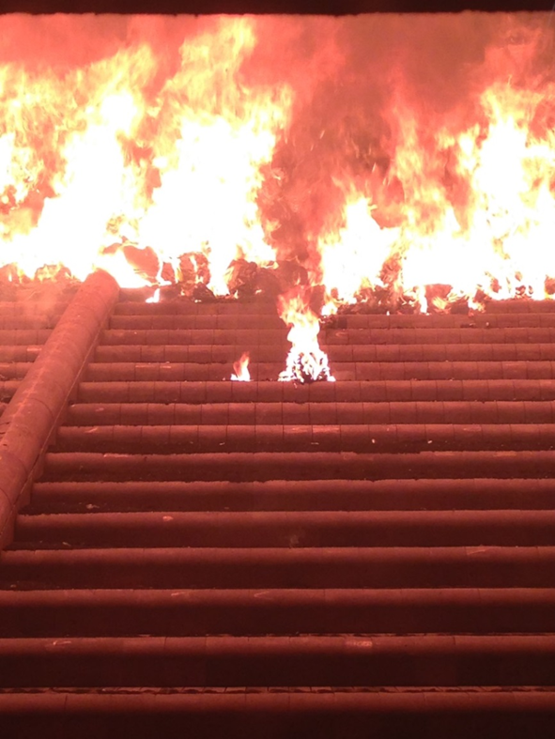
The waste is burnt in the ‘Combustion Chamber’. What does ‘combustion’ mean?
The process of burning
Notes:
Combustion is the process of burning.
A combustion chamber is an enclosure in which the burning is initiated and controlled

Slide 12
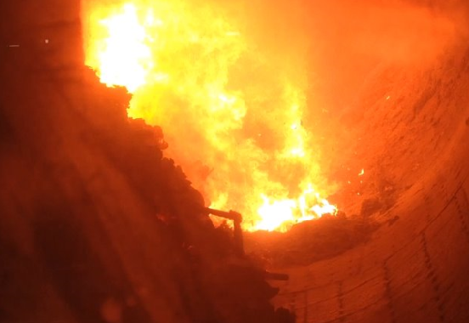
Which gas is essential to burn rubbish?
oxygen (O₂)
carbon dioxide (CO₂)
hydrogen (H₂)
methane (CH₄)

Slide 13

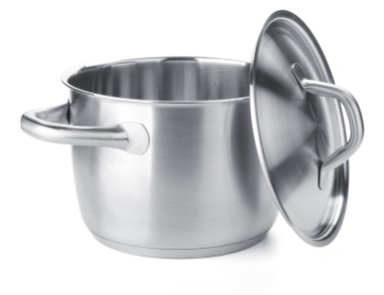
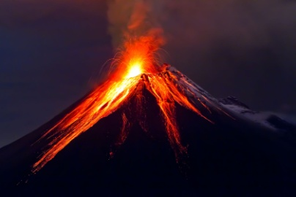
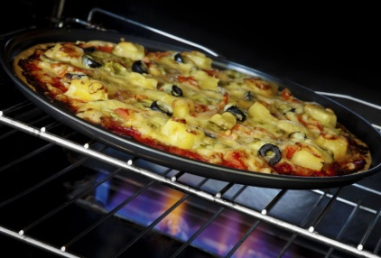
The temperature in the combustion chamber must reach what temperature?
3,550°C
The melting point of diamonds
The melting point of stainless steel
The temperature of volcano lava
The temperature of an oven to cook pizza
1,400°C
1,000°C
200°C
Notes:
When first erupted from a volcanic vent, lava is a liquid usually at temperatures from 700 to 1,200 °C
Source: https://en.wikipedia.org/wiki/Lava

Slide 14

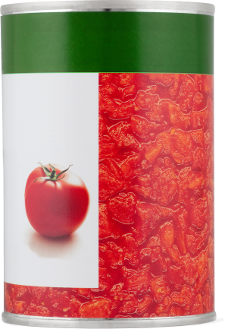

Which two materials can be removed from the ash after the rubbish has been incinerated?
What is used to remove these ferrous metals?
a magnet
plastic
iron
paper
food
steel
textiles
garden waste
cardboard
rubber
a sieve
warm water
hot air
Notes:
Metals are not removed at the Plymouth EfW, but are removed later at a processing plant.
IBA currently goes to Holland to be used as aggregate (Jan 2017)
Use real magnet during session to demo magnetism and help children make the link with school science lessons.
10 -15% of IBA (by weight) can be metal! Show examples of actual things that have been removed from the IBA.
Low melting point metals such as aluminium can cause problems in the plant. Plymouth EfW had to redesign their grate to stop molten aluminium from dripping into air holes.
Possible extension question: How much is metal worth? Should we be throwing it away? What would be a better thing to do with your steel things like cans i.e. put them in your recycling container.

Slide 15

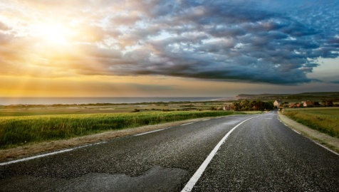


What can the bottom ash from the combustion chamber be used for?
fertilising flower beds
building roads
flavouring curries
cleaning floors

Slide 16
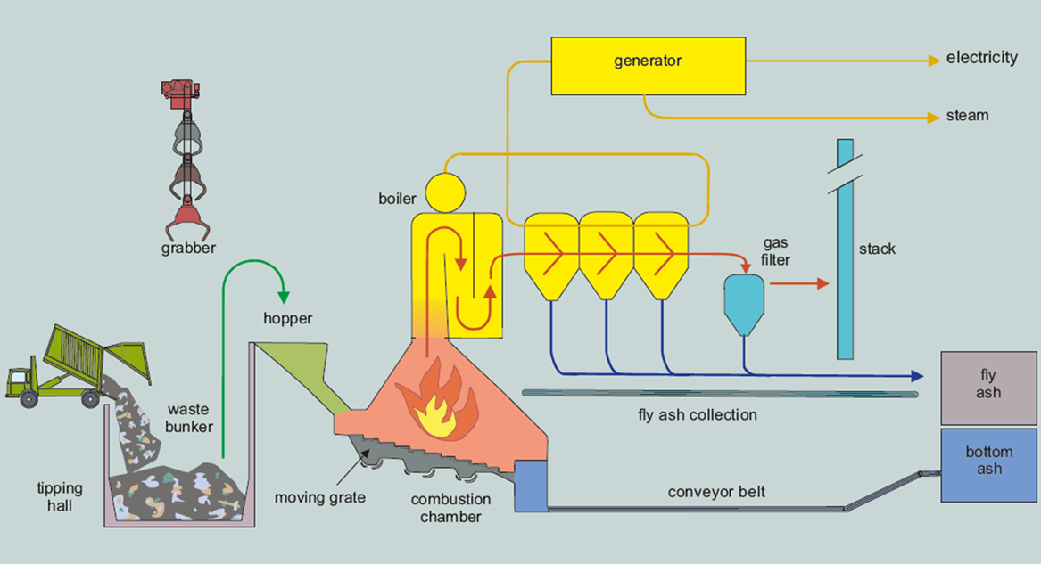
During the EfW process, steam is produced. How is it used?
Some steam is sent through big pipes to the Dockyard and used to heat the buildings
Steam is used to turn a turbine and create electricity
Notes:
Steam is used to turn a turbine and create electricity
Some steam is sent through big pipes to the dockyard next door and used to heat the buildings
This is called Combined Heat and Power or ‘CHP’

Slide 17
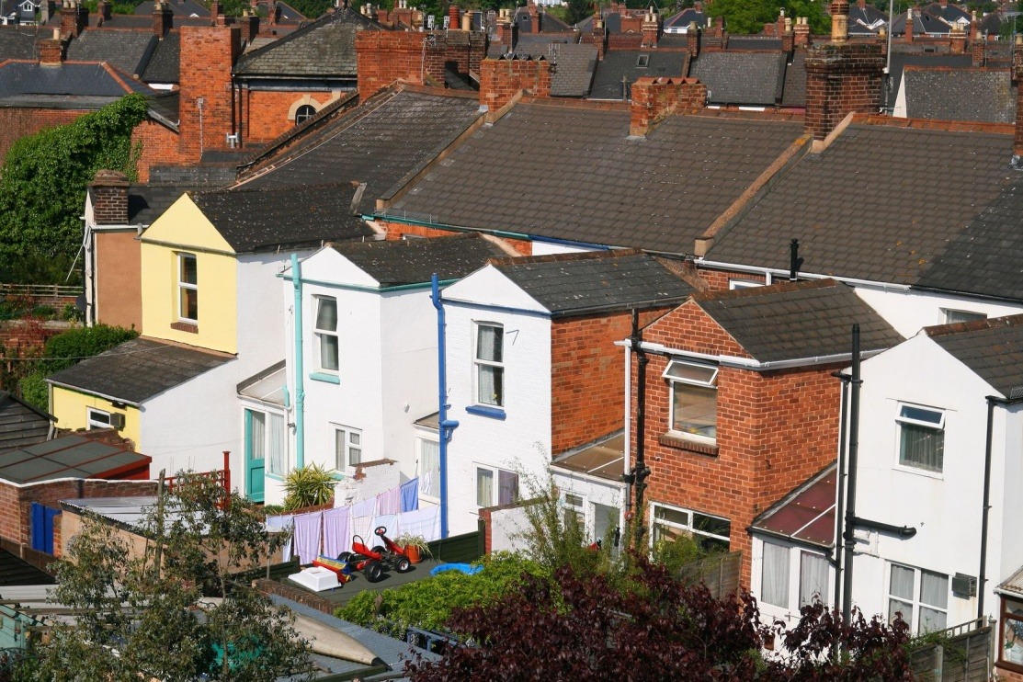
The Plymouth EfW process produces enough electricity to power how many family homes each year?
370
3,700
37,000
370,000
That’s nearly 1/3 of all homes in Plymouth!
Notes:
Plymouth dwelling stock in 2015 was 115,560.
Source: https://www.gov.uk/government/statistical-data-sets/live-tables-on-dwelling-stock-including-vacants
37,000 x 3 = 111,000 houses

Slide 18
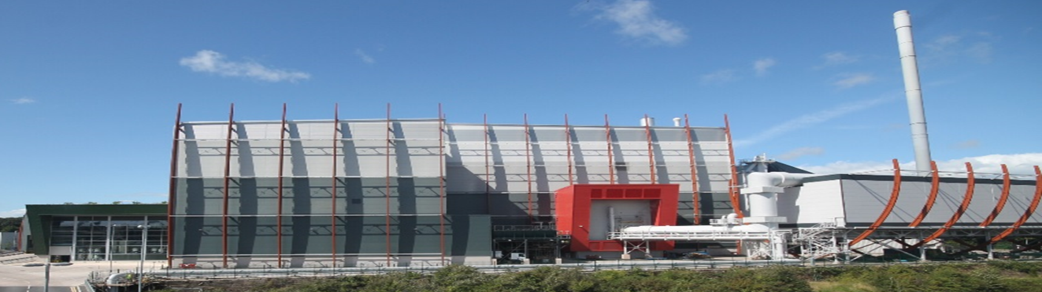
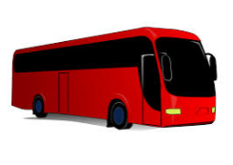

How tall is the Plymouth EfW’s chimney stack?...
95 metres high
That is nearly 8 coaches parked end to end
Notes:
Average full sized coach is about 12 metres long
95/12 = 7.9 coaches

Slide 19
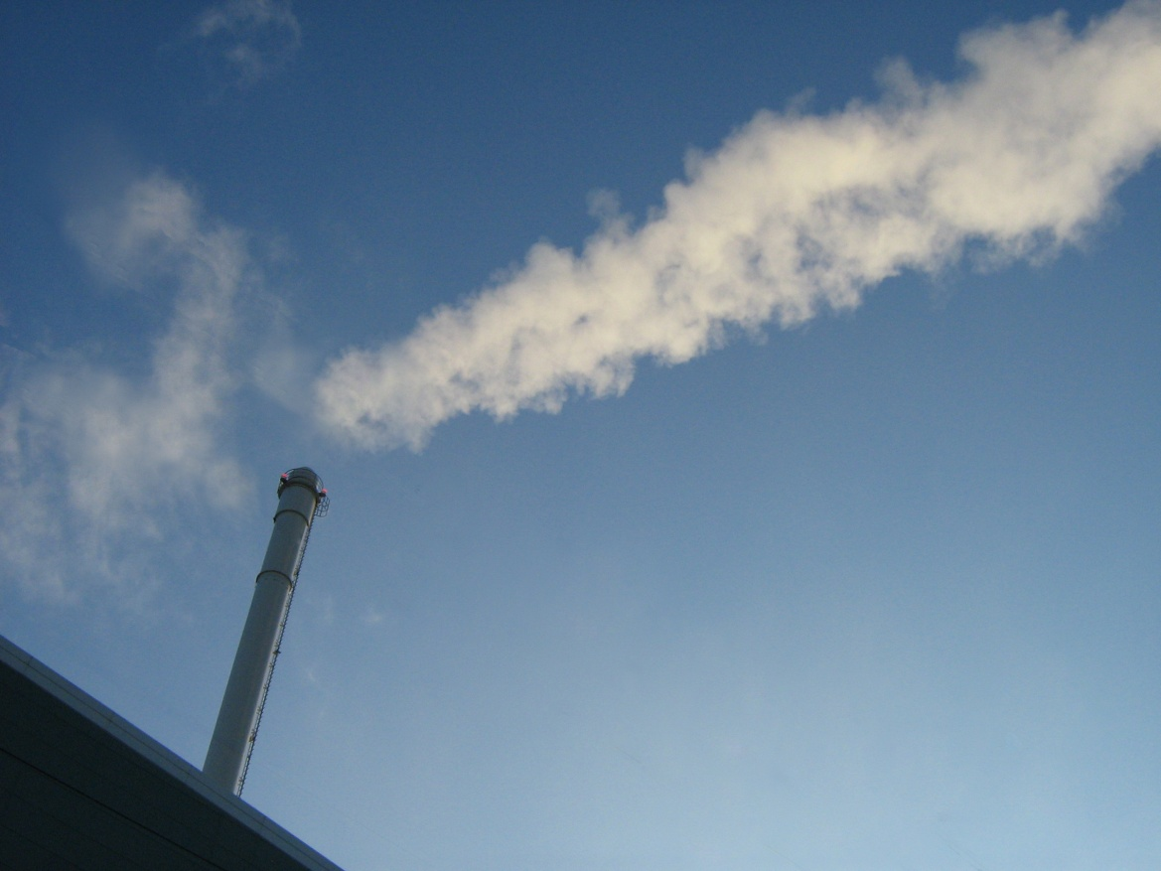
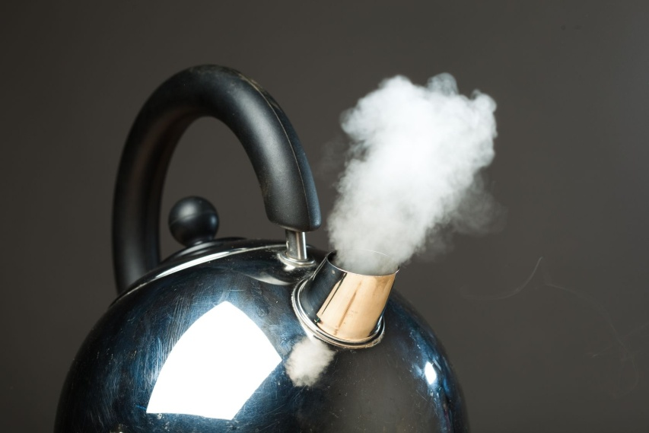
What can you sometimes see coming from the EfW’s chimney stack?...
oxygen
helium
steam
soot
nitrogen
Notes:
The gas consists of 66% Nitrogen, 15% water, 11% oxygen and 7.35% CO2. The rest 0.65% consists of tiny, tiny amounts of other gases: Oxides of Nitrogen / Carbon Monoxide / Sulphur Dioxide / Chlorine / Ammonia / Volatile Organic Compounds / Dust
In comparison; dry air outside naturally consists of 78% nitrogen, 21% oxygen, Argon 0.9%, CO2 0.037% and tiny, tiny amounts of other gases: hydrogen, argon, neon, helium, krypton and xenon.

Slide 20
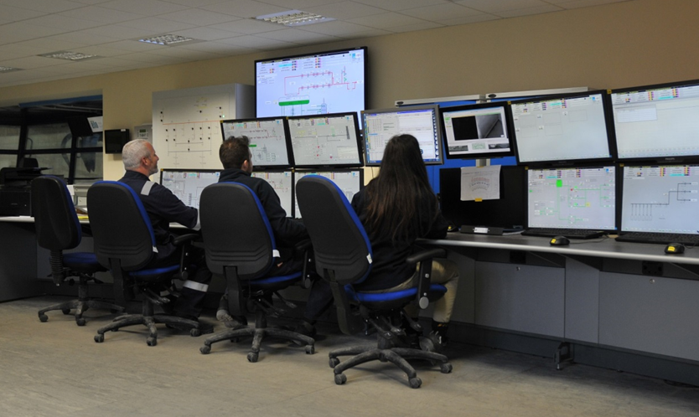
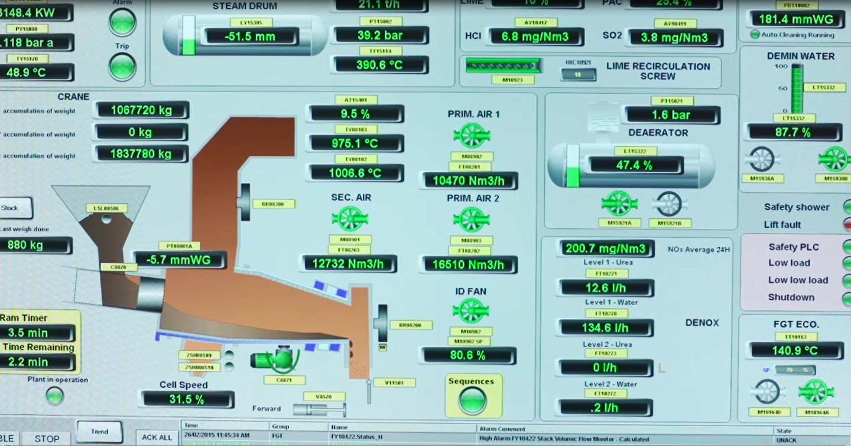
How do staff use the computers in the control room?
Notes:
Plymouth plant operates 24 hours a day, 7 days a week. Staff use the computers to monitor how the plant is working e.g.: temperature of the combustion chamber, how much electricity is being generated, to monitor the gases being produced.
Environment agency staff can ask to see the information from the sensors at any time to make sure the plant is working safely
Could be some amusing answers! Checking Facebook, emailing their friends, booking a holiday... (These are not allowed!)

Slide 21
What are the 3Rs ?
Refrain
Reduce
Reheat
Research
Reuse
Reward
Record
Recycle
Repeat
Notes:
Others are:
Repurpose – reuse is using plastic bottle as a plastic bottle – repurpose is using it as a scoop, junk modelling etc
Reheat – using left over foods
Refuse – no thanks to plastic bags in shops
Refill – plastic drinks bottles
Repair – clothing
Revamp – furniture, old clothing

Slide 22
Can you do the 3Rs actions?
Reduce
Reuse
Recycle

